Slide 1

1
Translate/ Add text
Translate the title and information to the community’s language by clicking into the text boxes and typing.
Feel free to edit/add copy to better fit the community’s needs. Please don’t change the font or style to maintain brand consistency across different assets.
2
Add your images
Head to the image bank in the next slide and follow the copy instructions there. Once you’re back here press Command + v or Ctrl + V to paste the image here.
Move your image to cover the dotted lines. Don’t size up/down the images for legibility once printed.
The COVID-19 vaccines are safe and effective.
The COVID-19 vaccines should be free for all, no matter of status.
ABOUT THE COVID-19 VACCINE
3
Export as a JPG using Google Slides:
File → Download → JPEG Image (Current Slide)
Use the saved image in your social media profile picture
Export as a JPG using PPT:
Select slide. File → Save As → JPEG Image
Two doses are required to have maximum protection
against COVID-19.
A small number of people may experience short term
side effects.

Slide 2
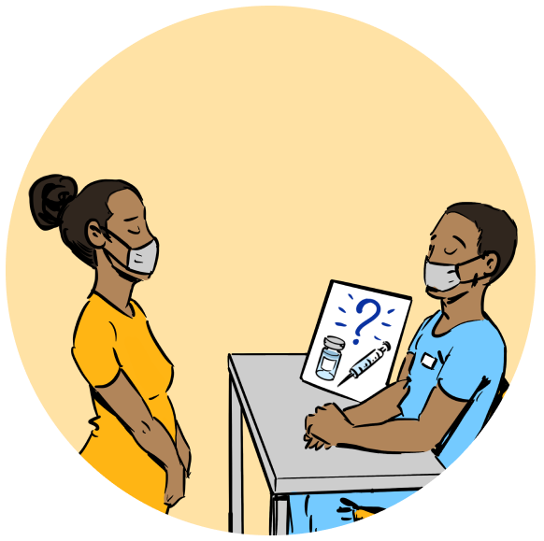
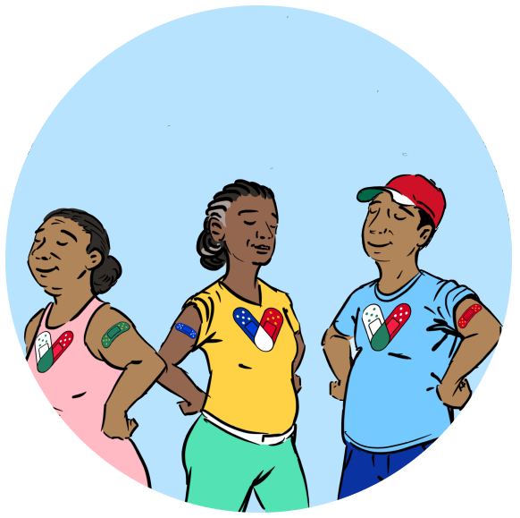




IMAGE BANK
3/3
i
Image Selection
Choose an image that conveys the information below it.
Choose images from here by copying and pasting into your template in the previous slide
1
Copy and Paste
Click on the image you’d like to place in your template. Press Command + C or Ctrl + C to copy the image.
Please don’t delete any images from here. This is an image bank that’s meant to remain as is for others to use.

Slide 3
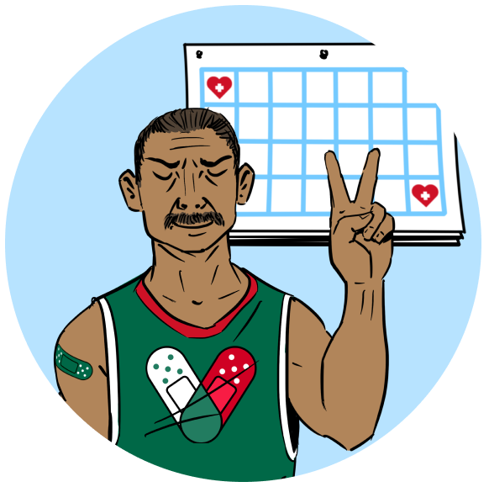
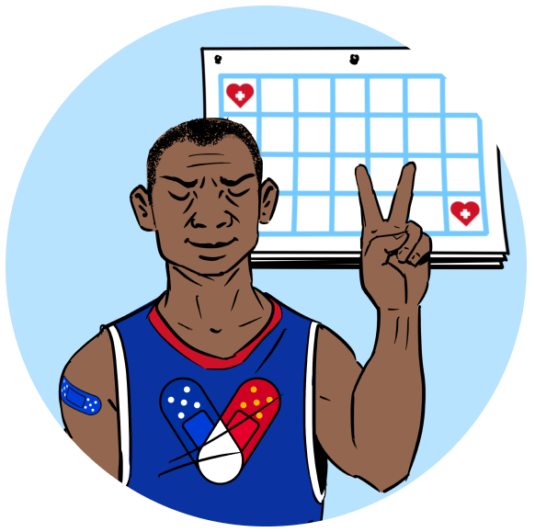
IMAGE BANK
2/3
i
Image Selection
Choose an image that conveys the information below it.
Choose images from here by copying and pasting into your template in the previous slide
1
Copy and Paste
Click on the image you’d like to place in your template. Press Command + C or Ctrl + C to copy the image.
Please don’t delete any images from here. This is an image bank that’s meant to remain as is for others to use.

Slide 4
EXAMPLE
FACT SHEET

Slide 5
The COVID-19 vaccines are safe and effective.
The COVID-19 vaccines should be free for all no matter of status.
ABOUT THE COVID-19 VACCINE
Two doses are required to have maximum protection
against COVID-19.
A small number of people may experience short term
side effects.

