Slide 1
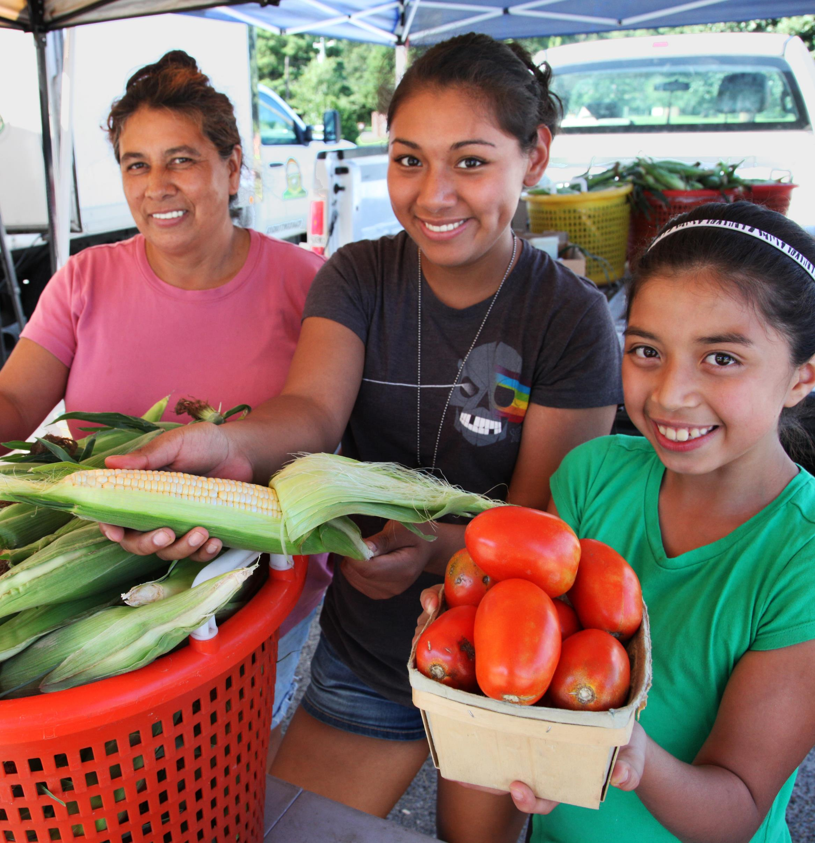


4
Export as a PDF using Google Slides:
File → Download → PDF Document
Export as a PDF using PPT:
Select slide. File → Save As Adobe PDF
______________________________________
Export as a JPG using Google Slides:
File → Download → JPEG Image (Current Slide)
Export as a JPG using PPT:
Select slide. File → Save As → JPEG Image
Print the saved PDF or image for
posters or flyers.
1
Add an image
and scale it
Go to Insert → Image → Upload from Computer and select an image you would like to use for the poster.
To scale, grab bottom right corner of image and hold the clicker down. Drag your mouse or finger across diagonally until it’s the same size/slightly bigger than the slide.
P.S don’t worry if the image is covering the message/art at the bottom. Head to step 2
Optional
Create a custom message
To update the “Vaccination is” message, start by editing the example message below and replacing it with your custom message.
Try to match the length of the message currently on the poster to ensure you have room for information below. The font of the text should be Arial Black. Adjust the font size as needed to fit the space provided.
Once the message is ready, delete the text currently on the poster and replace it with the new message.
To ensure the new message is centered on the poster, select Arrange → Align → Align Center.
2
Send your image back
Once you size your image and scale it proportionally to the size of the slide or slightly bigger, right click on the image and go to Order → Send to back
That will send your image behind the message and art at the bottom.
Vacúnate contra COVID-19
3
Check the font
Ensure the font of the text boxes on the poster are set to Arial Black. You can change the font of text by selecting a text box and using the drop-down menu at the top which has a list of fonts.
GOOGLE SLIDES:
When using Google Slides, you may need to add Arial Black to your font list using the “More Fonts” option from the font drop-down menu.
VACUNACIÓN ES
ESPERANZA
Inscríbete aquí
1-800-000-0000 + website link

