Slide 1
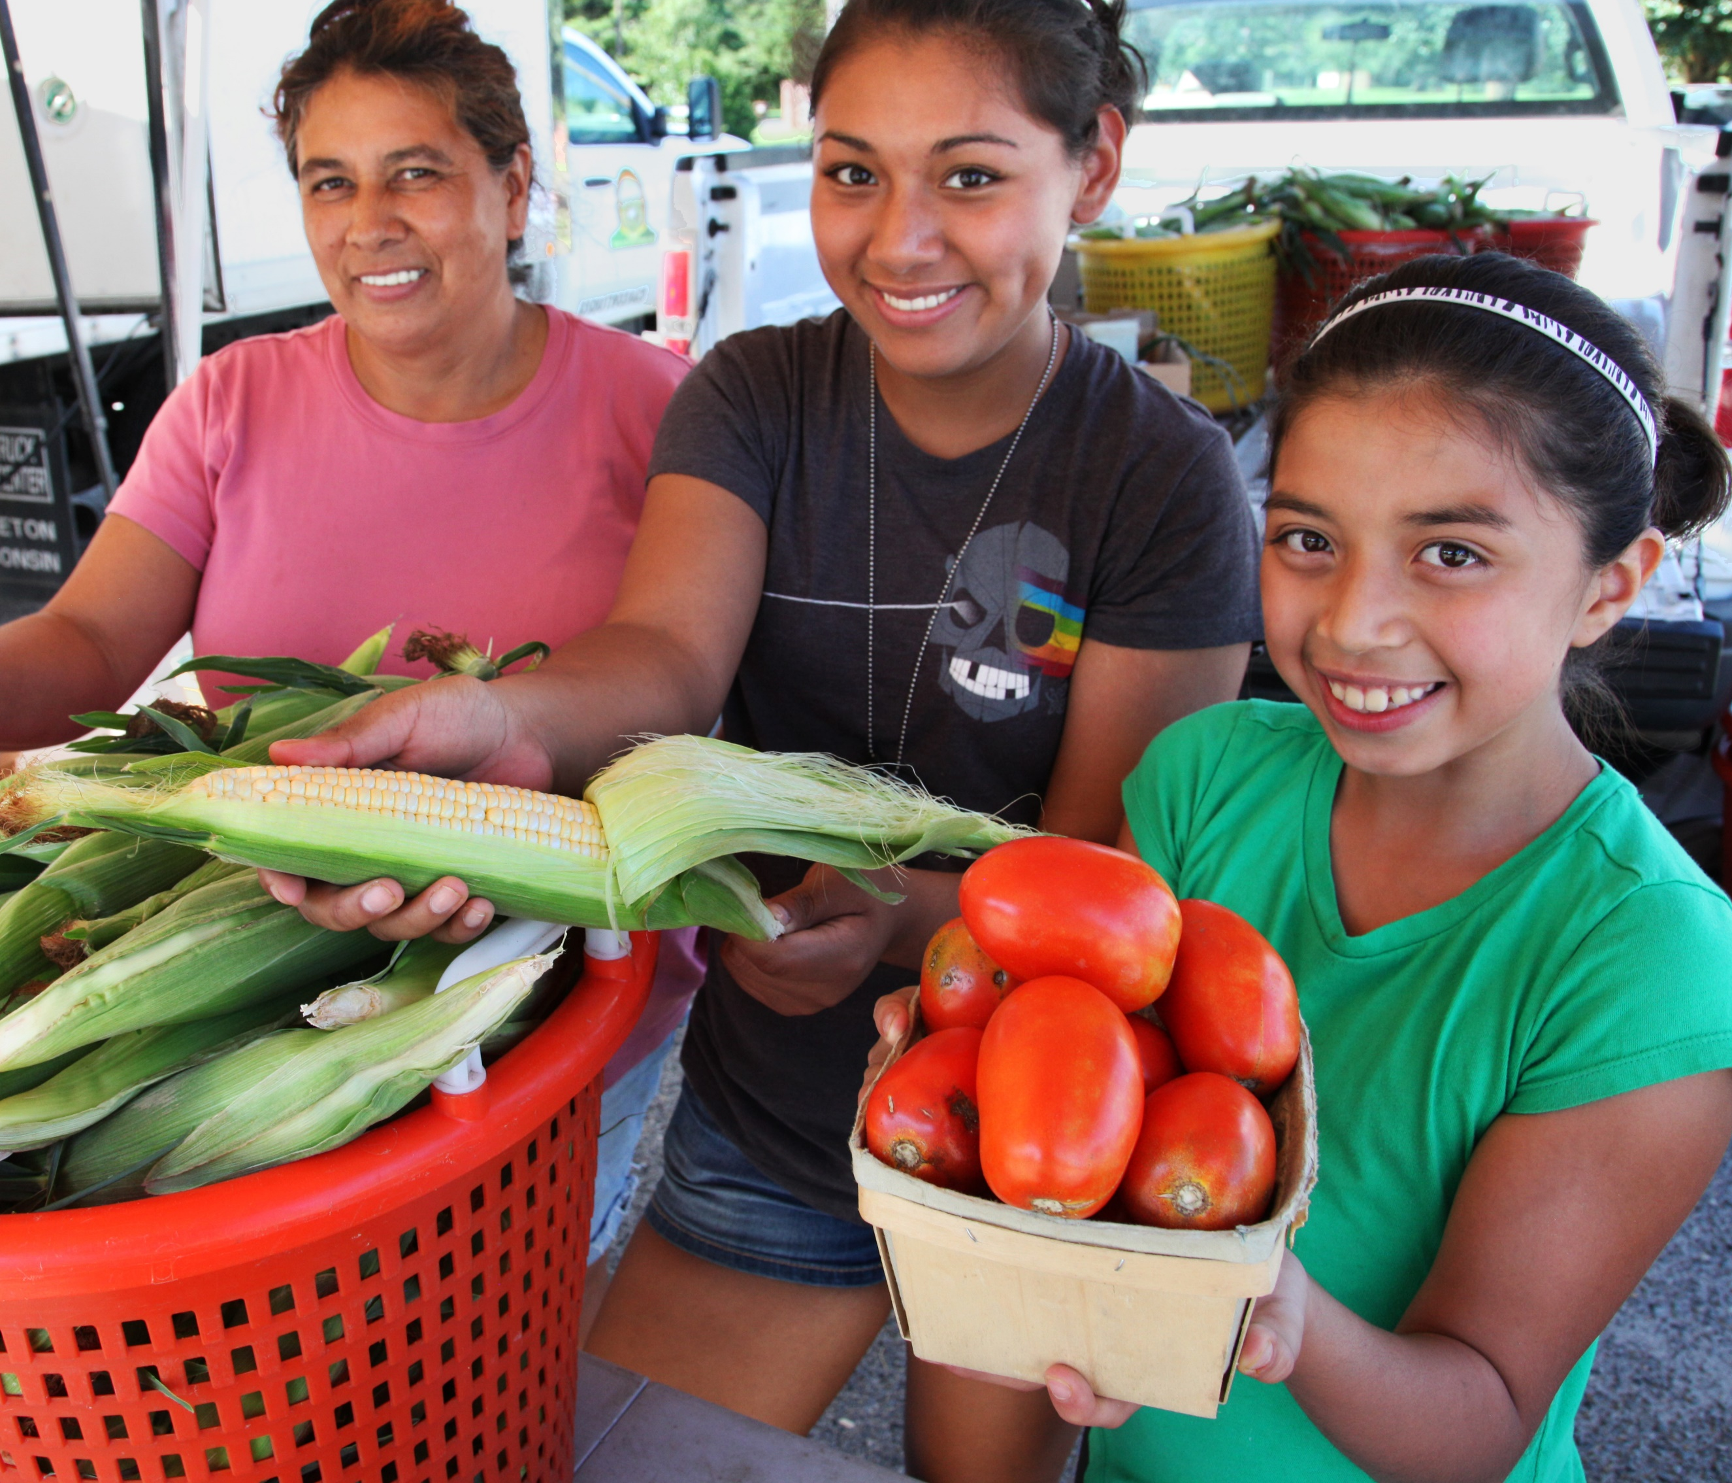

2
Send your image back
Once you size your image and scale it proportionally to the size of the slide or slightly bigger, right click on the image and go to Order → Send to back
That will send your image behind the message and art at the bottom.
1
Add an image
and scale it
Go to Insert → Image → Upload from Computer and select an image of you that you’d like as your profile picture
To scale, grab bottom right corner of image and hold the clicker down. Drag your mouse or finger across diagonally until it’s the same size/slightly bigger than the slide.
P.S don’t worry if the image is covering the message/art at the bottom. Head to step 2
3
Export as a JPG using Google Slides:
File → Download → JPEG Image (Current Slide)
Use the saved image in your social media profile picture
Export as a JPG using PPT:
Select slide. File → Save As → JPEG Image
VACCINATION IS
HOPE

Slide 2
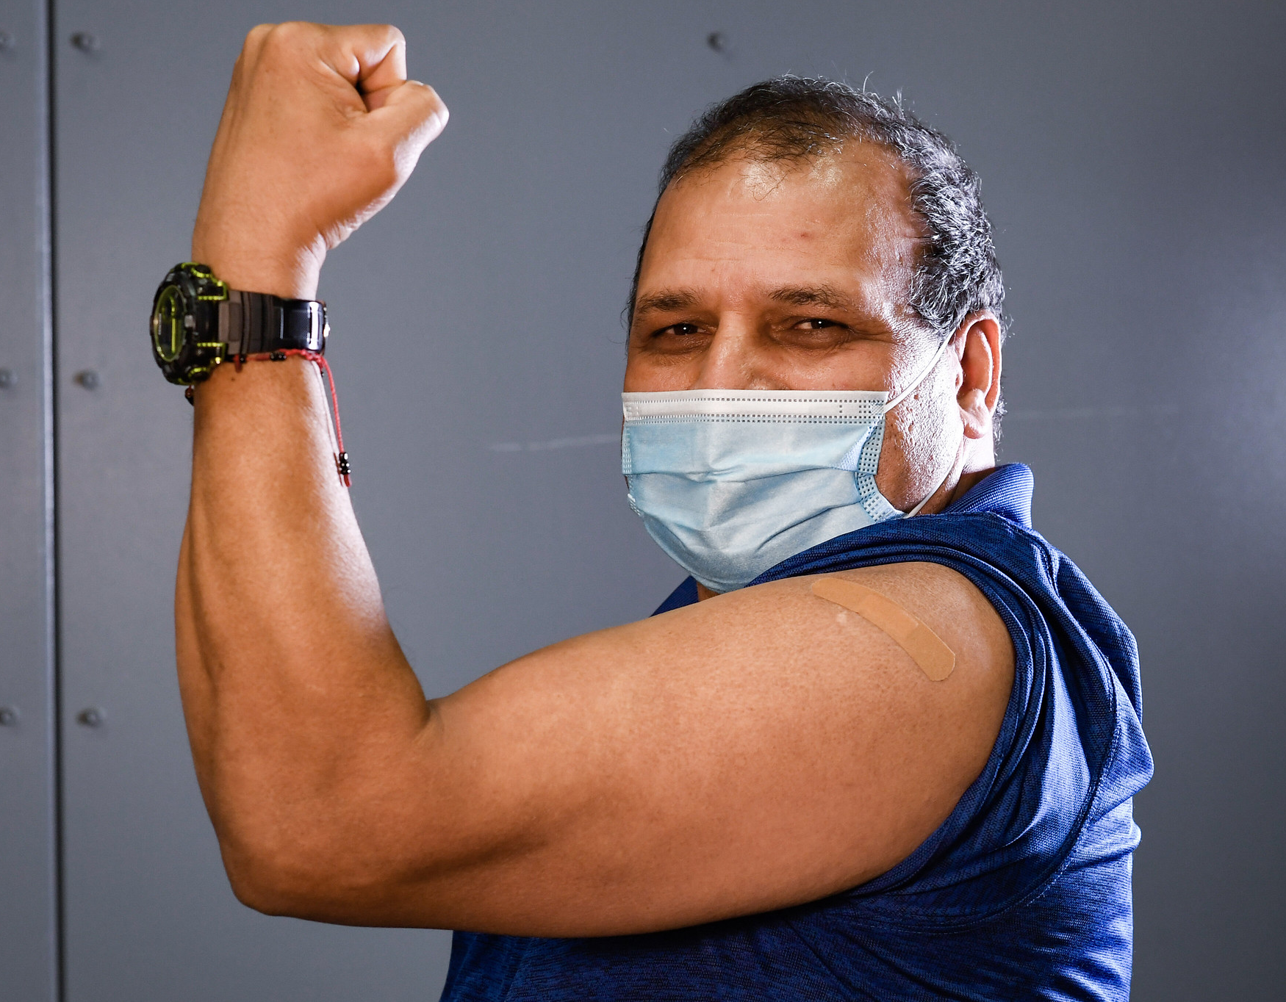
VACCINATION IS
STRENGTH

Slide 3
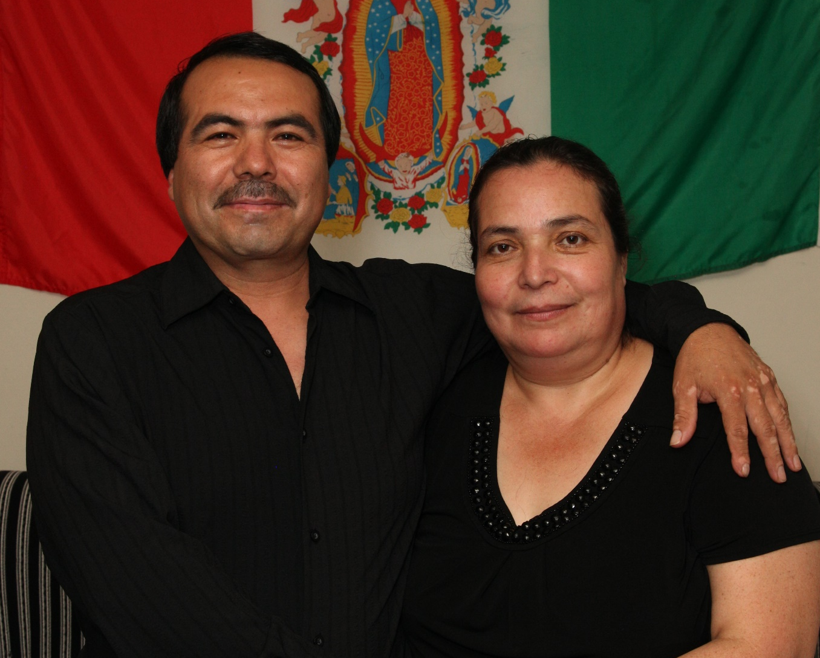
VACCINATION IS
PROTECTION

