Slide 1

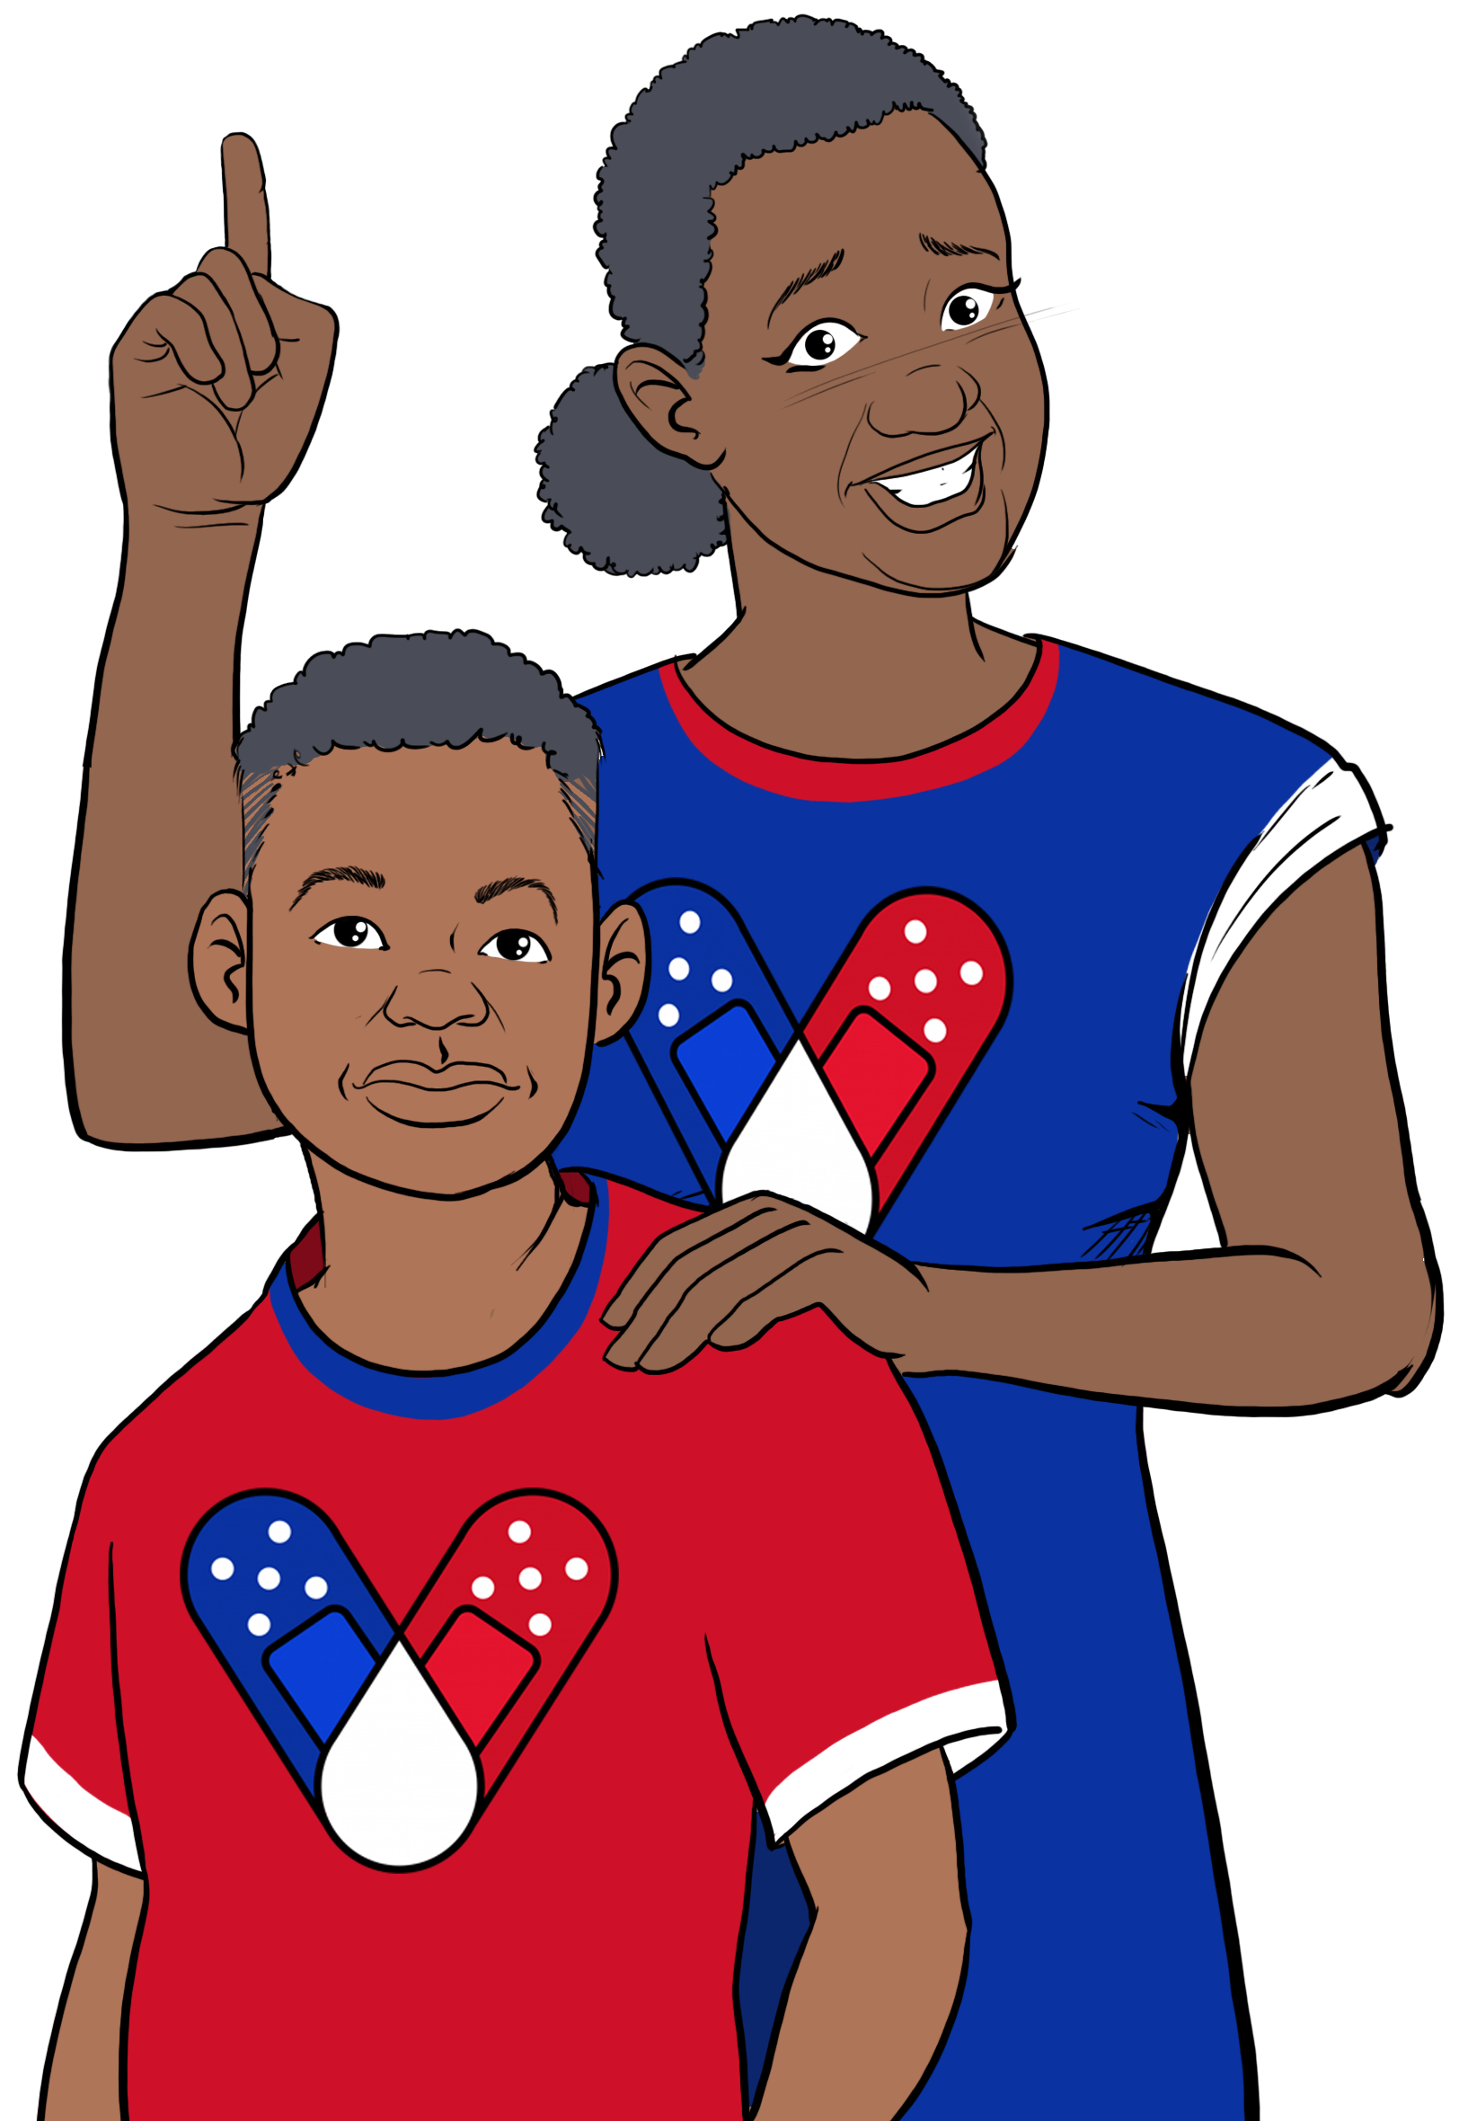


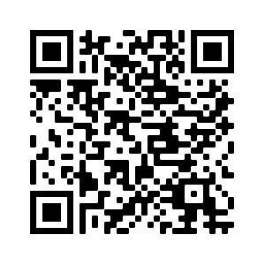

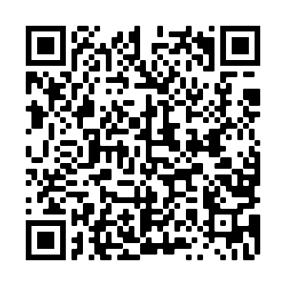
2
Include information on local vaccination efforts
Use the top portion back cover of the brochure to provide resources and links out to more information on vaccination in the area.
The text on this panel is completely editable and new text can be added by
right clicking on the border of a text box → selecting copy from the menu →
right click where you want the new text box → select Paste from the menu
1
Why should we vaccinate children?
HOW CAN I GET MY CHILD A COVID-19 VACCINE?
Add an image and scale it
Go to Insert → Image → Upload from Computer and select an image of you that you’d like on the brochure cover.
To scale, grab bottom right corner of image and hold the clicker down. Drag your mouse or finger across diagonally until it’s the same size/slightly bigger than the slide.
Send your image back
Once you size your image and scale it proportionally to the size of the slide or slightly bigger, right click on the image and go to Order → Send to back
Crop your image
If the image is larger than the brochure cover, you can crop it by right clicking on the image and selecting the Crop tool that appears in the pop-up menu. You can then drag the black bars at the edges of the image to trim it to the right size. Click outside of the image to apply the changes.
Some children get very sick from coronavirus. COVID-19 is a leading cause of death in children. It is #1 in deaths caused by infections/respiratory diseases. Thousands of children have been hospitalized for COVID-19.
Most children don't become as sick as adults, but they can still spread the virus. COVID-19 vaccines prevent grandparents, younger siblings, and others from severe disease, hospitalization, and death.
Getting kids vaccinated helps prevent outbreaks that cause school closures.
Contact your local health department to make an appointment or ask them where mobile vaccine clinics are located.
Contact your local community health center to make an appointment.
Ask your child's pediatrician if they offer COVID-19 vaccines.
Check with your local pharmacy. They will likely offer vaccines.
Speak with your child's school about getting a COVID-19 vaccine. They may offer in-school vaccine clinics.
In some places, parents are required to be present when their child is vaccinated. Look for after-hour and pop-up clinics to make it easier for working parents.
Is the vaccine safe for children?
As of May 2023, over 32% of children in the US 5-11, and 59% of children 12-17 have received their primary series.
Many children have also received an updated bivalent dose.
Risks from COVID-19 greatly outweigh any potential risks from the vaccine.
FOR MORE INFORMATION
Children and
the COVID-19 Vaccine
How do we keep children under six months old safe?
Visit Centers for Disease Control and Prevention:
https://www.cdc.gov/coronavirus/2019-ncov/
Currently, there is not an approved COVID-19 vaccine for children under 6 months old. But you can protect children from being infected and spreading the virus to others.
Ensure all household members aged 6+ months
are vaccinated.
Breastfeeding moms can get vaccinated to help pass antibodies to their baby.
Encourage indoor mask wearing and social distancing especially among the unvaccinated.
Wash hands.
For answers to Frequently Asked Questions, visit Migrant Clinicians Network (MCN):
https://bit.ly/3ki1xAI
GET VACCINATED!
Wear a mask
Social distancing
Wash your hands
Updated: July 25, 2023
COVID-19 Vaccine Awareness Campaign
3
Add information on your organization and other relevant resources
The bottom portion of the back cover allows you to include organizational links, phone numbers, and other information useful to your community.
Be sure to include a date on the brochure as information
changes quickly.

Slide 2
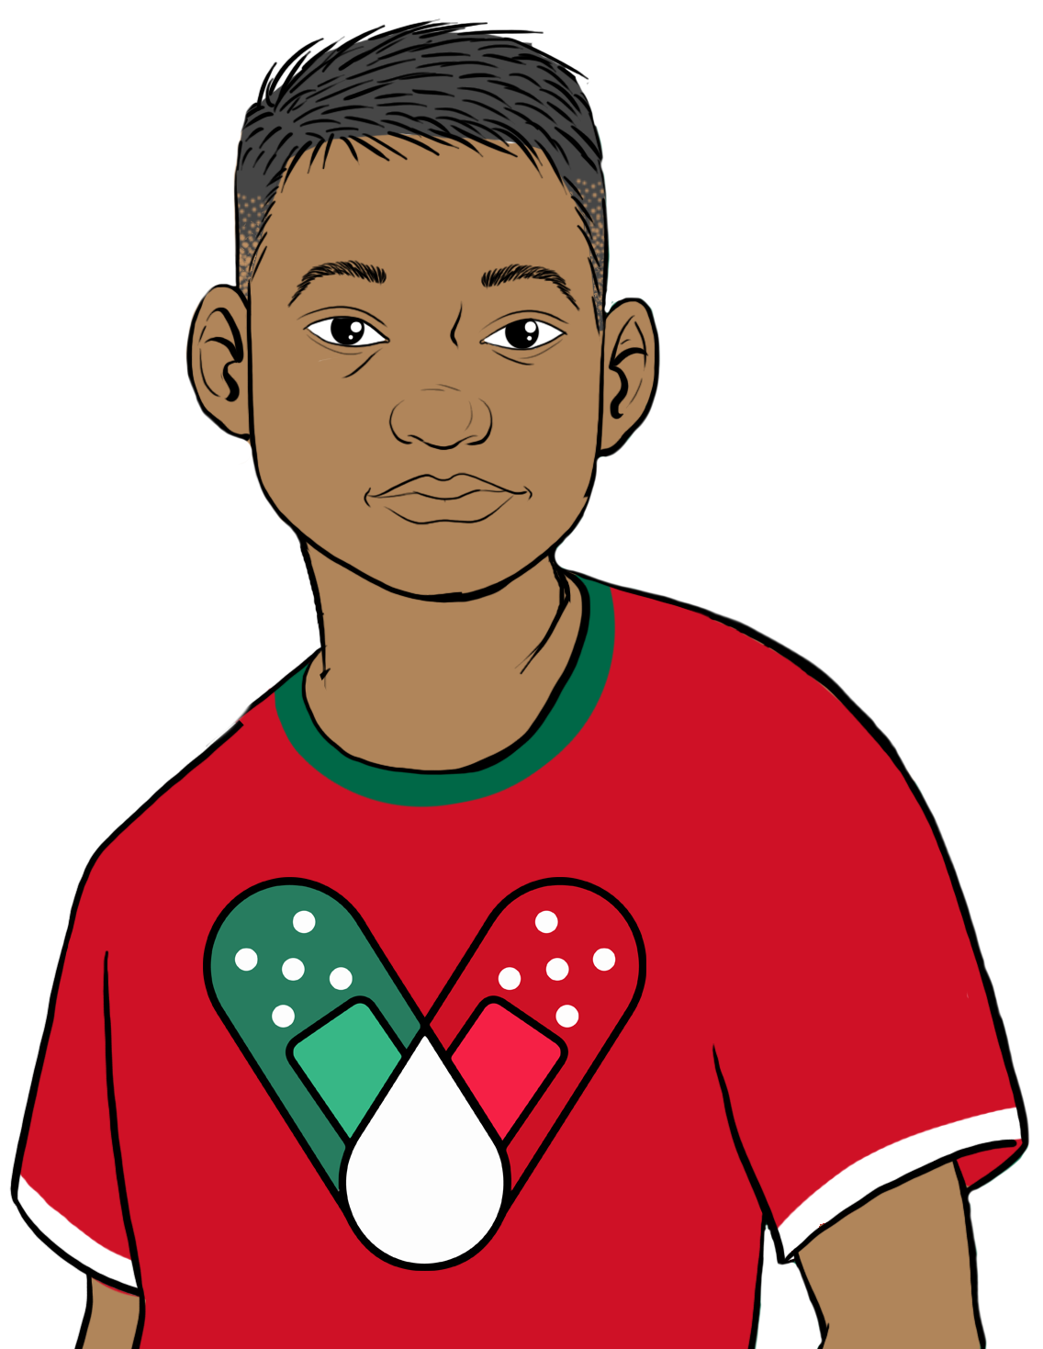
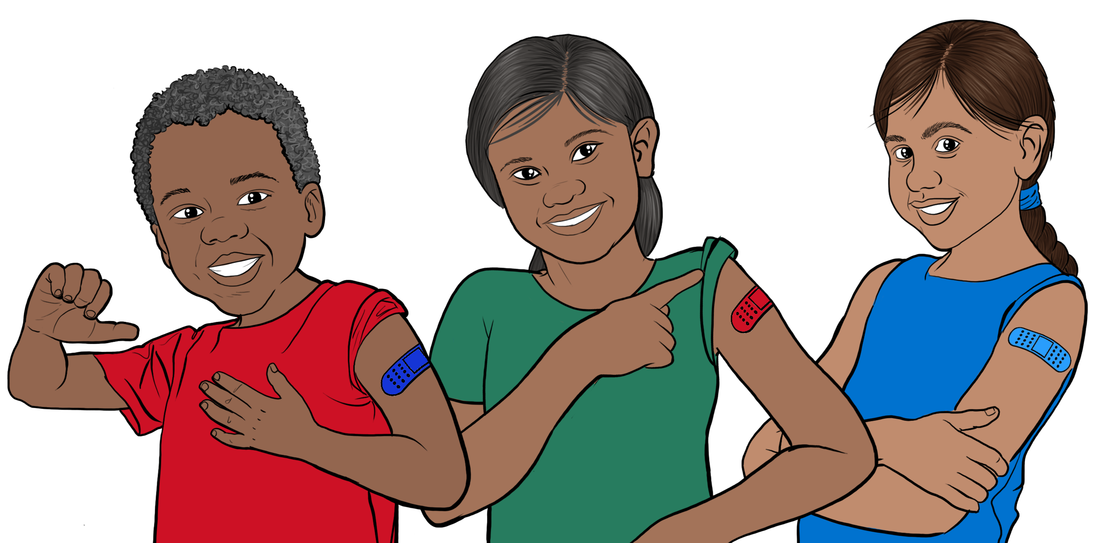

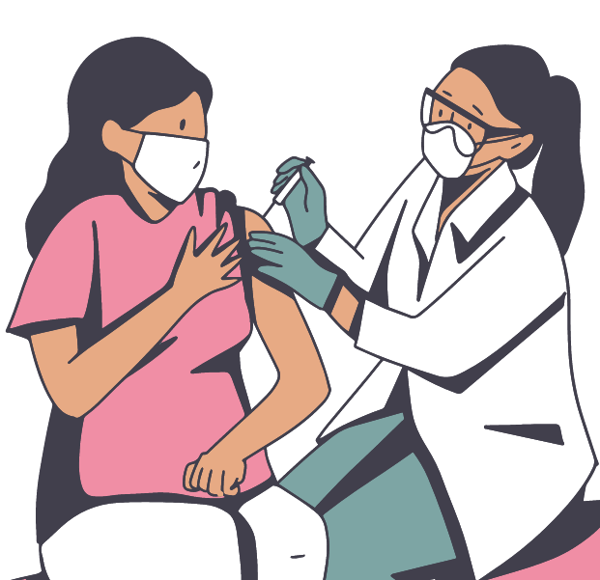

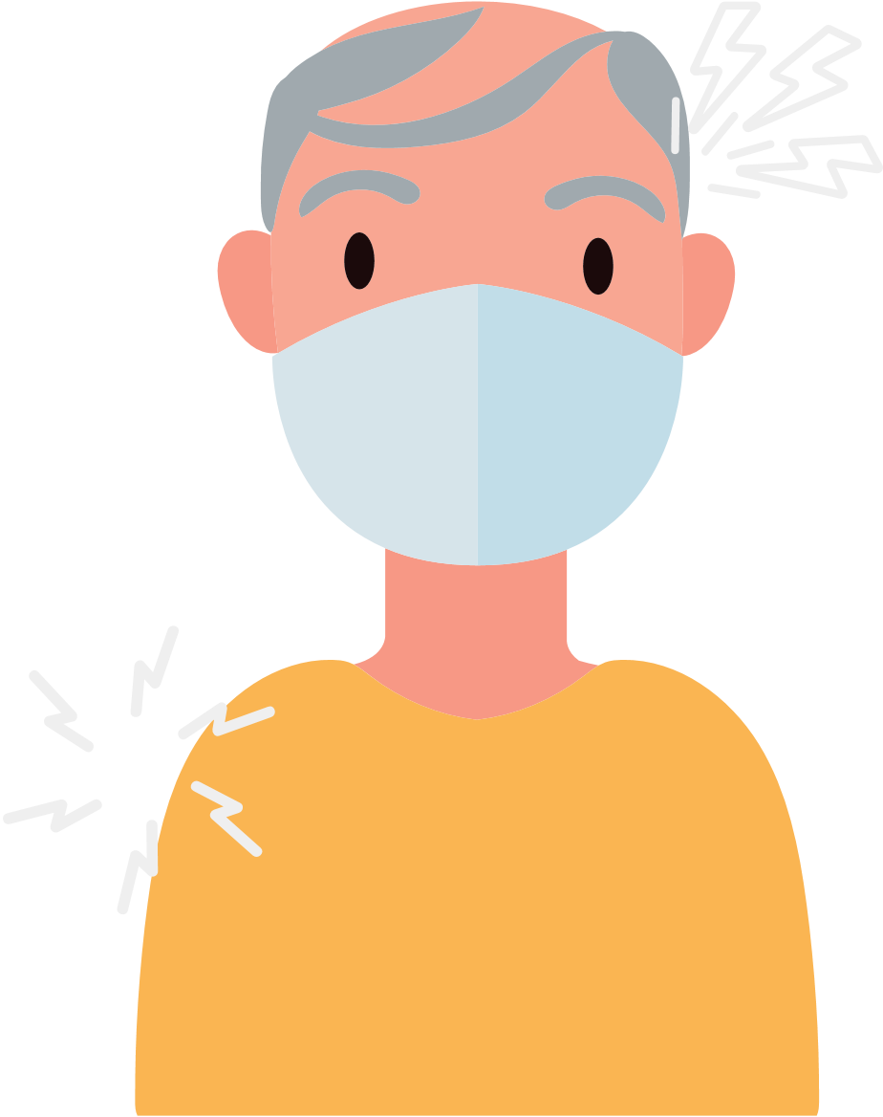


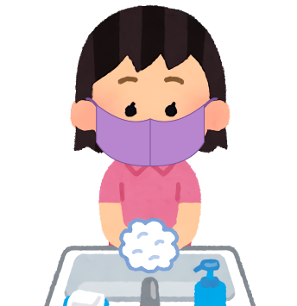

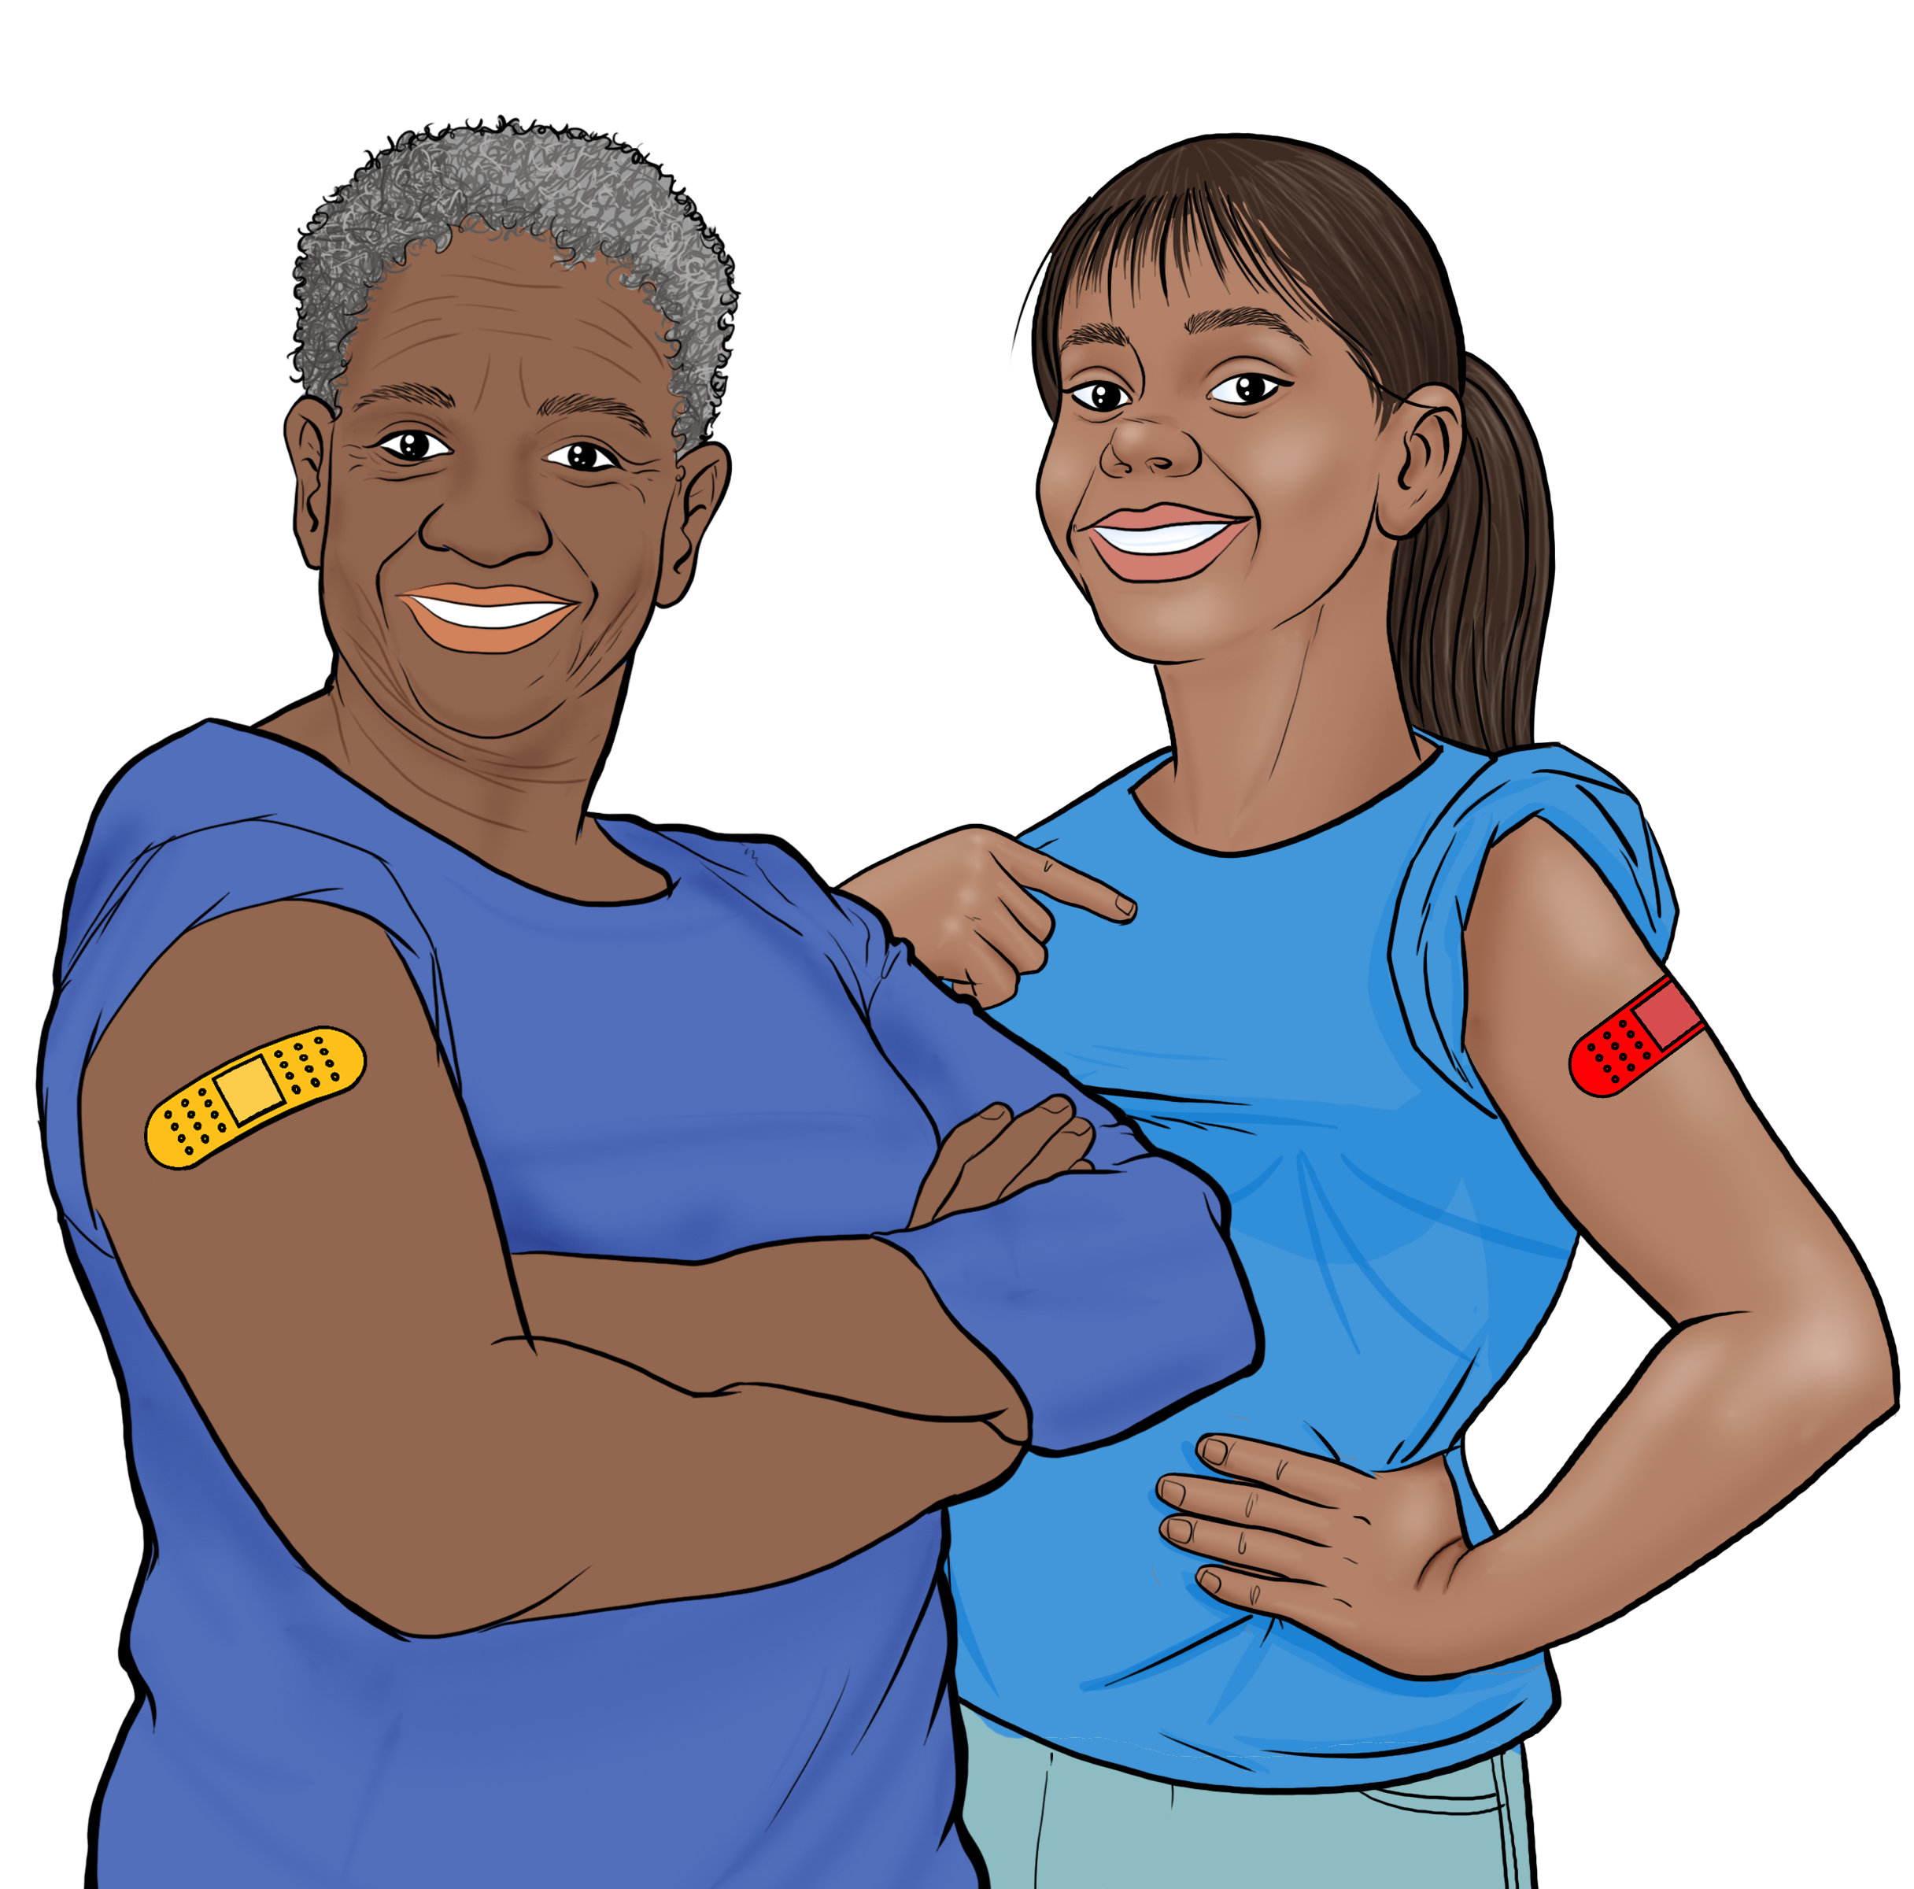
4
COVID-19 VACCINES
FOR CHILDREN
WHAT TO KNOW WHEN CHILDREN ARE GETTING THE COVID-19 VACCINE
Save the file as a PDF
Once the content of the brochure has been finalized, you can save the file as a PDF for printing and distribution.
Export as a PDF using PPT:
Select slide. File → Save As Adobe PDF
Export as a PDF using Google Slides:
File → Download → PDF Document
Children 6 mos. to 4 yrs: 3 doses of Pfizer vaccine or 2 doses of Moderna vaccine.
Children 5 yrs: 1 dose of Pfizer vaccine or 2 doses of Moderna vaccine.
6-17: 1 dose of Pfizer or Moderna vaccine.
Note: These recommendations are for the bivalent/updated vaccines. If your child has received any doses of the monovalent/original vaccines, ask your child's healthcare provider about how many doses of the updated vaccines are needed.
Immunocompromised children: Ask child's healthcare provider for dose recommendations.
Spacing between doses varies, by age: Ask child's healthcare provider. Visit the CDC's page for spacing: www.cdc.gov/vaccines/covid-19/clinical-considerations/interim-considerations-us
BENEFITS OF VACCINATION
It is important for children to get vaccinated, even if they've had COVID-19.
Check if vaccines are
offered for free at your
state or local health
department or pharmacy.
Vaccination protects children and their families from becoming seriously ill and being hospitalized.
Vaccination decreases the number of severe and deadly COVID-19 cases in
your community.
Vaccination protects hospitals and clinicians from being overwhelmed with severely ill COVID-19 patients.
The more vaccinated individuals in our community, the less we need to worry about new variants.
HOW TO PROTECT YOUR CHILDREN
The COVID-19 vaccine
is safe and effective
for children.
After vaccination kids may experience: arm pain, headache, fever, or chills.
Get vaccinated and get your children who are 6 months and older vaccinated.
Wear a mask in crowded indoor spaces even when you are up to date on your vaccines.
If your child is up to date on their vaccines and are exposed to COVID-19:
  If they have symptoms: Test immediately. If they have a negative test, test again in 48 hours.
  If they do not have symptoms: Test at least 5 days after exposure. If they have a negative test, test again after 48 hours, and then again after another 48 hours if their second results are negative. Get medical advice if you think they are ill.
Regardless of vaccination status, if your child has COVID-19, they must isolate. See CDC guidelines for how to isolate.
RISKS FOR UNVACCINATED
They feel better
a few days after
the injection.
Kids are considered up to date once they receive their final dose or doses.
Higher risk of COVID-19 infection.
Higher risk of serious infection, hospitalization, and death.
Higher risk of developing long-term symptoms of COVID-19 if infected.
Higher risk of being exposed to new forms of the virus that are more contagious and dangerous.
Recommendations:
For women of any age who are
pregnant, breastfeeding, or trying to
get pregnant, vaccines are critical for
keeping moms and their babies healthy.
Continue to wear a
mask in crowded spaces and wash your hands.
Getting vaccinated helps protects kids and others from getting very sick from COVID-19!

