Slide 1
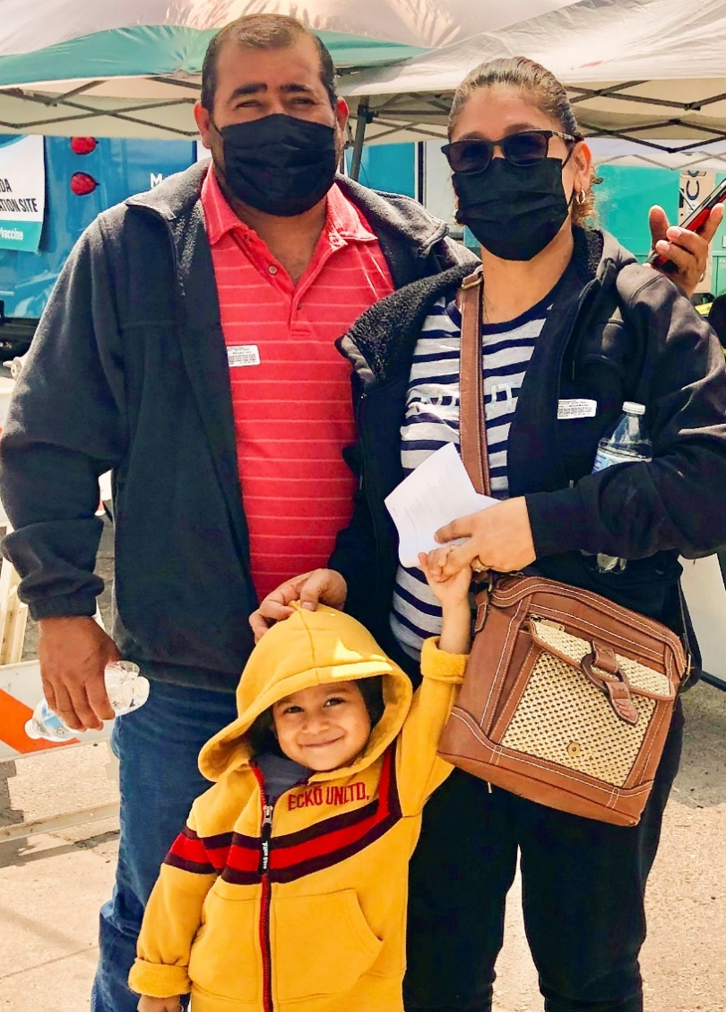
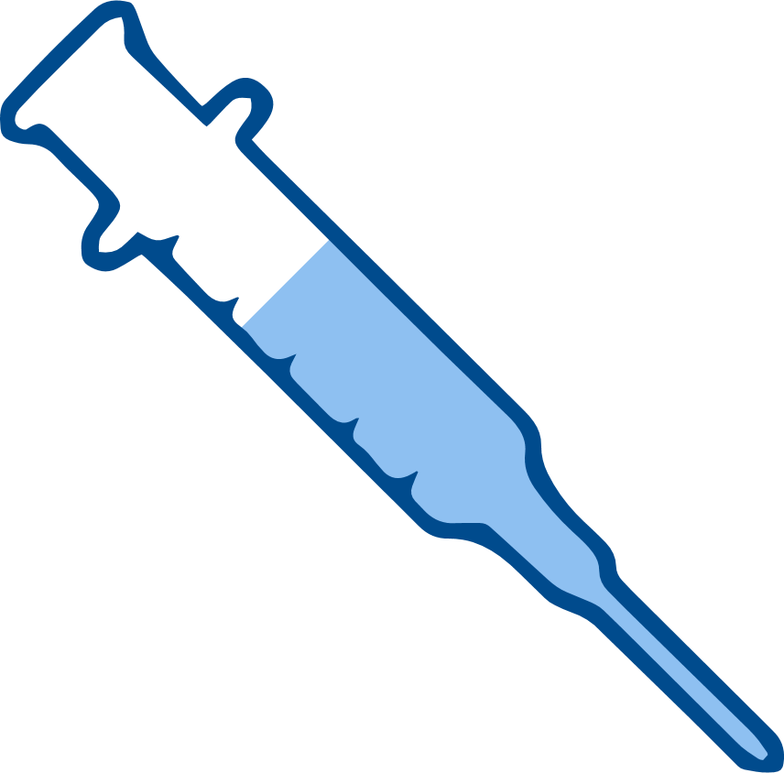





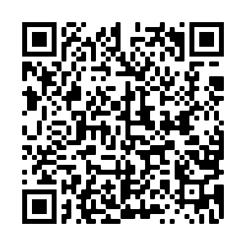
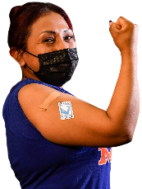
2
Include information on local vaccination efforts
Use the top portion back cover of the brochure to provide resources and links out to more information on vaccination in the area.
The text on this panel is completely editable and new text can be added by
right clicking on the border of a text box → selecting copy from the menu →
right click where you want the new text box → select Paste from the menu
COVID-19 VACCINES ARE SAFE AND EFFECTIVE
1
HOW DO I GET A
COVID-19 VACCINE?
Add an image and scale it
Go to Insert → Image → Upload from Computer and select an image of you that you’d like on the brochure cover.
To scale, grab bottom right corner of image and hold the clicker down. Drag your mouse or finger across diagonally until it’s the same size/slightly bigger than the slide.
Send your image back
Once you size your image and scale it proportionally to the size of the slide or slightly bigger, right click on the image and go to Order → Send to back
Crop your image
If the image is larger than the brochure cover, you can crop it by right clicking on the image and selecting the Crop tool that appears in the pop-up menu. You can then drag the black bars at the edges of the image to trim it to the right size. Click outside of the image to apply the changes.
Types of vaccines available in the US:
Pfizer
Moderna
For other options contact your health department or pharmacy.
Contact your local health department to make an appointment or ask them where mobile vaccine clinics are located.
Check with your local pharmacy.
They will likely offer vaccines.
Contact your local community health center to make an appointment.
Speak with your employer about getting a COVID-19 vaccine. They may be helpful in making arrangements to get a vaccine.
Check to see whether vaccines are offered for free at your state or local health department or local pharmacy. Check to see if fees can be waived.
Get one bivalent vaccine whether you have received the primary series or not. Adults 65 or older, the immunocompromised, and children 6 months - 5 years: seek guidance from a healthcare provider.
RECOMMENDATIONS
Get your updated vaccine.
Get your family updated vaccines.
Pfizer or Moderna are recommended.
Wear a mask in crowded in door or outdoor spaces, even when you are up to date on your vaccines.
If you are up to date on your vaccines and are exposed to COVID-19:
    Isolate
    If you have symptoms: Test 5 days after exposure. Stay home until you have no symptoms or symptoms are resolving and its been 24 hours since your last fever without medication.
    If you do not have symptoms: Test 5 days after exposure. If you have a negative test, test again after 48 hours, and then again after another 48 hours if your second results are negative.
    Get medical advice if you think you are ill.
FOR MORE INFORMATION
For answers to Frequently Asked Questions, visit Migrant Clinicians Network (MCN):
https://bit.ly/3ki1xAI
GET VACCINATED!
Wear a mask
Social distancing
Wash your hands
For women:
For women who are pregnant, breastfeeding, or trying to get pregnant, vaccines are critical for keeping moms and their babies healthy.
Updated: July 24, 2023
COVID-19 Vaccine Awareness Campaign
3
Add information on your organization and other relevant resources
The bottom portion of the back cover allows you to include organizational links, phone numbers, and other information useful to your community.
Be sure to include a date on the brochure as information
changes quickly.

Slide 2
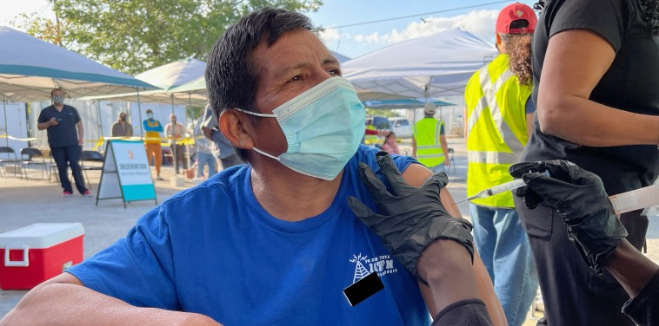
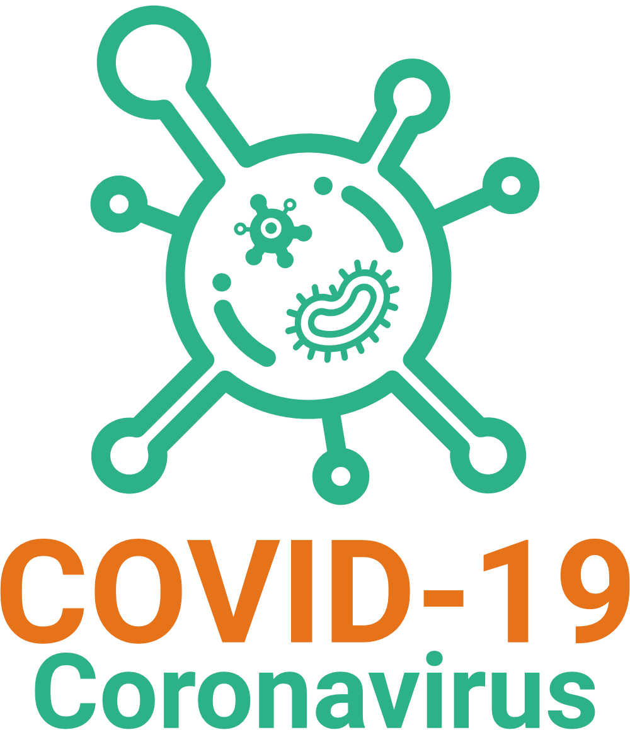
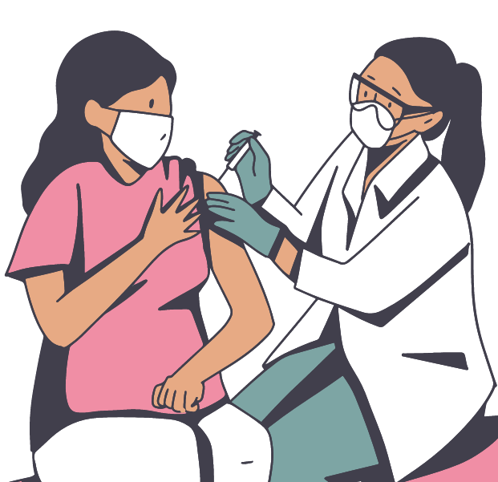
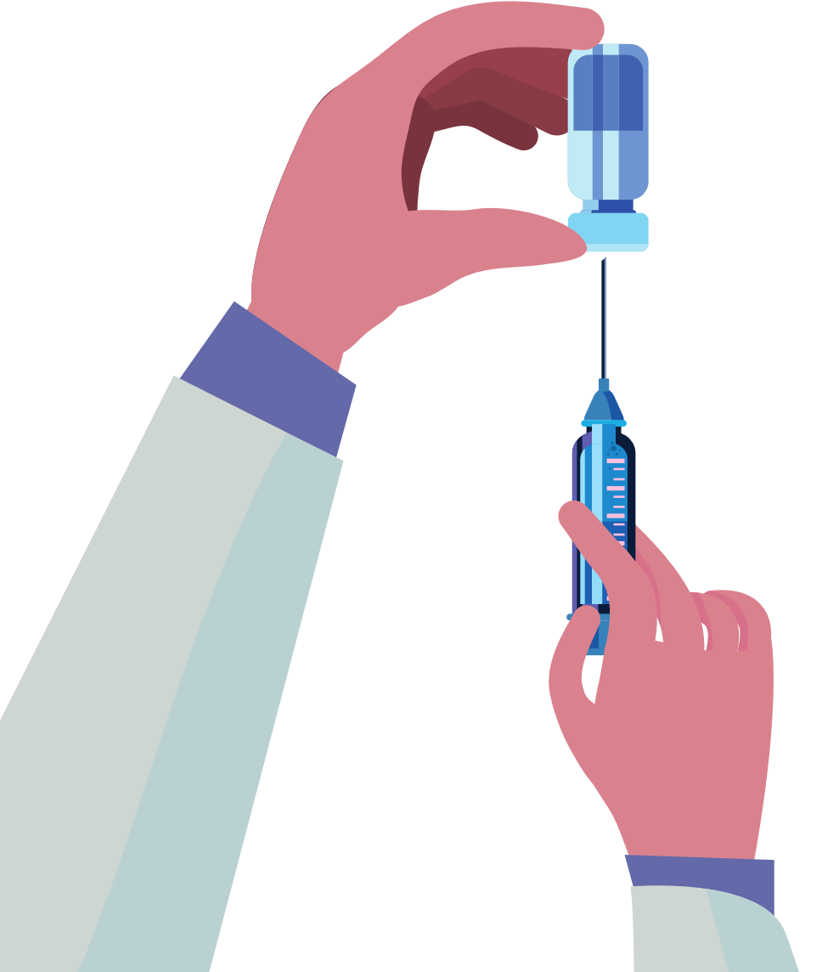
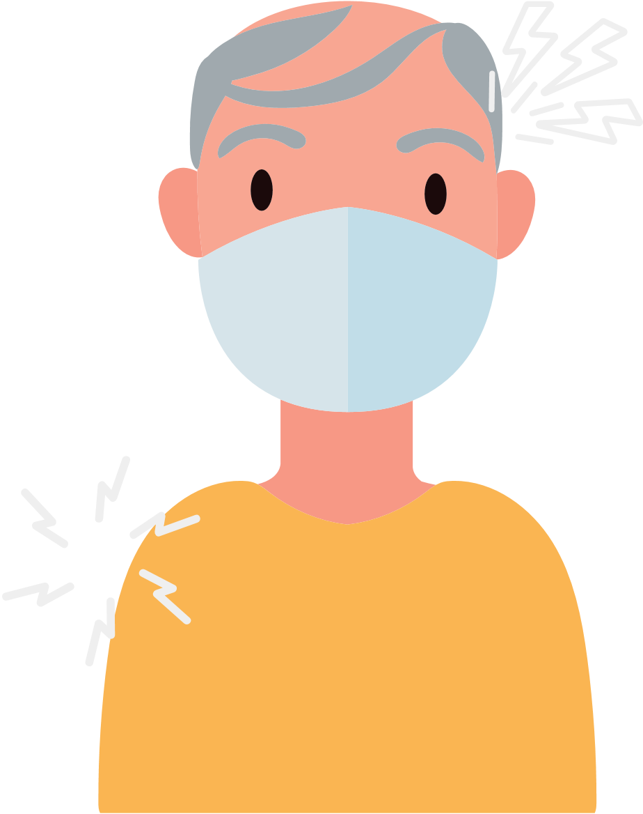

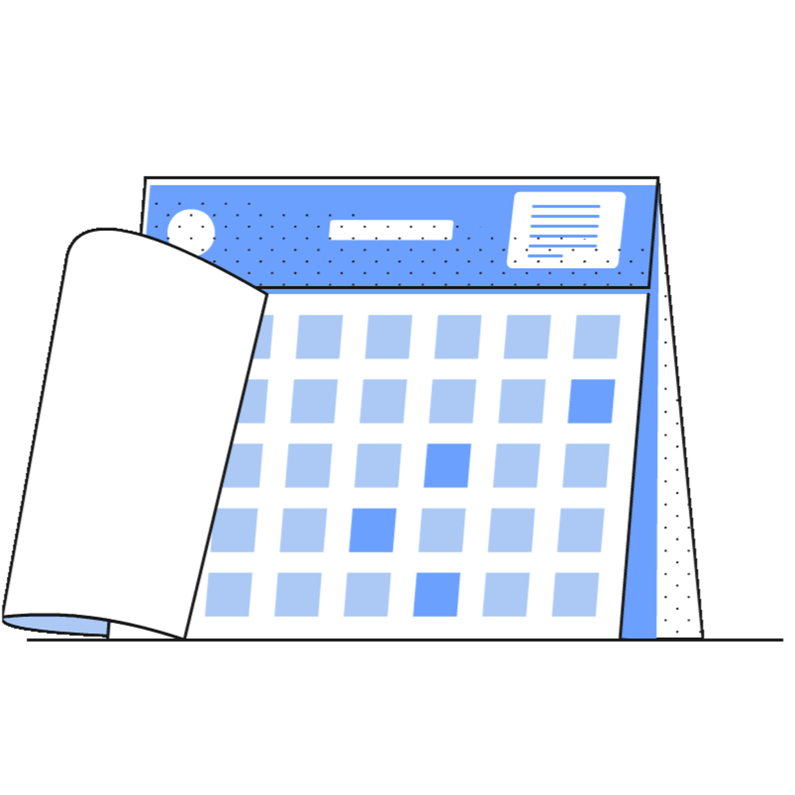
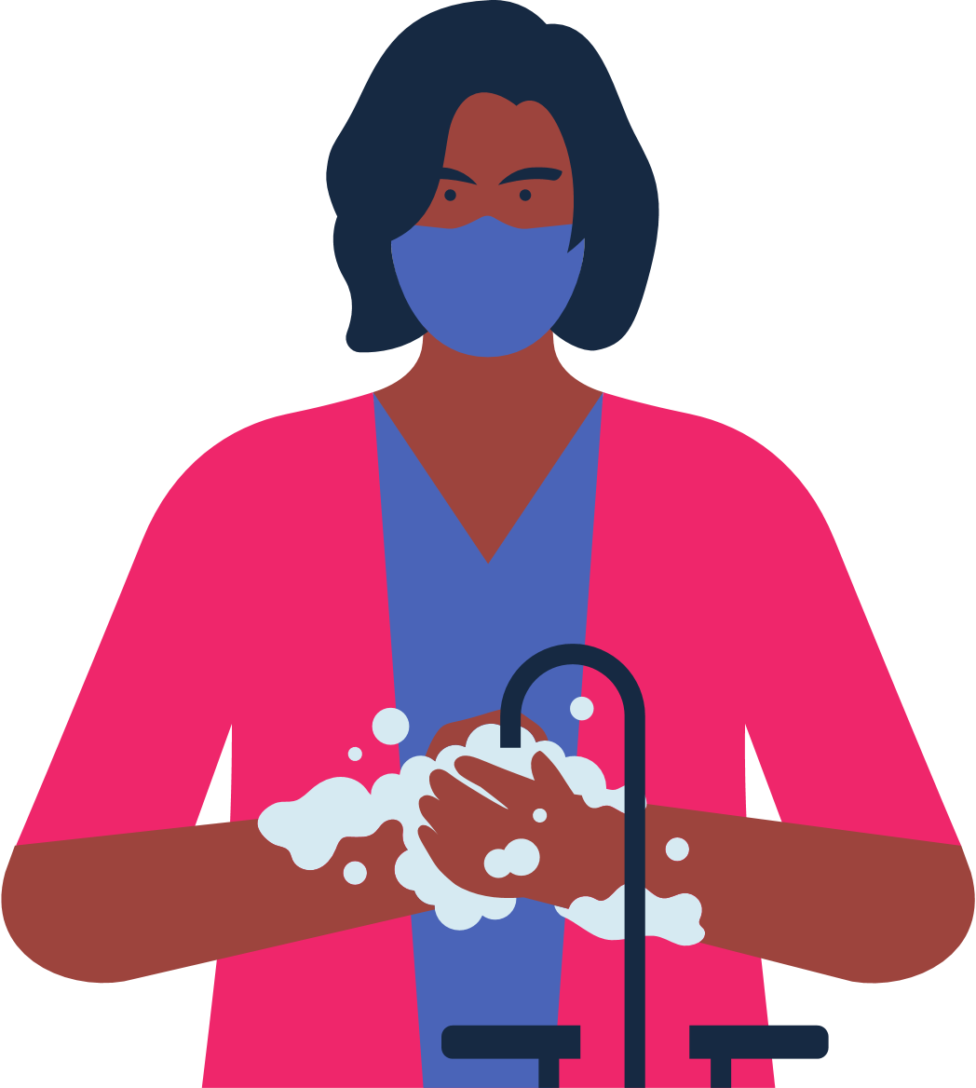
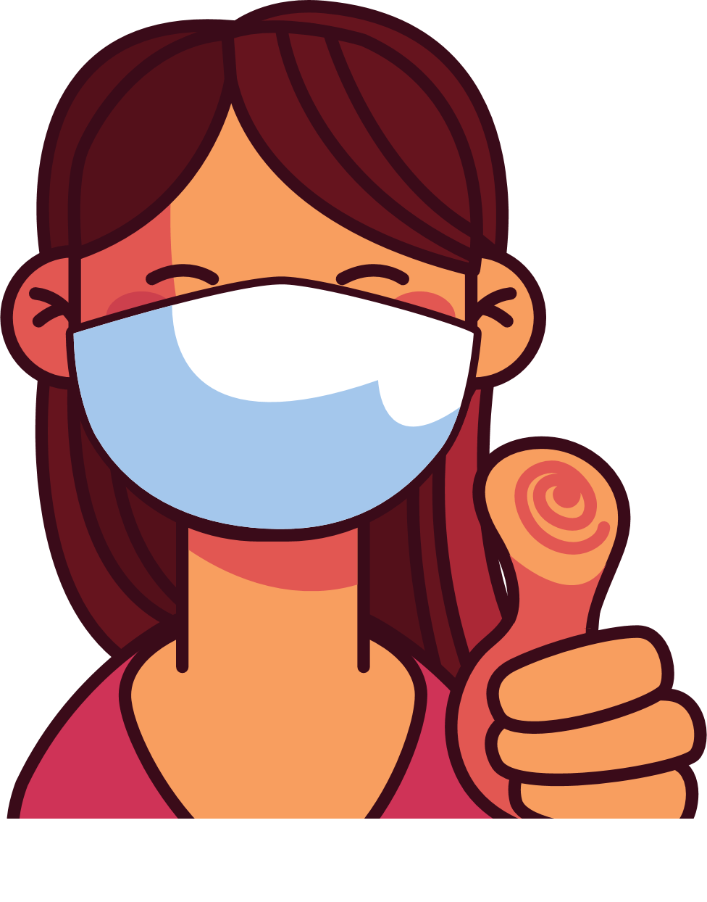

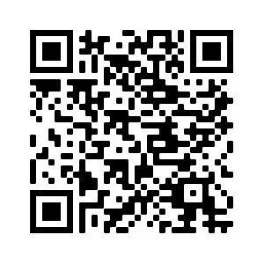
4
Address Concerns in the Community
This panel is intended to provide information addressing the concerns specific to the community receiving
the brochure.
The text boxes with the questions and answers can be edited, copied or deleted so you can customize this panel to fit your needs.
Here you can include links to relevant resources or more information addressing the community’s concerns.
WHAT TO KNOW WHEN
GETTING THE COVID VACCINE
HOW DO I KNOW WHEN OR
IF I NEED ANOTHER DOSE
OF THE VACCINE?
Immunocompromised individuals may need additional doses of the vaccine.
Those who are 6 years or older need a bivalent booster at least 2 months after completing their last vaccine if they have not already received a bivalent booster.
Check for latest updates about boosters.
BENEFITS OF VACCINATION
It is important to get vaccinated, even if you have had COVID-19.
Check if vaccines are offered for free at your state or local health department or pharmacy.
Vaccination protects you, your family, and your co-workers from becoming seriously ill and being hospitalized.
Vaccination decreases the number of severe and deadly COVID-19 cases in
your community.
Vaccination protects hospitals and clinicians from being overwhelmed with patients severely ill with COVID-19.
The more vaccinated individuals in our community, the less we need to worry about new variants.
WHAT SHOULD I DO IF I RECIEVED MY FIRST DOSE IN A DIFFERENT COUNTRY AND IT IS NOT AVAILABLE IN THE U.S?
Not all countries have approved the same COVID-19 vaccines as the United States.
Some vaccines aren't available in the US but are recognized. If your vaccine is recognized by the CDC, and you have documentation of your vaccination, then you don't have to start over. You can get a shot of Pfizer or Moderna vaccine (mRNA) to become fully vaccinated. If you do not have documentation you will need to start over. Seek medical advice on the recommended timing between doses.
There are various types of vaccines. All vaccines against COVID-19 are safe and effective.
After vaccination you may experience: arm pain, headache, fever, or chills.
5
Save the file as a PDF
Once the content of the brochure has been finalized, you can save the file as a PDF for printing and distribution.
Export as a PDF using PPT:
Select slide. File → Save As Adobe PDF
Export as a PDF using Google Slides:
File → Download → PDF Document
RISKS FOR UNVACCINATED
You will feel better
a few days after
your injection.
You are considered up to date once you receive your needed dose or doses.
Higher risk of COVID-19 infection.
Higher risk of serious infection, hospitalization, and death.
If a majority of individuals DO NOT get vaccinated against COVID-19, then there is a larger risk of serious illness and risk of new mutations that are more contagious and dangerous.
WHERE DO I GET
MORE INFORMATION?
Visit Centers for Disease Control and Prevention:
https://www.cdc.gov/coronavirus/2019-ncov/
Continue to wear a mask
in crowded spaces
and wash your hands.
You did your part to protect yourself and others from COVID-19!

