Slide 1
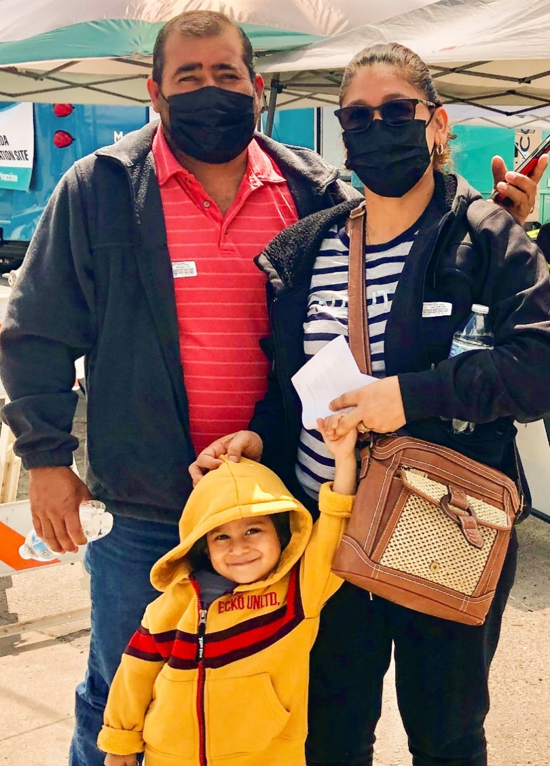






2
Include information on local vaccination efforts
Use the top portion back cover of the brochure to provide resources and links out to more information on vaccination in the area.
The text on this panel is completely editable and new text can be added by
right clicking on the border of a text box → selecting copy from the menu →
right click where you want the new text box → select Paste from the menu
1
VAKSEN KONT COVID-19 YO SAN DANJE EPI YO EFIKAS
Kòman mwen kapab jwenn Vaksen kont COVID-19?
Add an image and scale it
Go to Insert → Image → Upload from Computer and select an image of you that you’d like on the brochure cover.
To scale, grab bottom right corner of image and hold the clicker down. Drag your mouse or finger across diagonally until it’s the same size/slightly bigger than the slide.
Send your image back
Once you size your image and scale it proportionally to the size of the slide or slightly bigger, right click on the image and go to Order → Send to back
Crop your image
If the image is larger than the brochure cover, you can crop it by right clicking on the image and selecting the Crop tool that appears in the pop-up menu. You can then drag the black bars at the edges of the image to trim it to the right size. Click outside of the image to apply the changes.
Kalite vaksen ki disponib Etazini:
Pfizer
Moderna
Pou lòt opsyon yo kontakte depatman sante oswa famasi ou a.
Kontakte depatman sante ki nan zòn ou an pou pran yon randevou oswa mande yo ki kote klinik mobil pou vaksen an ye.
Verifye avèk famasi ki nan zòn ou an.
Gen chans pou yo ofri vaksen yo.
Kontakte depatman sante ki nan zòn ou an pou pran yon randevou.
Pale avèk patwon ou an sou fason ou kapab jwenn vaksen kont COVID-19 la. Yo ka ede w nan aranjman w ap fè pou pran yon vaksen.
Tcheke pou wè si yo ofri vaksen yo gratis nan depatman sante lokal oswa eta a oswa nan famasi lokal ou a. Tcheke pou wè si yo ka anile frè yo.
Pran yon sèl vaksen bivalan kit ou te pran seri vaksen prensipal yo kit ou pa t pran yo. Adilt ki gen 65 an oswa plis, moun ki gen sistèm iminitè yo fèb, ak timoun ki gen 6 mwa jiska 5 ane: chèche konsèy nan men yon pwofesyonèl swen sante.
Rekòmandasyon
Pran dènye dòz vaksen ou an.
Fè fanmi ou pran dènye dòz vaksen yo.
Yo rekòmande Pfizer oswa Moderna.
Mete yon respiratè nan espas anndan ki gen anpil moun, menm si ou deja pran dènye dòz vaksen yo.
Si w ajou nan vaksen ou yo epi w trape COVID-19:
  Izole
  Si ou santi sentòm yo: Fè tès la 5 jou apre ou fin gen kontak ak viris la. Rete lakay ou jiskaske w pa gen okenn sentòm, oswa jiskaske sentòm ou yo disparèt, epi gen 24 èdtan ki pase depi dènye lafyèv ou te genyen an te tonbe san medikaman.
  Si w pa santi sentòm yo: Fè tès la 5 jou apre ou fin gen kontak ak viris la. Si tès ou a negatif, refè tès la ankò apre 48 èdtan, epi fè sa ankò apre yon lòt 48 èdtan si dezyèm rezilta ou a negatif.
  Chèche wè yon doktè si w panse w malad.
Pou w jwenn plis enfòmasyon
Pwoteje Tèt ou Kont COVID-19
Vizite Sant Kontwòl Maladi yo ak Pwevansyon:
https://www.cdc.gov/coronavirus/2019-ncov/
Al pran vaksen an!
Mete yon mask
Distans Sosyal
Lave men ou
Pou Repons ak Keksyon yo poze souvan, vizite Migrant Clinicians Network:
https://bit.ly/3ki1xAI
Pou fi yo:
Pou fi ki ansent, ki ap bay tete, oswa ki ap eseye ansent, vaksen yo enpòtan anpil pou kenbe manman ak ti bebe yo an sante.
Mizajou: 25 Jiyè 2023
Kanpay Sansibilizasyon pou Vaksen
kont COVID-19
3
Add information on your organization and other relevant resources
The bottom portion of the back cover allows you to include organizational links, phone numbers, and other information useful to your community.
Be sure to include a date on the brochure as information
changes quickly.

Slide 2
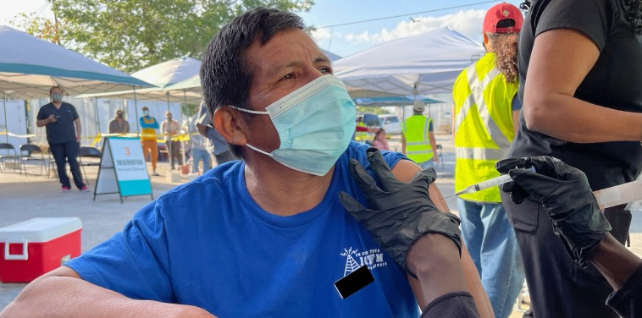


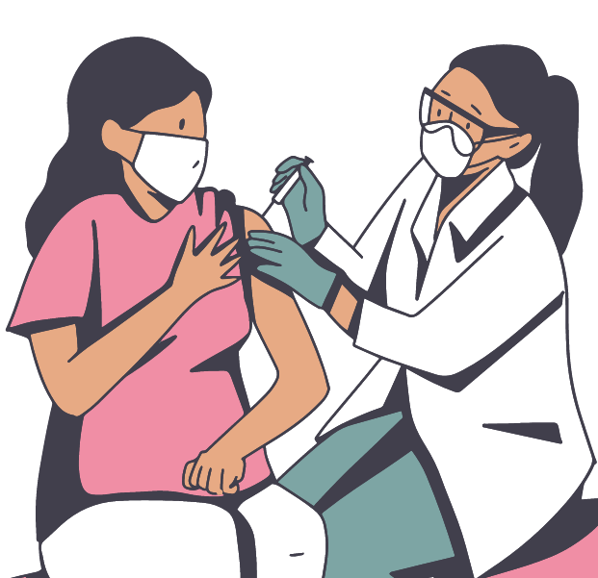
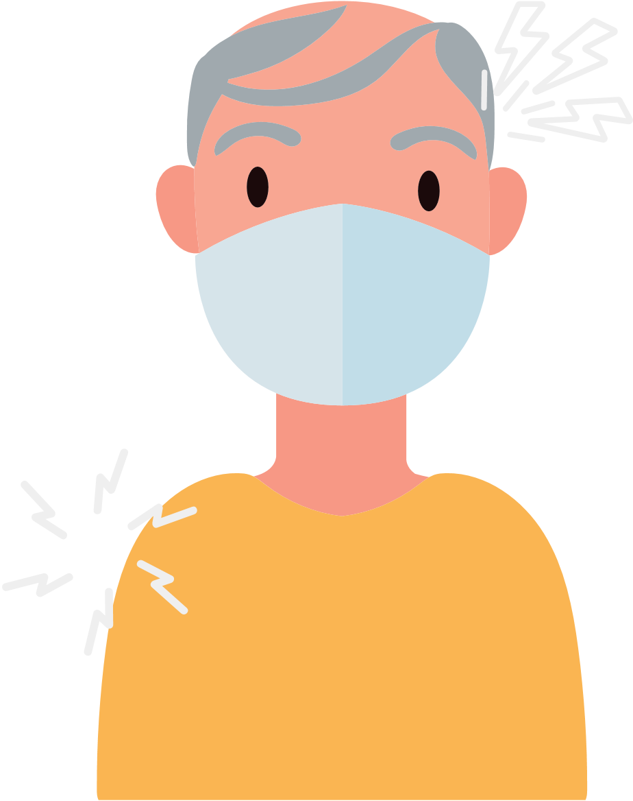


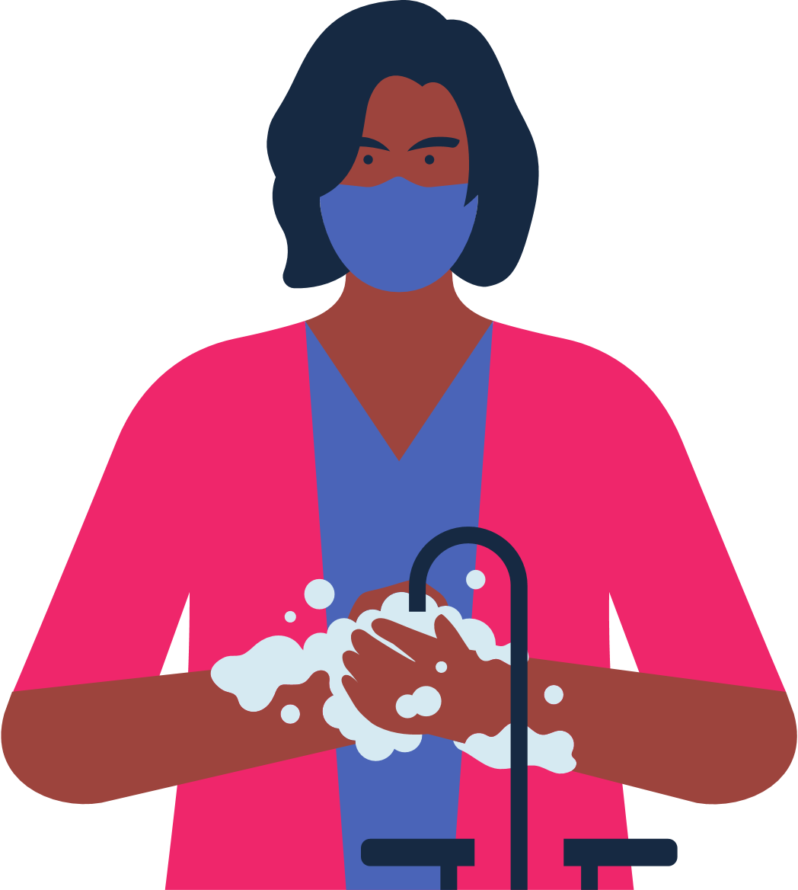
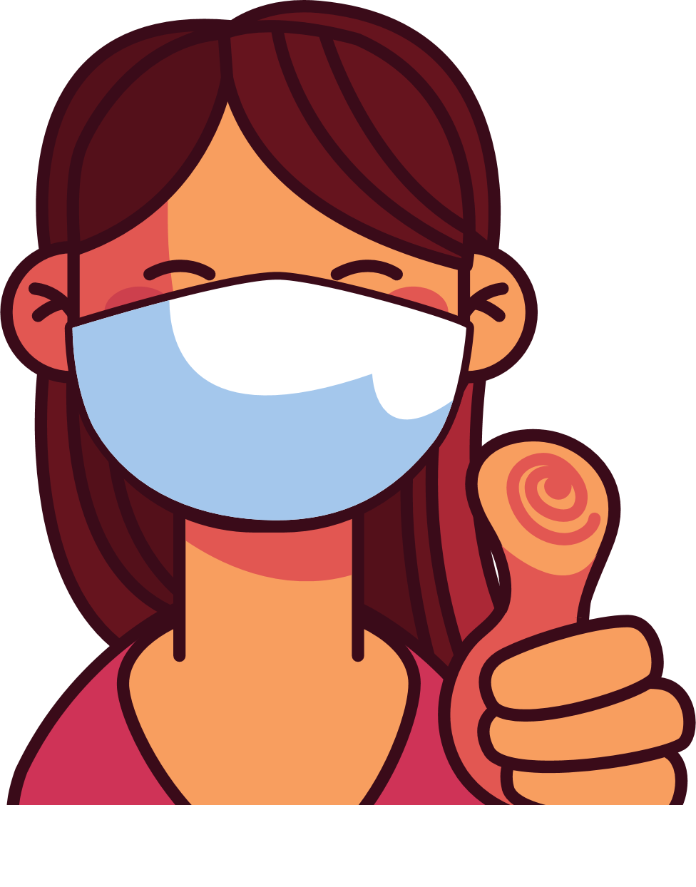
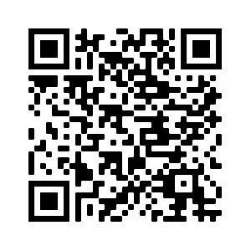
4
Address Concerns in the Community
This panel is intended to provide information addressing the concerns specific to the community receiving
the brochure.
The text boxes with the questions and answers can be edited, copied or deleted so you can customize this panel to fit your needs.
Here you can include links to relevant resources or more information addressing the community’s concerns.
KISA POU KONNEN LÈ W AP PRAN VAKSEN COVID
Kòman m ap fè konnen kilè oswa si mwen bezwen yon lòt dòz vaksen an?
Moun ki gen sistèm iminitè ki fèb yo bezwen dòz vaksen anplis.
Moun ki gen 6 an oswa plis bezwen yon rapèl bivalan omwen 2 mwa apre yo fin pran dènye vaksen yo a si yo potko pran yon rapèl bivalan.
Verifye pou w kapab gen enfòmasyon sou vaksen rapèl yo.
Avantaj Vaksinasyon an
Li enpòtan pou pran vaksen an, menm si ou te gen COVID-19.
Gen plizyè kalite vaksen. Tout vaksen kont COVID-19 yo san danje epi yo efikas.
Vaksinasyon an pwoteje w, fanmi w, ak kòlèg ou yo kont maladi grav epi pou yo pa entène lopital.
Vaksinasyon an diminye kantite nouvo ka COVID-19 ki grav epi ki tiye moun nan kominote ou a.
Vaksinasyon an pwoteje lopital ak doktè yo pou yo pa plen avèk pasyan ki malad grav avèk COVID-19.
Plis gen moun nan kominote nou an ki vaksine, mwens nou bezwen enkyete pou nouvo varyan yo.
Nan pa twò lontan nou ap kapab retounen nan aktivite nòmal nou si gen plis moun
ki vaksine.
Kisa mwen ta dwe fè si mwen te resevwa premye dòz mwen an nan yon lòt peyi epi li pa disponib Etazini?
Se pa tout peyi ki apwouve menm vaksen kont COVID-19 avèk Etazini.
Gen kèk vaksen ki pa disponib Ozetazini men yo rekonèt yo. Si Sant Kontwòl ak Prevansyon Maladi (Centers for Disease Control and Prevention, CDC) rekonèt vaksen w lan, epi w gen kat vaksen, lè konsa ou pa bezwen rekòmanse. Ou ka pran yon dòz vaksen mesaje Asid RiboNikleyik (messenger RiboNucleic Acid, mRNA) (Pfizer oswa Moderna) pou w ka fin pran vaksinen an nèt. Si w pa gen kat vaksen, ou pral bezwen rekòmanse. Chache wè yon doktè pou konnen kantite tan ki rekòmande pou pran pran dòz yo.
Tcheke pou wè si yo ofri vaksen yo gratis nan eta kote ou ye a oswa nan depatman sante lokal la oswa nan famasi lokal ou a.
Apre vaksinasyon an ou ka gen: doulè nan bra, tèt fè mal, lafyèv, oswa frison.
5
Save the file as a PDF
Once the content of the brochure has been finalized, you can save the file as a PDF for printing and distribution.
Export as a PDF using PPT:
Select slide. File → Save As Adobe PDF
Export as a PDF using Google Slides:
File → Download → PDF Document
Risk ki genyen pou moun ki pa
pran vaksen an
Ou ap santi w byen kèk jou apre ou fin pran piki a.
Yo konsidere ou ajou depi w resevwa dòz ou bezwen an (yo).
Plis risk pou kontamine ak COVID-19.
Plis risk pou gen gwo enfeksyon, entène lopital ak lanmò.
Si yon majorite moun PA PRAN VAKSEN kont COVID-19 la, alò risk pou gen maladi ki grav epi risk pou gen nouvo mitasyon ki pi kontajye ak danjere vin pi plis.
Ki kote mwen ka jwenn
plis enfòmasyon?
Vizite Sant pou Kontwòl ak Prevansyon Maladi: https://www.cdc.gov/coronavirus/2019-ncov/
Kontinye mete mask nan espas kote ki chaje moun epi lave men ou.
Ou fè pati pa w la pou pwoteje tèt ou ak lòt moun kont COVID-19 la!

