Slide 1
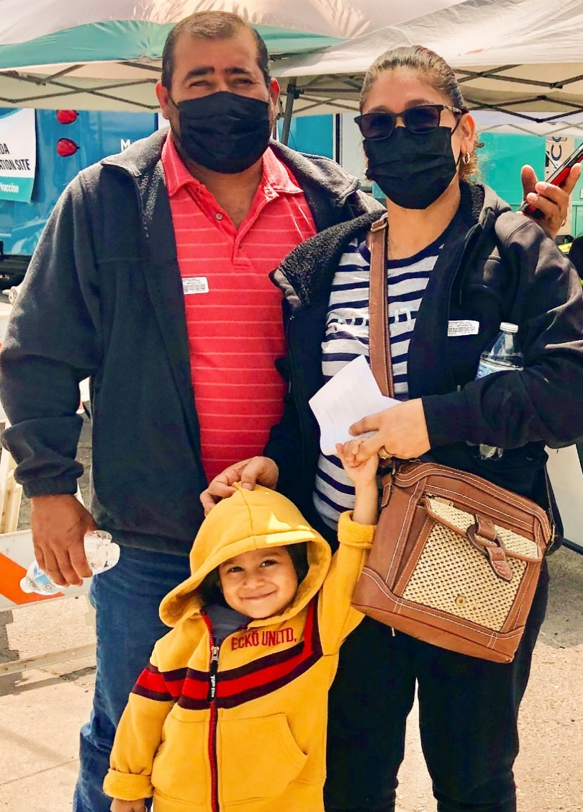





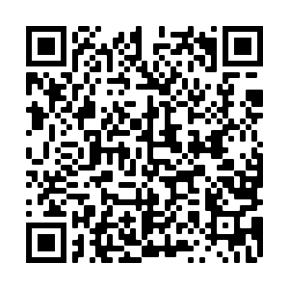
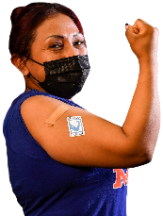
2
Include information on local vaccination efforts
Use the top portion back cover of the brochure to provide resources and links out to more information on vaccination in the area.
The text on this panel is completely editable and new text can be added by
right clicking on the border of a text box → selecting copy from the menu →
right click where you want the new text box → select Paste from the menu
1
COVID-19 VACCINES ARE SAFE AND EFFECTIVE
HOW DO I GET A
COVID-19 VACCINE?
Add an image and scale it
Go to Insert → Image → Upload from Computer and select an image of you that you’d like on the brochure cover.
To scale, grab bottom right corner of image and hold the clicker down. Drag your mouse or finger across diagonally until it’s the same size/slightly bigger than the slide.
Send your image back
Once you size your image and scale it proportionally to the size of the slide or slightly bigger, right click on the image and go to Order → Send to back
Crop your image
If the image is larger than the brochure cover, you can crop it by right clicking on the image and selecting the Crop tool that appears in the pop-up menu. You can then drag the black bars at the edges of the image to trim it to the right size. Click outside of the image to apply the changes.
Everyone ages six months and older should get an updated COVID-19 vaccine!
The vaccine is free for most people, including those without insurance.
Check to see where to access the COVID vaccine for free:
Ask about mobile clinics and health fairs
Health department
Community health center
Pharmacies near you
Speak with your employer about getting the COVID-19 vaccine. They may be helpful in making arrangements to get a vaccine.
Find vaccines: https://www.vaccines.gov/search/
People who were vaccinated before or have never been vaccinated get just one shot.
Some people get more than one shot: children six months to 5 years, immunocompromised, and people 65 and older should talk to their doctor.
RECOMMENDATIONS
Get your updated vaccine.
Get your family updated vaccines.
Pfizer or Moderna are recommended.
Wear a mask in crowded indoor or outdoor spaces, even when you are up to date on your vaccine.
If you were exposed to COVID-19, follow these steps, even if you are vaccinated:
    Wear a mask or respirator for 10 days.
    If you have symptoms: Isolate. Test immediately.
    If you don’t have symptoms: Test at least 5 full days after exposure. If you are positive, isolate!
    If you have a positive test or have symptoms, see CDC guidelines for how to isolate.
    If you get very sick, go to the doctor!
FOR MORE INFORMATION
For answers to Frequently Asked Questions, visit Migrant Clinicians Network (MCN):
https://bit.ly/3ki1xAI
Get An Updated COVID Vaccine
For women:
For women who are pregnant, breastfeeding, or trying to get pregnant, vaccines are critical for keeping moms and their babies healthy.
Updated: October 5, 2023
COVID-19 Vaccine Awareness Campaign
3
Add information on your organization and other relevant resources
The bottom portion of the back cover allows you to include organizational links, phone numbers, and other information useful to your community.
Be sure to include a date on the brochure as information
changes quickly.

Slide 2
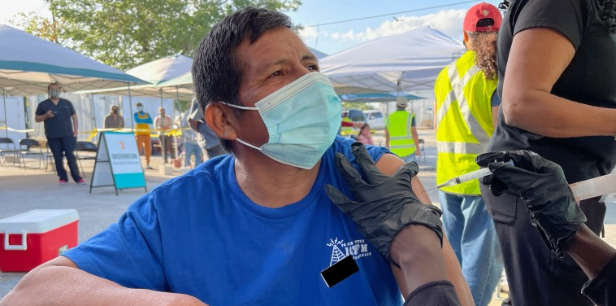

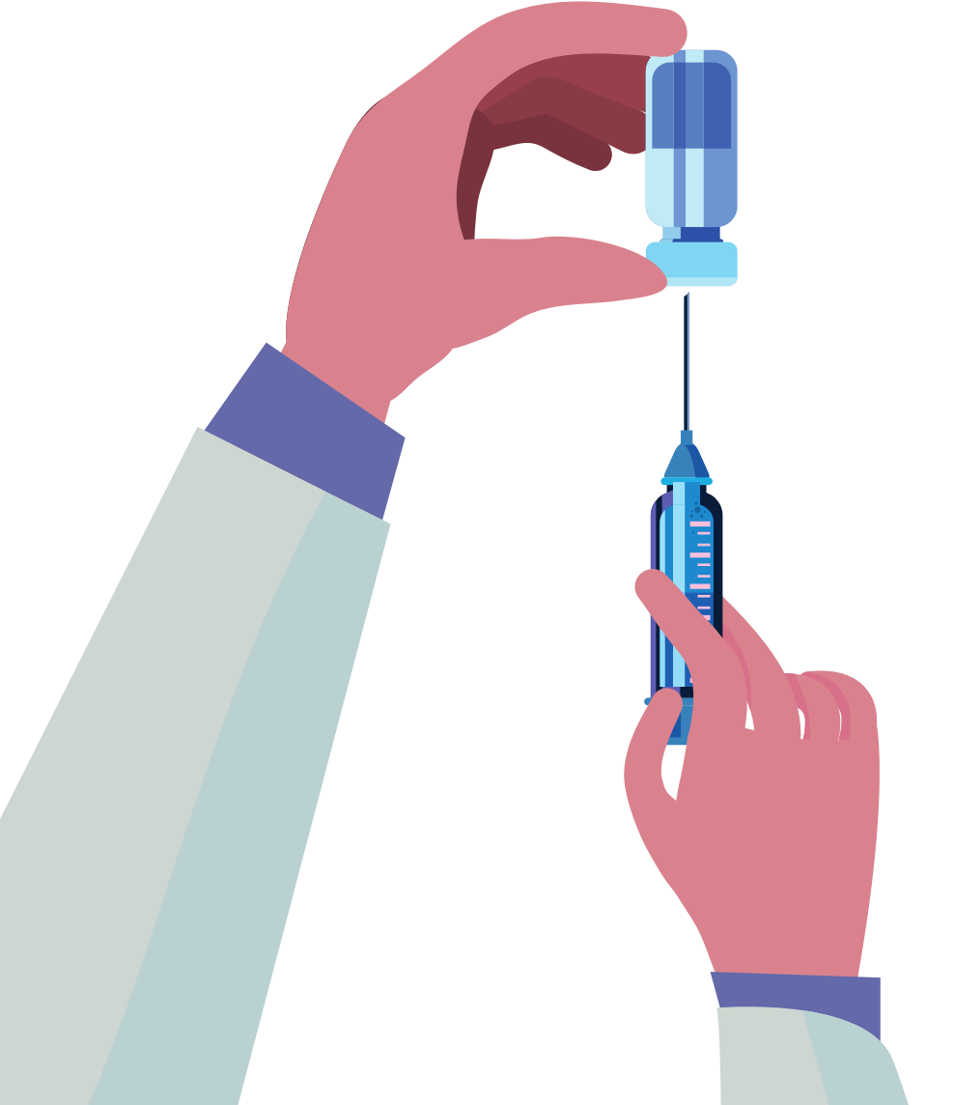
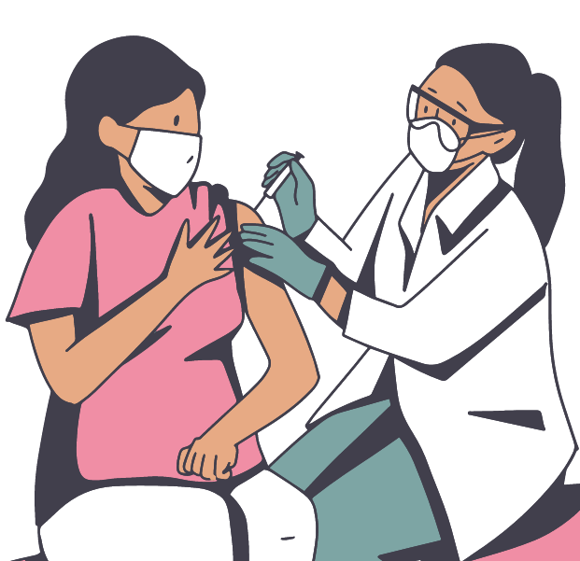
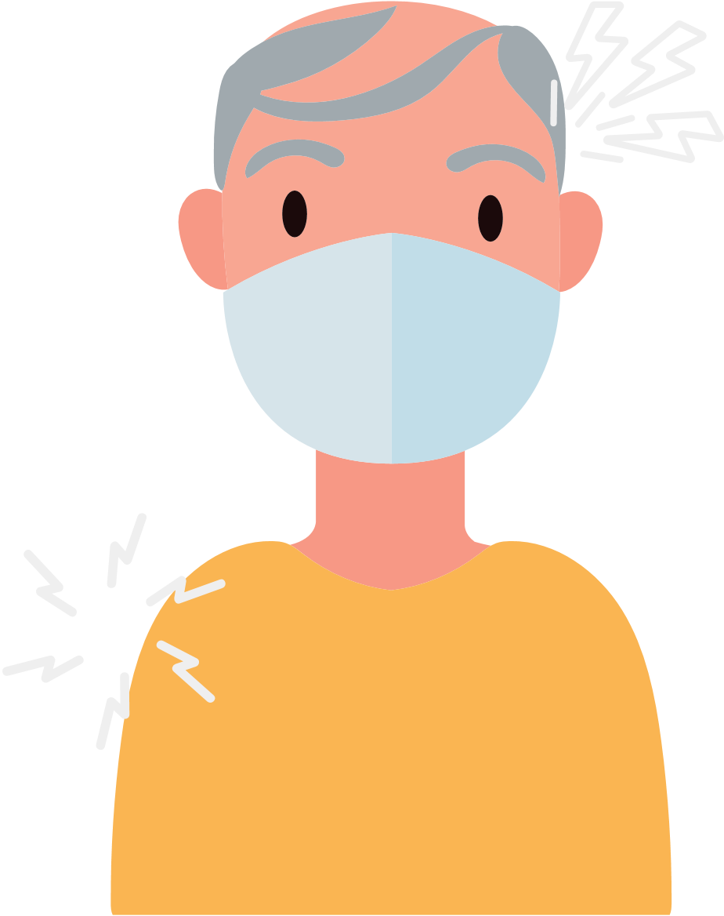

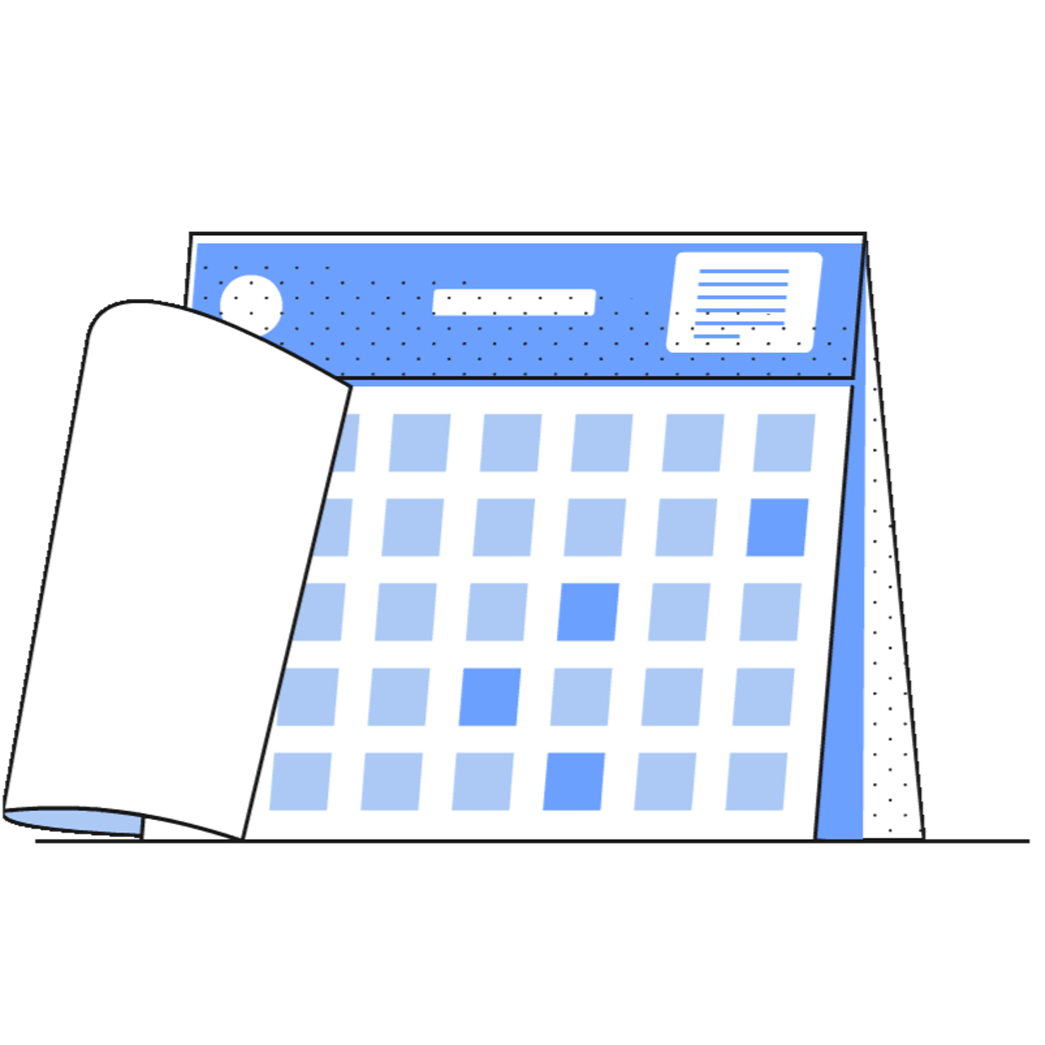
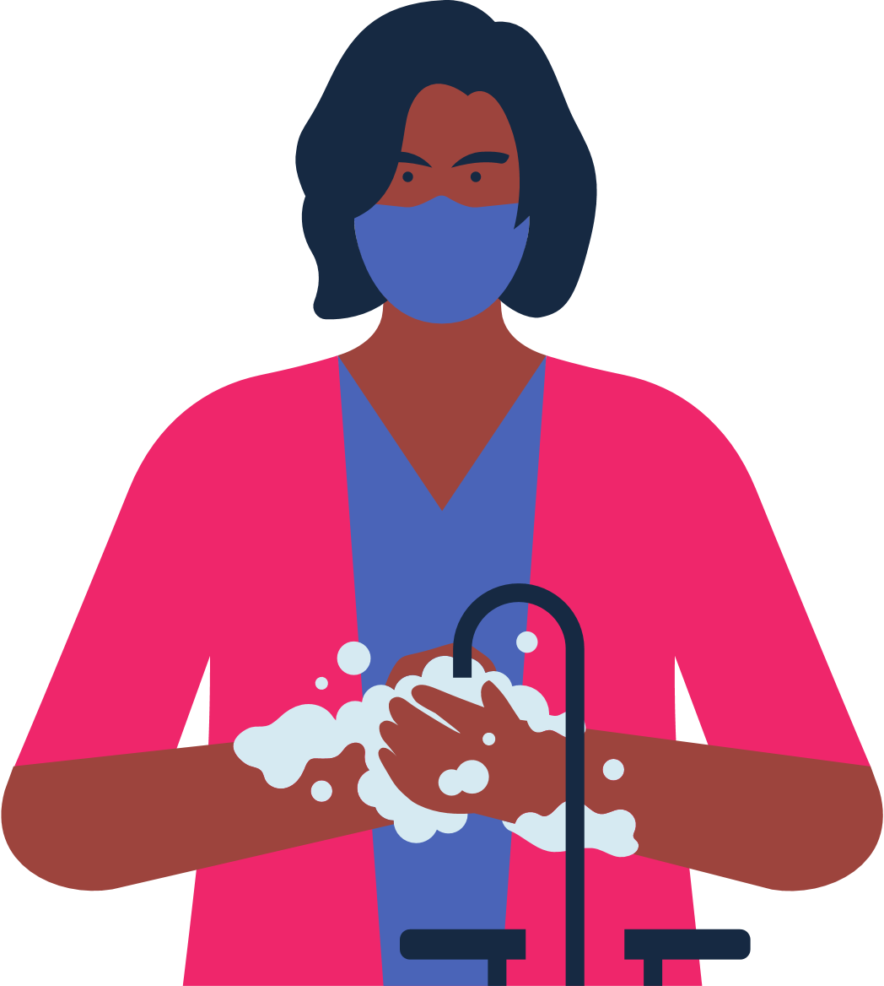
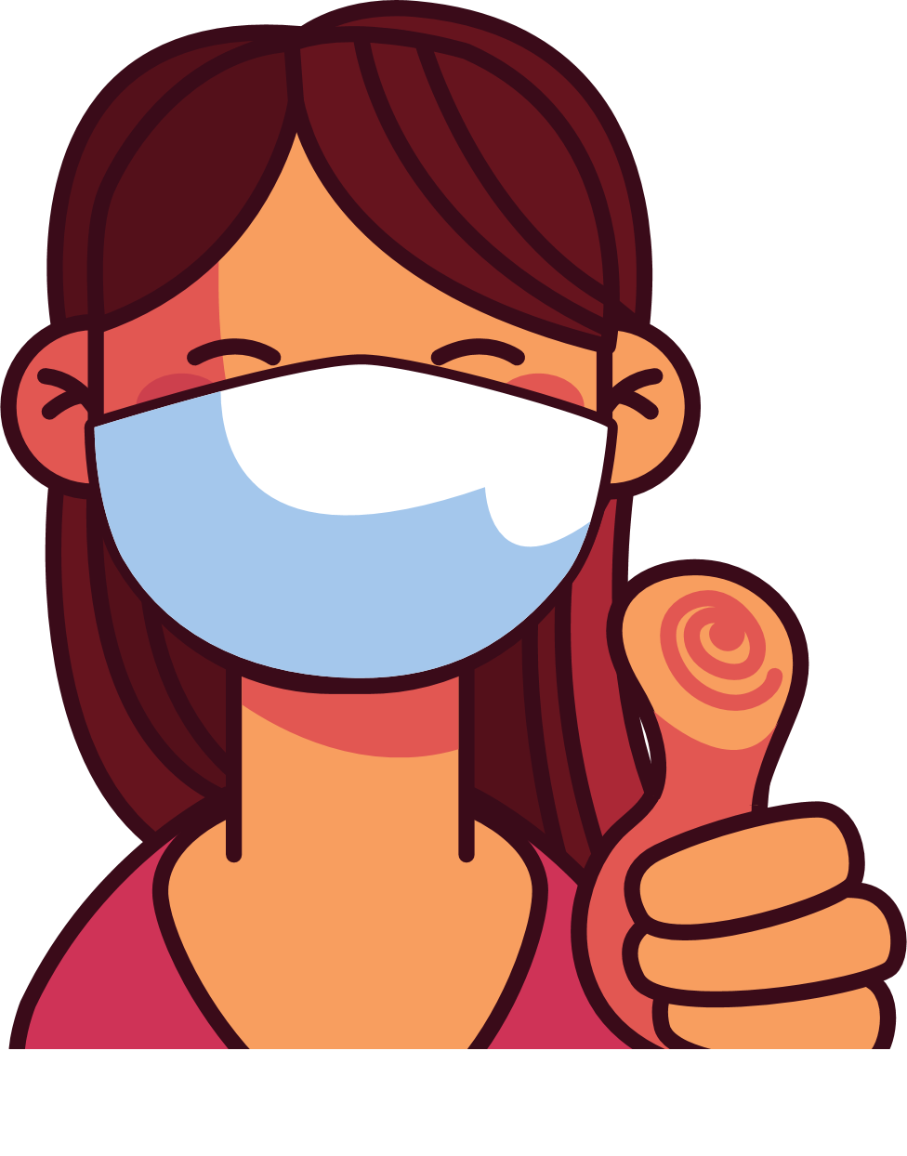

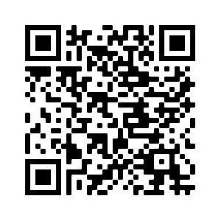
4
Address Concerns in the Community
This panel is intended to provide information addressing the concerns specific to the community receiving
the brochure.
The text boxes with the questions and answers can be edited, copied or deleted so you can customize this panel to fit your needs.
Here you can include links to relevant resources or more information addressing the community’s concerns.
WHAT TO KNOW WHEN
GETTING THE COVID VACCINE
HOW DO I KNOW WHEN OR
IF I NEED THE COVID VACCINE?
Immunocompromised individuals may need additional doses of the vaccine.
Those who are 5 years or older need an updated covid vaccine at least 2 months after completing their last vaccine if they received previous doses of the COVID vaccine.
Check for latest updates about vaccines.
BENEFITS OF VACCINATION
It is important to get vaccinated, even if you have had COVID-19.
All vaccines against COVID-19 are safe and effective.
Vaccination protects you, your family, and your co-workers from becoming seriously ill and being hospitalized.
Vaccination decreases the number of severe and deadly COVID-19 cases in
your community.
Vaccination protects hospitals and clinicians from being overwhelmed with patients severely ill with COVID-19.
The more vaccinated individuals in our community, the less we need to worry about new variants.
WHAT SHOULD I DO IF I RECEIVED DIFFERENT COVID VACCINES IN A DIFFERENT COUNTRY AND THE SAME KIND IS NOT AVAILABLE IN THE U.S?
Check where vaccines are offered for free at your state or local health department, pharmacy, or health center.
After vaccination
you may experience:
arm pain, headache, fever, or chills.
Not all countries have approved the same COVID-19 vaccines as the United States.
Some vaccines aren't available in the US but are recognized. If your vaccine is recognized by the CDC, and you have documentation of your vaccination, then you don't have to start over. You can get a shot of Pfizer or Moderna vaccine (mRNA) to become fully vaccinated. If you do not have documentation you will need to start over. Seek medical advice on the recommended timing between doses.
5
Save the file as a PDF
Once the content of the brochure has been finalized, you can save the file as a PDF for printing and distribution.
Export as a PDF using PPT:
Select slide. File → Save As Adobe PDF
Export as a PDF using Google Slides:
File → Download → PDF Document
RISKS FOR UNVACCINATED
You will feel better
a few days after
your injection.
You are considered up to date once you receive your needed dose or doses.
Higher risk of COVID-19 infection.
Higher risk of serious infection, hospitalization, and death.
If a majority of individuals DO NOT get vaccinated against COVID-19, then there is a larger risk of serious illness and risk of new mutations that are more contagious and dangerous.
WHERE DO I GET
MORE INFORMATION?
Visit Centers for Disease Control and Prevention:
https://www.cdc.gov/coronavirus/2019-ncov/
Continue to wear a mask
in crowded spaces
and wash your hands.
You did your part to protect yourself and others from COVID-19!

