Slide 1






2
Include information on local vaccination efforts
Use the top portion back cover of the brochure to provide resources and links out to more information on vaccination in the area.
The text on this panel is completely editable and new text can be added by
right clicking on the border of a text box → selecting copy from the menu →
right click where you want the new text box → select Paste from the menu
1
VAKSEN KONT COVID-19 YO SAN DANJE EPI YO EFIKAS
Kòman mwen kapab jwenn Vaksen kont COVID-19?
Add an image and scale it
Go to Insert → Image → Upload from Computer and select an image of you that you’d like on the brochure cover.
To scale, grab bottom right corner of image and hold the clicker down. Drag your mouse or finger across diagonally until it’s the same size/slightly bigger than the slide.
Send your image back
Once you size your image and scale it proportionally to the size of the slide or slightly bigger, right click on the image and go to Order → Send to back
Crop your image
If the image is larger than the brochure cover, you can crop it by right clicking on the image and selecting the Crop tool that appears in the pop-up menu. You can then drag the black bars at the edges of the image to trim it to the right size. Click outside of the image to apply the changes.
Tout moun ki gen 6 mwa ou plis dwe pran yon dòz vaksen ajou pou COVID-19!
Moun ki ajou ak vaksen yo jis pran yon sèl dòz vaksen COVID-19 Pfizer, Moderna oswa Novavax.
Kèk moun resevwa plis pase yon sèl dòz: timoun si mwa rive 5 lane, sila yo ki gen 12 lane ou plis ki pa t ajou ak vaksen yo, moun ki gen sistèm iminitè fèb yo, epi moun ki gen 65 lane oswa plis ta dwe pale ak doktè yo.
Vaksen an gratis pou pifò moun, menm pou moun ki pa gen asirans.
Tcheke pou w wè ki bò w ka jwenn vaksen COVID gratis:
Mande si pa genyen klinik mobil ak ekspozisyon sou sante
Depatman sante
Sant Sante Kominotè
Famasi bò lakay ou
Pale avèk patwon w lan sou fason ou kapab jwenn vaksen kont KOVID-19 la. Yo ka ede w nan aranjman w ap fè pou jwenn yon vaksen.
Jwenn vaksen: https://www.vaccines.gov/search/
Rekòmandasyon
Pran vaksen ajou w l a(yo).
Fè fanmi ou pran dènye dòz vaksen yo.
Nou pa an 2020 ankò – men COVID toujou ap fè moun malad grav epi nou dwe pran mezi pou nou ka alabri ak pou nou pa gaye li!
Si ou tonbe malad:
  Li rekòmande pou fè tès men li pa obligatwa.
  Rete lakay ou epi evite lòt moun. jiskaske ou pa gen lafyèv pandan 24 èdtan epi lè ou kòmanse retabli.
  Apre sa, mete yon mask oswa yon respiratè pandan 5 jou apre ou fin pase 24 èdtan san fyèv.
  Gade direktiv CDC yo pou plis enfòmasyon.
Pou w jwenn plis enfòmasyon
Pwoteje Tèt ou Kont COVID-19
Vizite Sant Kontwòl Maladi yo ak Pwevansyon:
https://www.cdc.gov/coronavirus/2019-ncov/
Pou Repons ak Keksyon yo poze souvan, vizite Migrant Clinicians Network:
https://bit.ly/3ki1xAI
Pran yon Vaksen kont KOVID ki ajou
Pou fi yo:
Pou fi ki ansent, ki ap bay tete, oswa ki ap eseye ansent, vaksen yo enpòtan anpil pou kenbe manman ak ti bebe yo an sante.
Mizajou: 5 Out 2024
Kanpay Sansibilizasyon pou Vaksen
kont COVID-19
3
Add information on your organization and other relevant resources
The bottom portion of the back cover allows you to include organizational links, phone numbers, and other information useful to your community.
Be sure to include a date on the brochure as information
changes quickly.

Slide 2
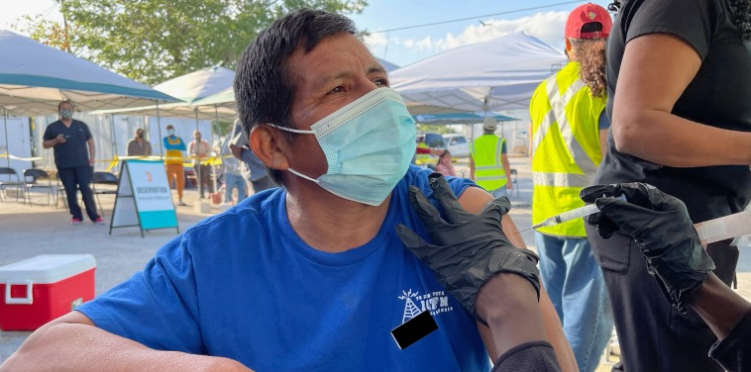

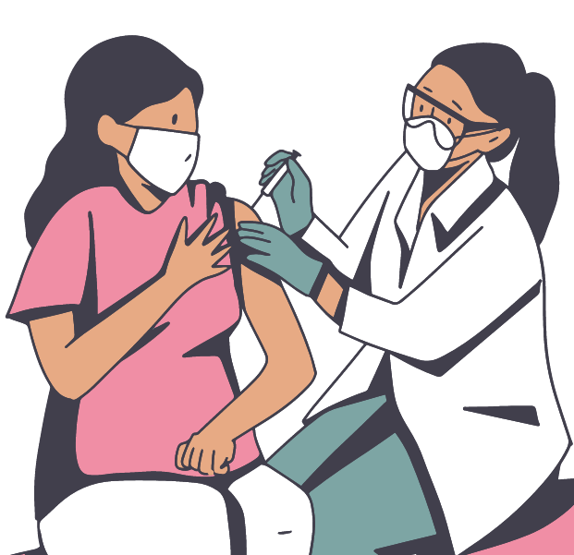

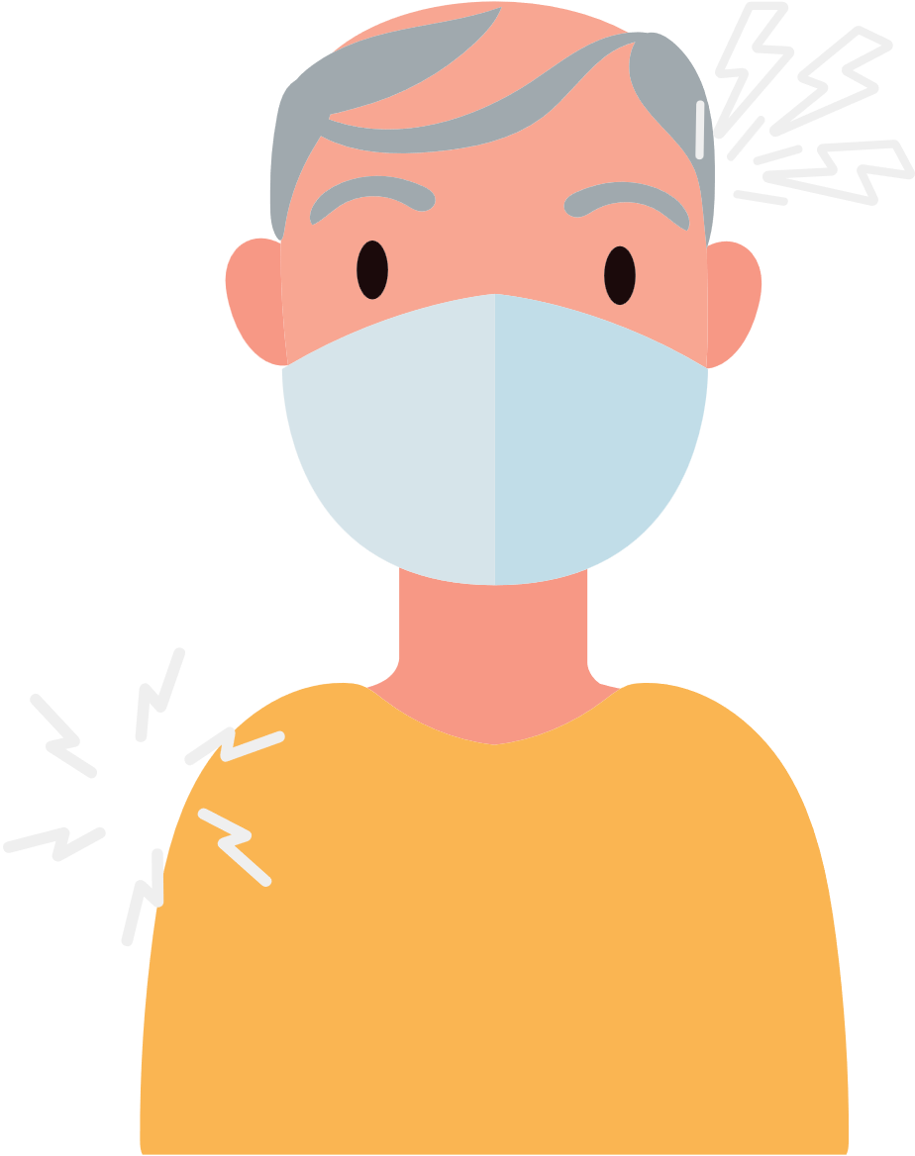



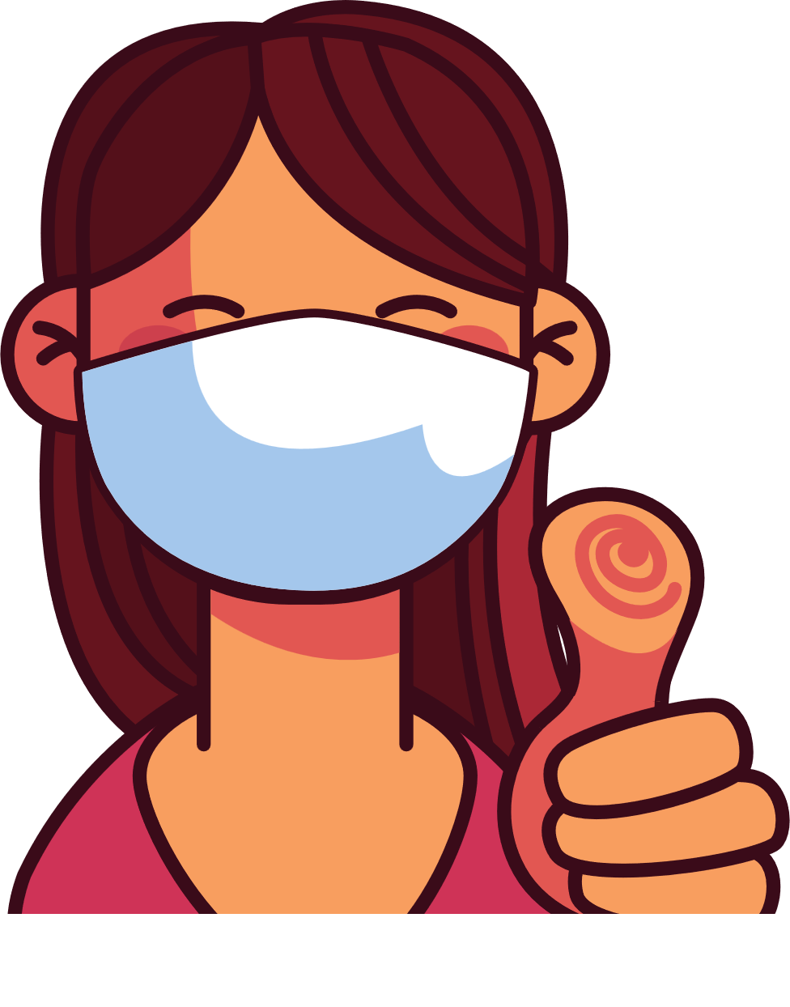
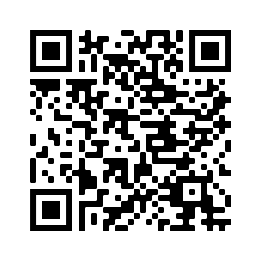
4
Address Concerns in the Community
This panel is intended to provide information addressing the concerns specific to the community receiving
the brochure.
The text boxes with the questions and answers can be edited, copied or deleted so you can customize this panel to fit your needs.
Here you can include links to relevant resources or more information addressing the community’s concerns.
KISA POU KONNEN LÈ W AP PRAN VAKSEN COVID
Kòman m ap fè konnen kilè oswa si mwen bezwen yon lòt vaksen an?
Moun ki gen sistèm iminitè ki fèb yo bezwen dòz vaksen anplis.
Si w pako vaksinen, mande pwofesyonèl swen sante ou a kèk rekòmandasyon sou dòz yo.
Chèche jwenn dènye enfòmasyon sou vaksen yo.
Avantaj vaksinasyon an
Li enpòtan pou pran vaksen an, menm si ou te gen COVID-19.
Chèche konnen ki kote ki ofri vaksen gratis nan eta w la oswa depatman sante, famasi oswa sant sante nan zòn pa w la.
Vaksinasyon an pwoteje w, fanmi w, ak kòlèg ou yo kont maladi grav epi pou yo pa entène lopital.
Vaksinasyon an diminye kantite nouvo ka COVID-19 ki grav epi ki tiye moun nan kominote ou a.
Vaksinasyon an pwoteje lopital ak doktè yo pou yo pa plen avèk pasyan ki malad grav avèk COVID-19.
Plis gen moun nan kominote nou an ki vaksine, mwens nou bezwen enkyete pou nouvo varyan yo.
Nan pa twò lontan nou ap kapab retounen nan aktivite nòmal nou si gen plis moun ki vaksine.
Kisa Mwen Ta Dwe Fè Si Mwen Te Resevwa Vaksen Kont Kovid Nan Yon Peyi Diferan Epi Li Pa Disponib Nan Peyi Etazini?
Se pa tout peyi ki apwouve menm vaksen kont COVID-19 avèk Etazini.
Gen kèk vaksen ki pa disponib Ozetazini men yo rekonèt yo. Si Sant Kontwòl ak Prevansyon Maladi (Centers for Disease Control and Prevention, CDC) rekonèt vaksen w lan, epi w gen kat vaksen, lè konsa ou pa bezwen rekòmanse. Ou ka pran vaksen ajou w la (yo) pou w ka vaksinen konplètman. Si w pa gen kat vaksen, ou pral oblije rekòmanse. Chache wè yon doktè pou konnen kantite tan ki rekòmande pou pran pran dòz yo.
Tout vaksen kont KOVID-19 yo san danje epi yo efikas.
Apre vaksinasyon an ou ka gen: doulè nan bra, tèt fè mal, lafyèv, oswa frison.
5
Save the file as a PDF
Once the content of the brochure has been finalized, you can save the file as a PDF for printing and distribution.
Export as a PDF using PPT:
Select slide. File → Save As Adobe PDF
Export as a PDF using Google Slides:
File → Download → PDF Document
Risk ki genyen pou moun ki pa
pran vaksen an
Ou ap santi w byen kèk jou apre ou fin pran piki a.
Yo konsidere ou ajou depi w resevwa dòz ou bezwen an (yo).
Ki kote mwen ka jwenn
plis enfòmasyon?
Plis risk pou kontamine ak COVID-19.
Plis risk pou gen gwo enfeksyon, entène lopital ak lanmò.
Si yon majorite moun PA PRAN VAKSEN kont COVID-19 la, alò risk pou gen maladi ki grav epi risk pou gen nouvo mitasyon ki pi kontajye ak danjere vin pi plis.
Vizite Sant pou Kontwòl ak Prevansyon Maladi: https://www.cdc.gov/coronavirus/2019-ncov/
Lave men w epi pran mezi pou w pa gaye COVID-19.
Ou fè pati pa w la pou pwoteje tèt ou ak lòt moun kont COVID-19 la!

