Slide 1
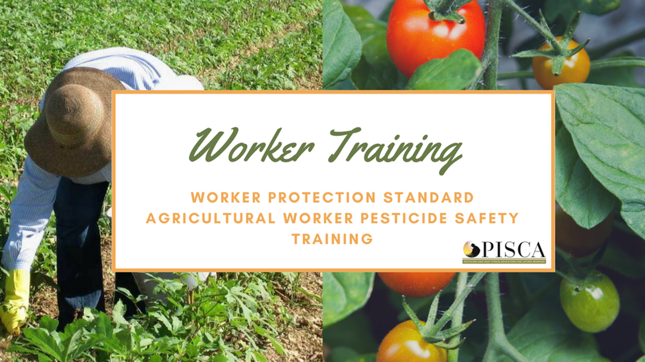
EPA WPS Worker PST 00036
Notes:
Introduce yourself and the presentation briefly.
Trainer: Welcome to our training about pesticide safety. We’re going to start with an icebreaker to get us thinking about pesticides.

Slide 2
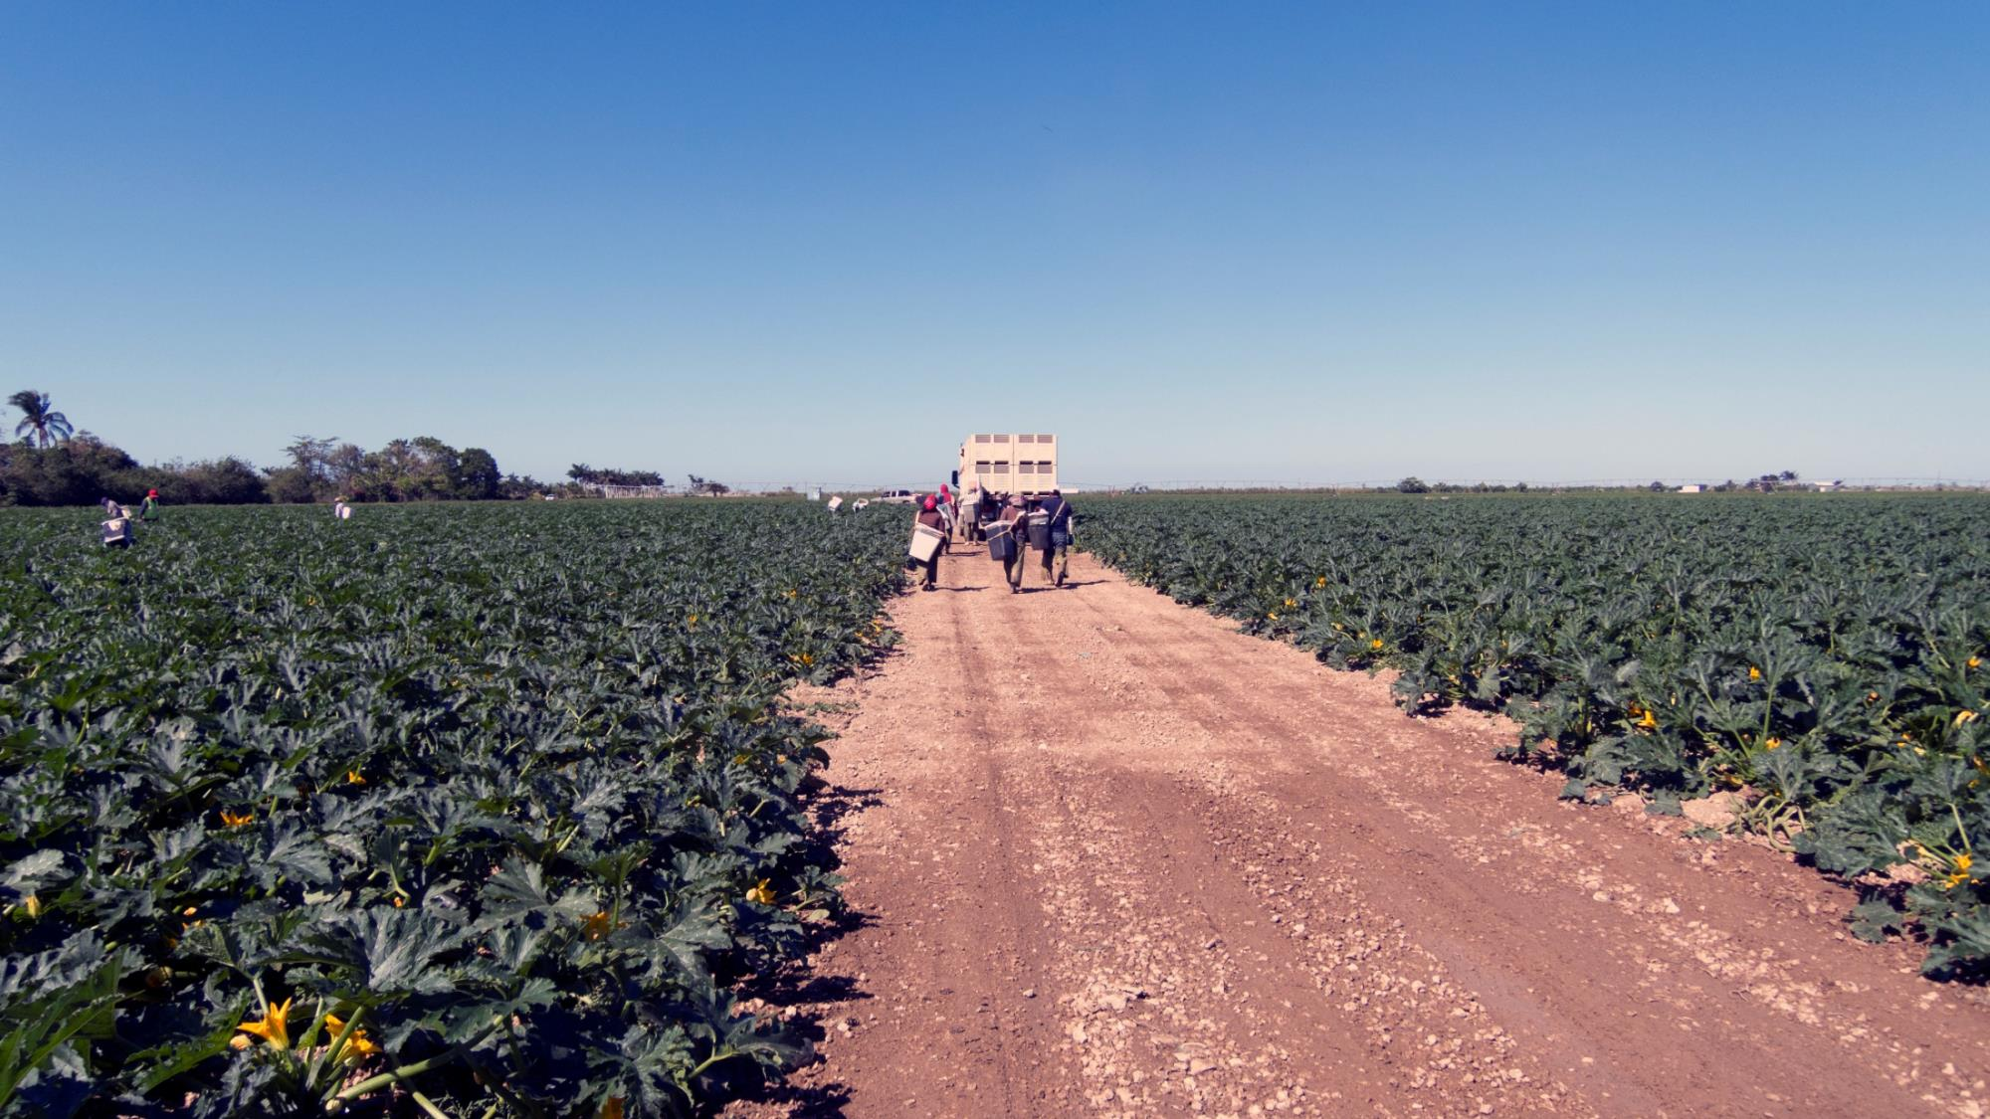
[Icebreaker]
EPA has approved this material to fully train workers on pesticide safety in accordance with the 2015 WPS (40 CFR 170). The approval number is EPA WPS Worker PST 00036.
Notes:
Start the icebreaker activity.
Option 1 (Guessing Game)
Prepare three cards with a picture. (Note: You can use any fun and easy picture like a soccer game or a party. One of the cards should have an image of pesticides and the word “pesticides” written on the card.)
Ask for three volunteer. Show one picture to each volunteer and the volunteer to act out or describe it.
Show the image of the pesticide last. After the volunteer is done, explain that you will talk about pesticide in today’s training.
Option 2 (Introduction Activity)
Ask participants to share their name and their favorite good.

Slide 3
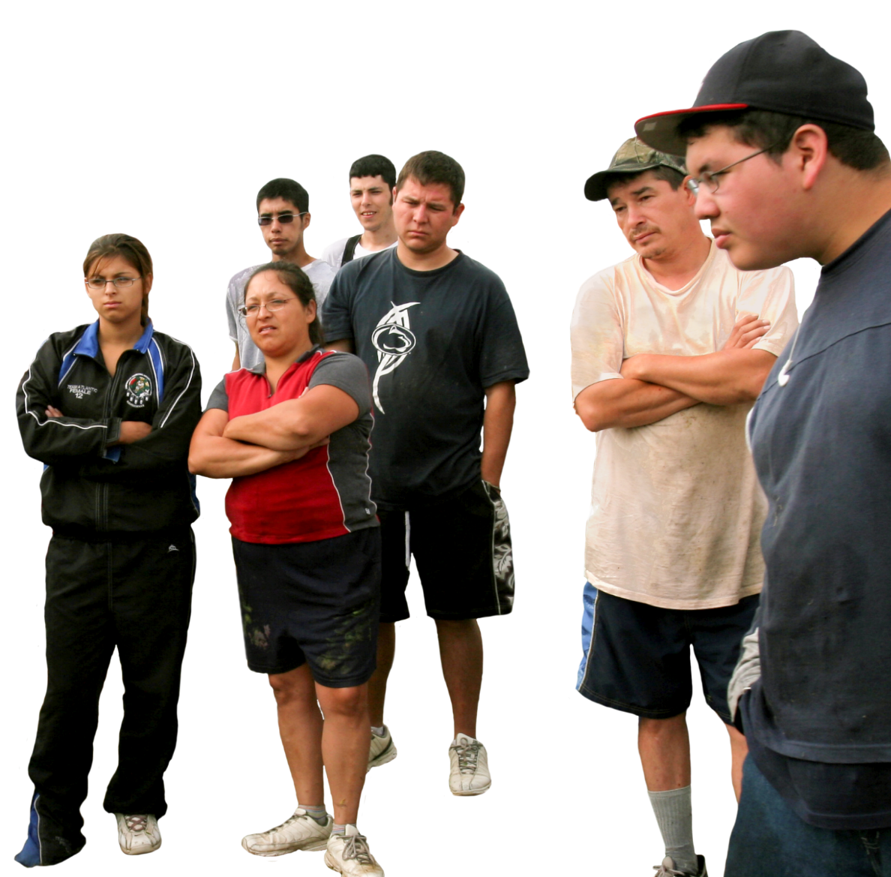
Why are we taking this training?
foto ©www.earldotter.com
Notes:
Ask the question on the slide: Why are taking this training? Allow participants to answer the question.
Explain the Worker Protection Standard and point out that handlers need additional trainings.
Trainer: Now, why are you taking this training? The Worker Protection Standard or WPS is a rule that is part of a federal law. The WPS was designed to reduce the risks of illness or injury for workers who work with pesticides. Following the recommendations of this training can reduce the exposures to pesticides among agricultural workers. This includes workers like you who are paid to work in the fields, in groves, in orchards, in groves, in nurseries, and packing houses. Your employer has to provide this training every year. This training we are doing today is for regular farmworkers. If any of you apply or mix pesticides, you will receive additional training to be able to do that kind of work.
Sometimes if we’ve been working on farms when we talk about pesticides it can make us worried and sometimes it scares us. This training is about understanding how to work safely around pesticides so that we can protect ourselves and our families.

Slide 4

Worker Protection Standard (WPS)
Notes:
Explain the three main areas of WPS.
Trainer: The Worker Protection Standard is focused on three main areas: Information, protection, and action.
Information:
Employers must provide you with information about pesticides and workers protections through pesticide safety trainings like this one every year. They must provide information about what pesticides are being applied and when it is safe for workers to enter fields treated with pesticides. They also must have information accessible about the type of pesticides being used.
Protection:
Employers must provide different resources including warning signs and or oral notifications and keep workers and other people away from pesticide treated areas during and after applications.
Action:
In case you have an accident, for example, where pesticides get on your body, employers must be prepared to act when a worker has been exposed to pesticides. In case something like this happens, they have to provide materials for emergency washing and decontaminating and provide emergency transportation to a clinic or hospital, if necessary.

Slide 5
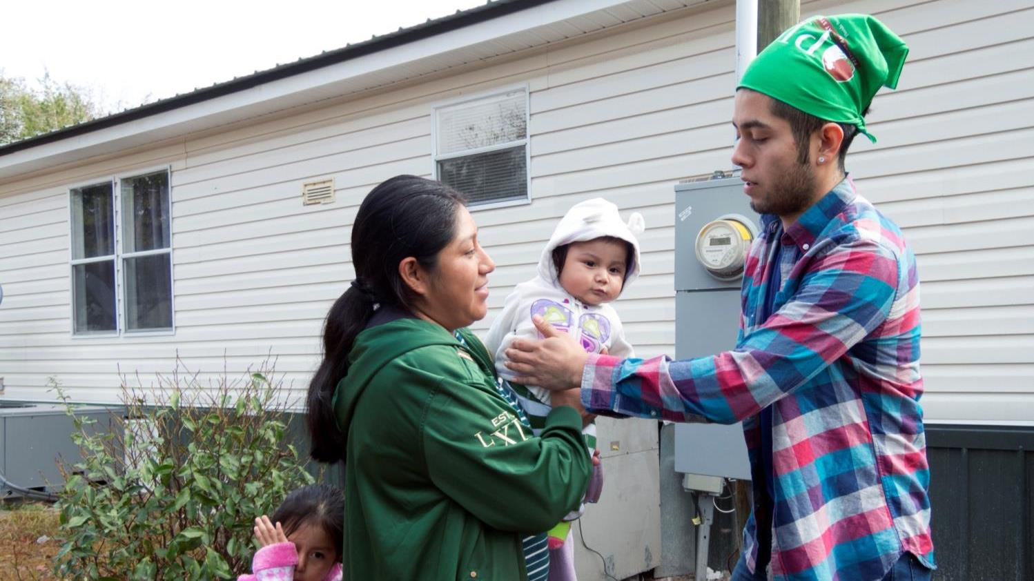
Protect yourself and your family
Notes:
Tell participants the objectives of this training
Trainer: Okay. Now let's talk about how to protect yourself and your family. In this training:
You will receive information about the possible risks of exposure to pesticides in your workplace.
You will be shown the steps you can take to protect yourself, protect your family or anyone else from exposure to pesticides.
In addition, you will also learn the steps to follow in the event that you or anyone else is affected by pesticides.
You will learn the employer's responsibilities to your workers when they work in areas where pesticides are used.
In addition, you will receive information about your rights as a worker.

Slide 6
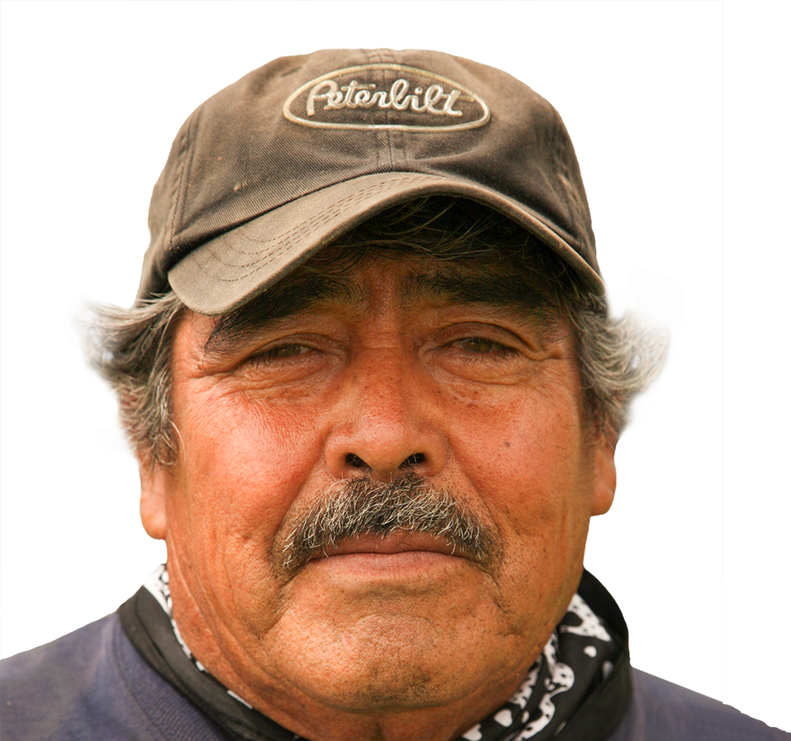
What are Pesticides?
foto ©www.earldotter.com
Notes:
Ask the question on the slide. Allow participants to answer the question and write responses on a flip chart.
Trainer: You already named several pesticides. Now let's review.
A pesticide is a substance used to protect plants and control pests such as insects, weeds, fungi and diseases caused by fungi and rodenticides

Slide 7
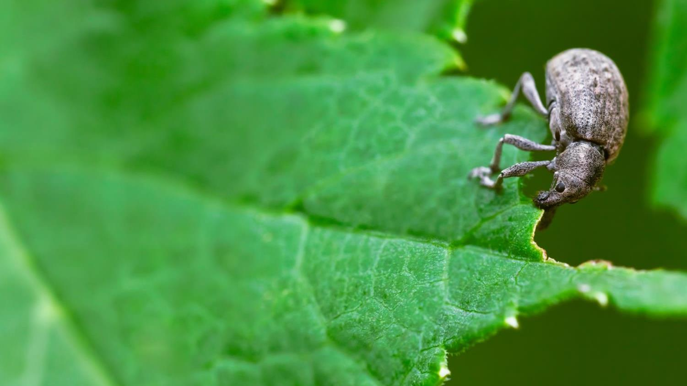
Insecticides
Notes:
Trainer: Let’s review the he types of pesticides most commonly used in agriculture Insecticides are used to kill insects.

Slide 8
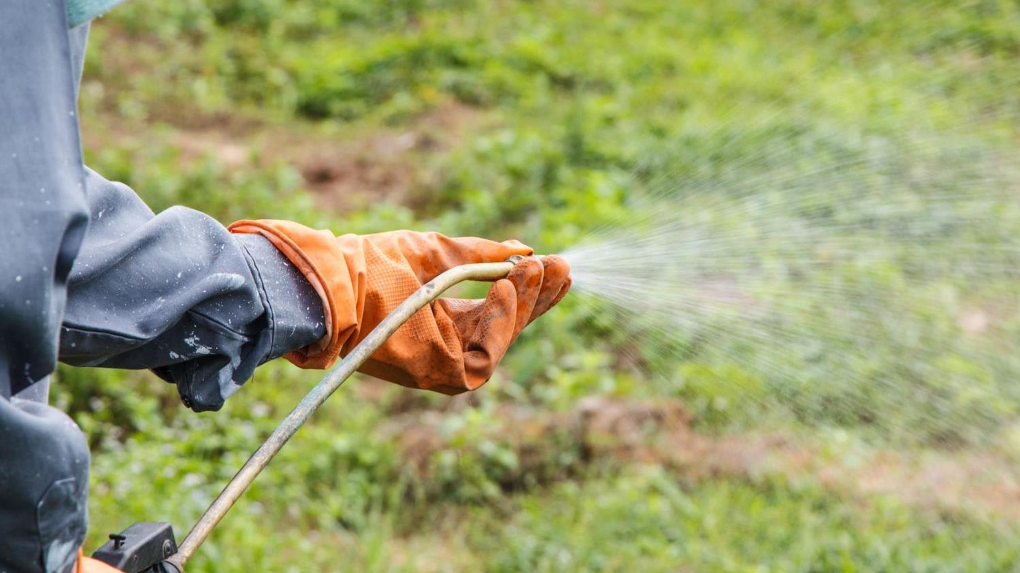
Herbicides
Notes:
Trainer: Herbicides are used to kill grass or weeds.

Slide 9
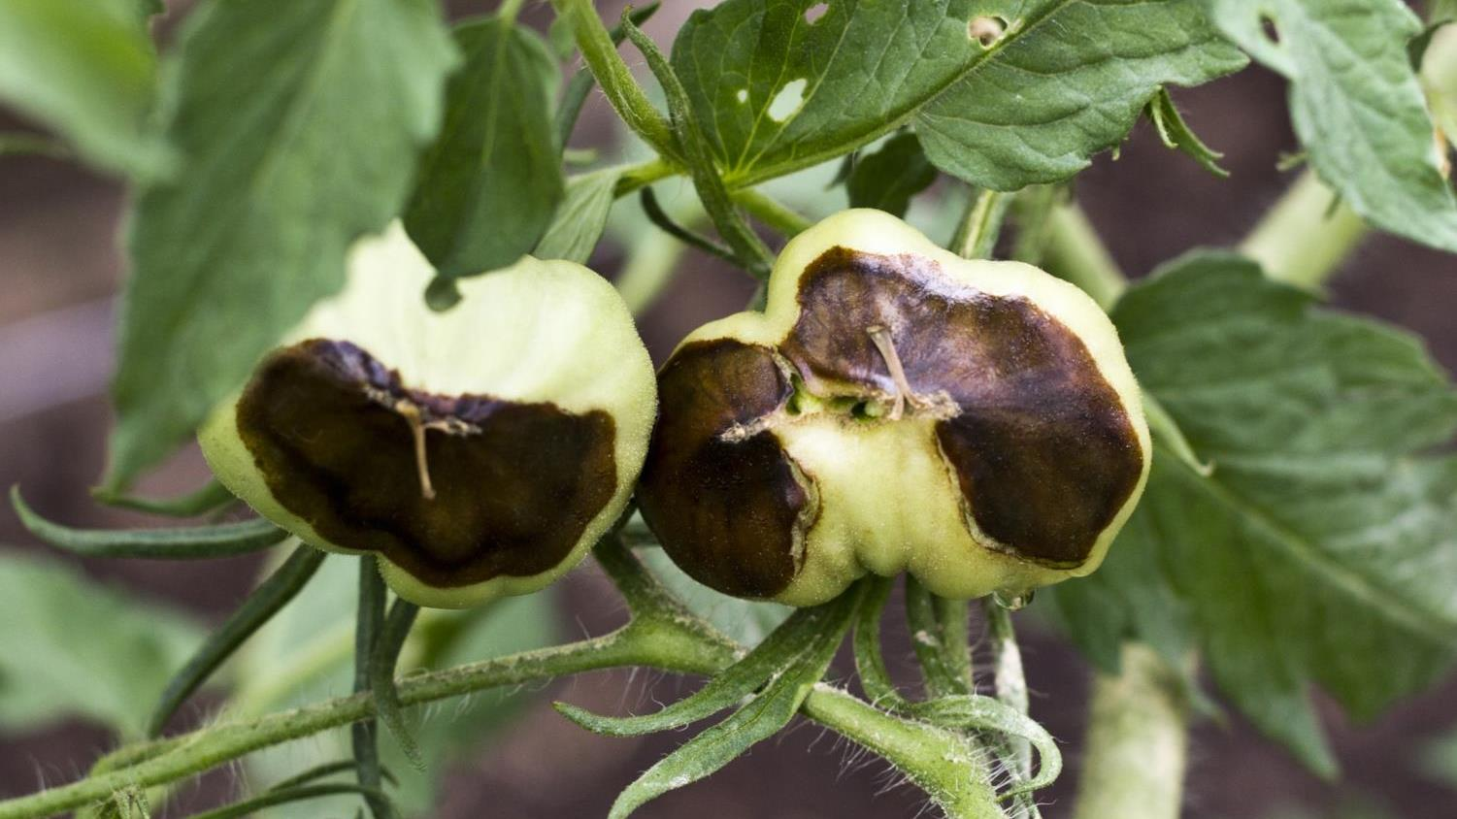
Fungicides
Notes:
Trainer: Fungicides are those that are used to kill fungi or diseases caused by fungi.

Slide 10
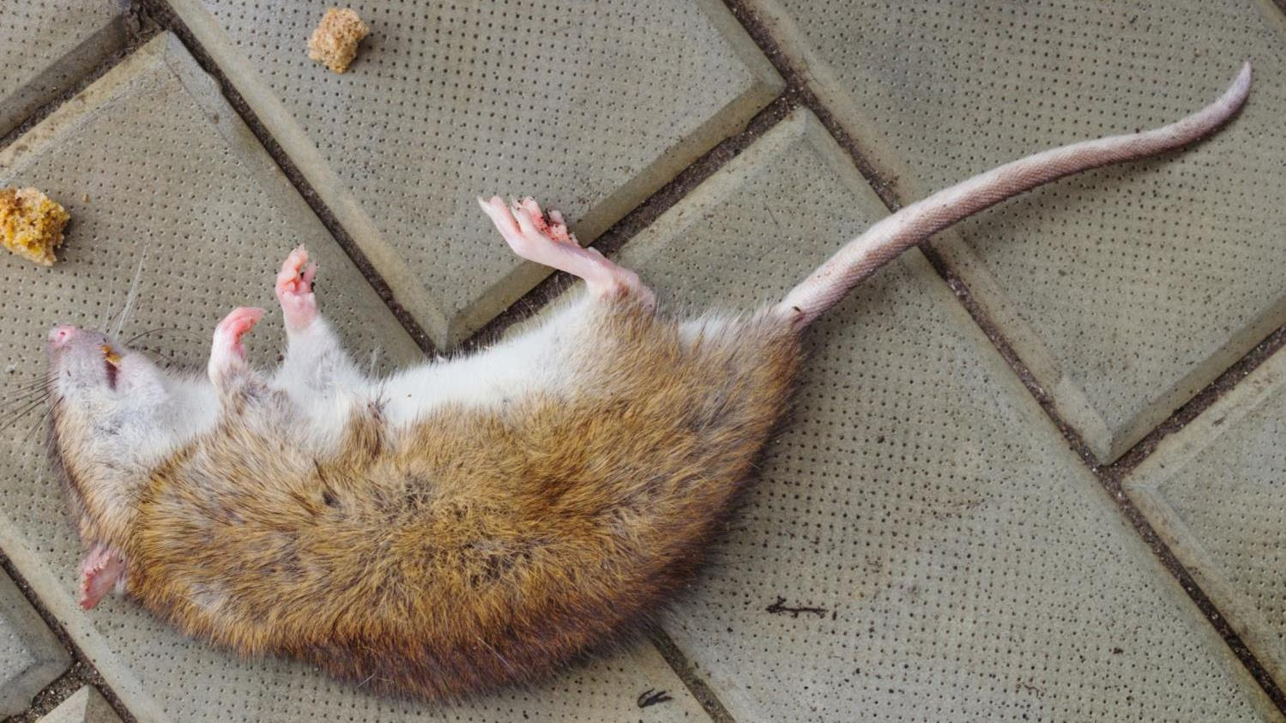
Rodenticides
Notes:
Trainer: Rodenticides are used to kill rodents like mice and rats.

Slide 11

Where can pesticides be found?
©www.earldotter.com
Notes:
Ask the question on the slide. Allow participants to answer the question and write responses on a flip chart.
Trainer: So, my question for you is: Where can we find pesticides? Can you tell me some places where pesticides are found?
You told me some places. There are many places where we can find pesticides. In the next pictures we will talk about the places where we can find them.

Slide 12
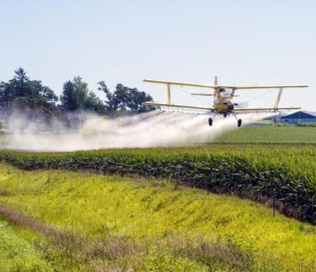
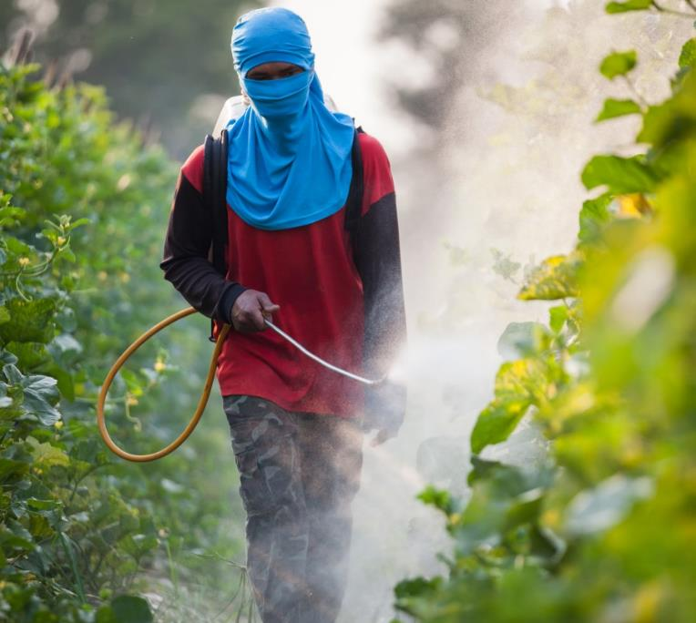
Drift
Notes:
Discuss the ways that workers can get pesticides exposure. (Slides 12-14)
Trainer: You can get exposed to pesticides through drift. Pesticides can drift or be carried by the wind from the place where it is applied to other places, away from the area that is being targeted. Sometimes it can drift on people.

Slide 13
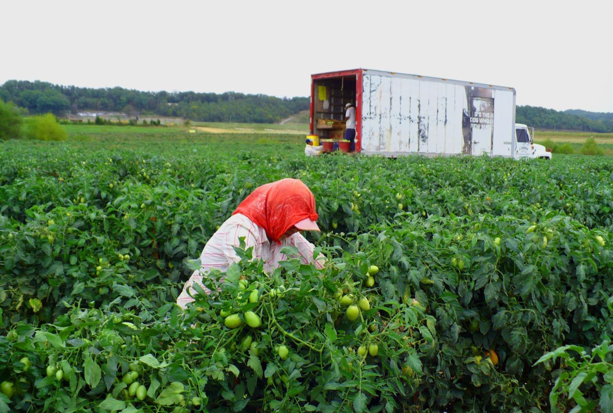
Treated plants, vegetables, fruits and soil
Notes:
Trainer: Another way you can be exposed to pesticides is when you are working in the field and you come in contact with the plants, fruits, vegetables and soil that has been treated with pesticides. Although you do not see them, the plants and fruits have pesticide residues and the residue can stick to your body and your clothes.

Slide 14
Irrigation water and chemigation equipment
Pesticide containers
Pesticide application equipment
Pesticide mixing and loading areas
Notes:
Trainer:
Other sources of exposure to pesticides include:
Irrigation water and chemigation equipment.
Pesticide containers (do not take empty pesticide containers to your home)
Personal Protective Equipment (PPE)
Equipment used to apply pesticides, including tractors
Areas where pesticides are loaded or mixed
Remember if you see irrigation water, it may has pesticides in it. Stay away from it. Don’t drink it.

Slide 15
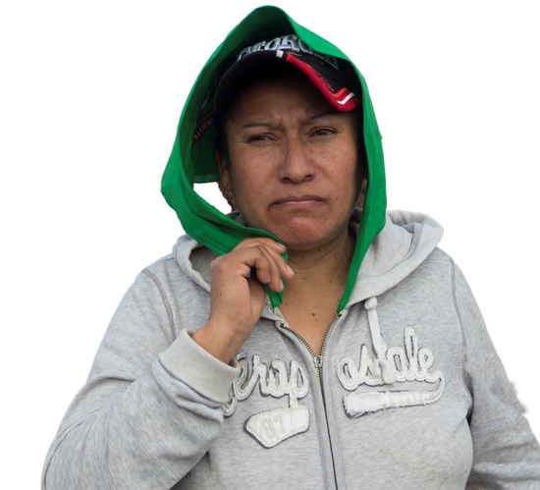
How do pesticides get into my body?
Notes:
Ask the question on the slide and write responses on a flip chart.
Trainer: Do you know anyone who has been harmed or made sick by using chemicals at work? What happened? Why do you think the worker was harmed?

Slide 16

How pesticides get in your body…
Nose
Skin and Eyes
Mouth
Notes:
Explain the ways that pesticides get into our body and point out that different ways have different level of impact on our body.
Trainer: Each one of you told us about the different ways pesticides get in our bodies. Let's summarize because how pesticides enter your body is an important factor that determines how much damage this can cause. Pesticides enter your body through your mouth, your skin and eyes and through your nose, when you breathe again makes a difference how it enters your body. For example, if you drink a spoonful of chlorine it is more harmful than if that spoonful of chlorine falls on your skin.
The most common way pesticides enter the body of workers in the field is through the skin, including the eyes. Sometimes, you cannot see or feel that a chemical is entering your body through the skin. For certain chemicals, your skin is like a sponge. For example, think about putting lotion on your hands and rubbing it in. The cream disappears because it is entering our body through our skin.
Optional Activity: Ask for a volunteer or two to apply hand cream or hand sanitizer on their hands and rub it in.
One thing that is important to know is that pesticides also enter your body through the genitals.
There are many ways that you can protect yourself from pesticides and we will talk more about that in a minute. But washing your hands is one way to protect yourself. So if you go to the bathroom, you need to wash your hands before you to go to prevent pesticides from entering your body.

Slide 17



Dose-time relationship
Notes:
Use does-time relationship to explain the effect of being exposed to pesticides can also depend on the amount of time and the amount of pesticide you are using.
Trainer: The effect of being exposed to pesticides can also depend on the amount of time you are exposed to a pesticide and the amount or the dose of pesticide you are using. Let’s think about beer. What happens when you slowly drink one beer over the course of one hour? What happens if you drink three beers in one hour? What happens if you drink six beers in an hour? The effect of the beer will differ depending on the amount you drink. But time makes a difference too. Drinking three beers in 15 minutes is going to affect you differently than if you drink three beers in three hours. Drinking a lot of beer in a short period of time means your body can’t get rid of the chemical as needed.

Slide 18
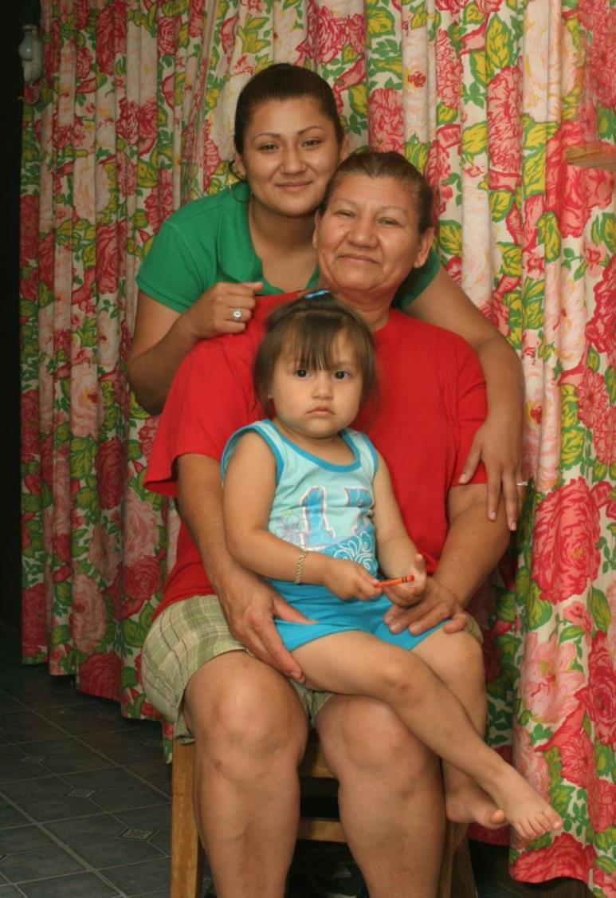
  Other factors that impact how pesticides may harm you
Type of pesticde
Sensitivity
Gender
Age
Health condition
Body size
Photo © earldotter.com
Notes:
Discuss the other factors that impact how pesticides harm a person.
Trainer: Other factors that impact the way pesticides can harm a person:
The type of pesticides: There are some pesticides that are more toxic than others. And of course, the more toxic pesticide causes more damage than one that is less toxic.
Sensitivity to pesticides: There are some people who are more sensitive than others to pesticides. Repeated exposure to a pesticide may cause some people to become sensitive to the pesticide and have a bad reaction, similar to that of an allergic reaction.
The sex of the person: Women and men do not process chemicals in the same way, and this will determine how pesticides will affect them.
Age: Children are affected much differently than adults because their body is smaller. Even if an adult and child are exposed to the same amount of a pesticide, it is going to have a greater effect on the child.
The health of the person: Sick people are also affected much more than a healthy person.
The size of the person: Just like with the child, a person who weighs less could be affected more than a heavier person.
exposed. You can also become sensitize to pesticide overtime or after suffering of pesticide exposure.

Slide 19
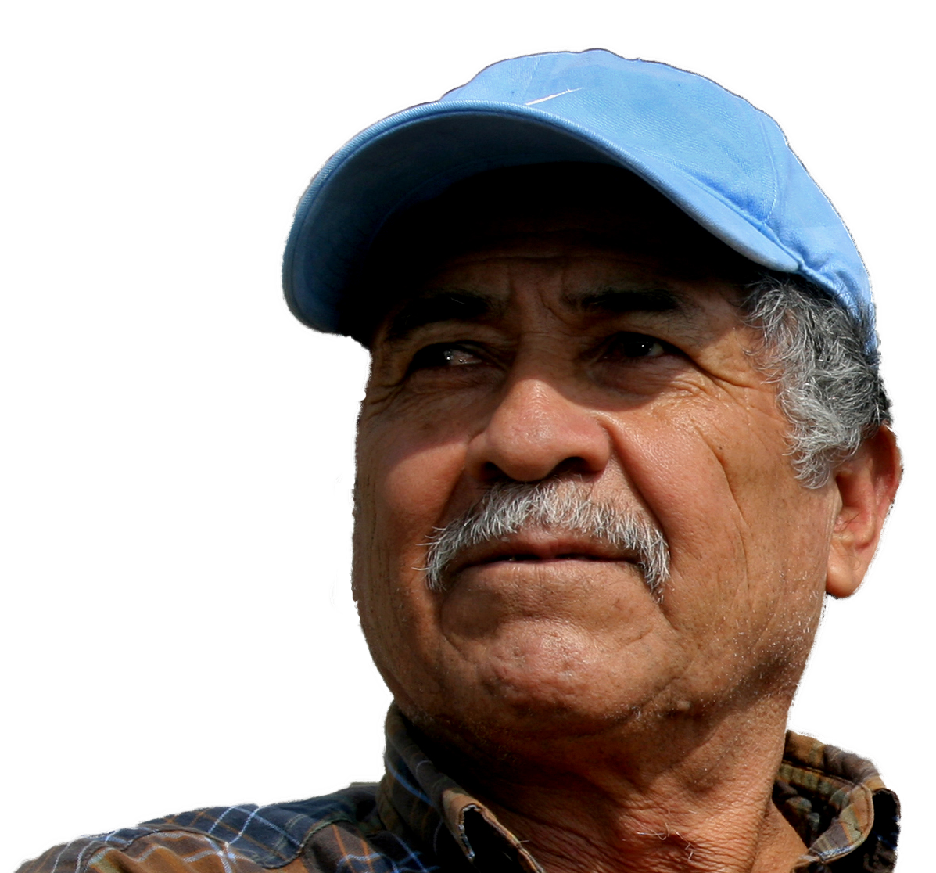
What can happen to me if I get over exposed to pesticides?
foto ©www.earldotter.com
Notes:
¿Qué pasa si yo estoy sobre expuesto a los pesticidas?
Permita tiempo para que los participantes respondan.
Recuerde que hay varios factores que influyen en cómo la exposición a los pesticidas podría afectarnos, pero queremos asegurarnos que evitemos estar sobre expuestos/

Slide 20

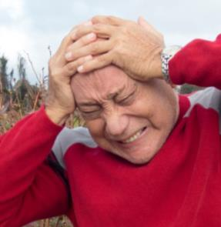
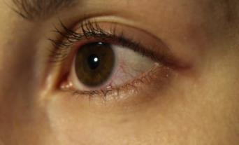
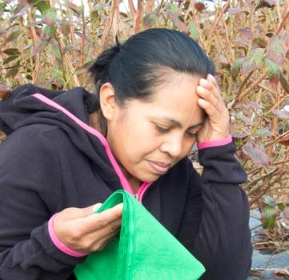
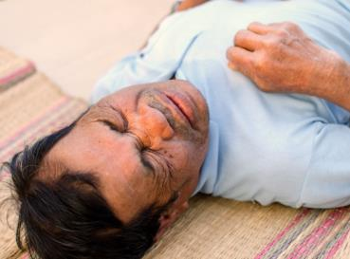
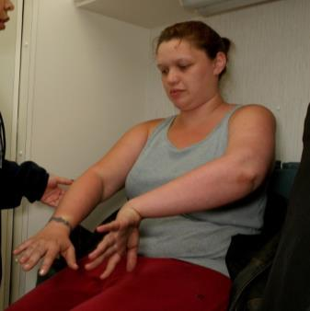
Within a few hours…
CHEST PAIN
IRRITATED EYES
HEADACHE
SKIN RASH
CONVULSIONS OR
EVEN DEATH
DIZZY
Notes:
Show the signs and symptoms of being over exposed to pesticides.
Trainer: As we talked before, there are many factors that influence how pesticides can affect us. One has to be careful not to be overexposed to pesticides. There are many signs and symptoms that occur when you are exposed to pesticides, one simple exposure can result in an acute reaction right away or can be delay for some hours or days. Some of this immediate effects from a pesticide poisoning include eye irritation, skin rashes, and dizziness. Some symptoms are milder than others. Others are more severe including convulsions, chest pain, and breathing difficulties and even death.
It is extremely important that you take care that pesticides do not get into your body.

Slide 21


Possible Effects Over Time
Other?
Neurological
Birth Defects
Cancer
Asthma
Reproductive Problems
Notes:
Explain what chronic health effects are.
Trainer: Some pesticides can cause injuries and illnesses right away, but there are also pesticides that can have delayed effects. Delayed effects do not immediately appear after an exposure. When they do appear, they can take the form of acute and severe symptoms. Moreover, some pesticides can have long-term effects.
What would be the possible long-term effects that could be caused by being exposed to pesticides? That is, 3, 5 or 10 years from now?
Chronic health effects include diseases that result from being exposed to pesticides. Exposure can be caused by a small amount that the worker is exposed to many times. You may not notice anything at the moment because the effect is takes place over time. This type of exposure could cause asthma, sterility, cancer and neurological defects or problems in the nervous system such as epilepsy and Parkinson's disease. Remember Mohamed Ali. Since I know that you all like boxing, I be you then you know who Mohamed Ali was. He suffered from Parkinson's disease. It is a disease where the person cannot control the body.
It is very important that you are aware of sterility or infertility, because that affects your future and make it hard for you to have kids. If you are overexposed to pesticides when you are young, it is possible that in the future you could become sterile and could not have children.

Slide 22
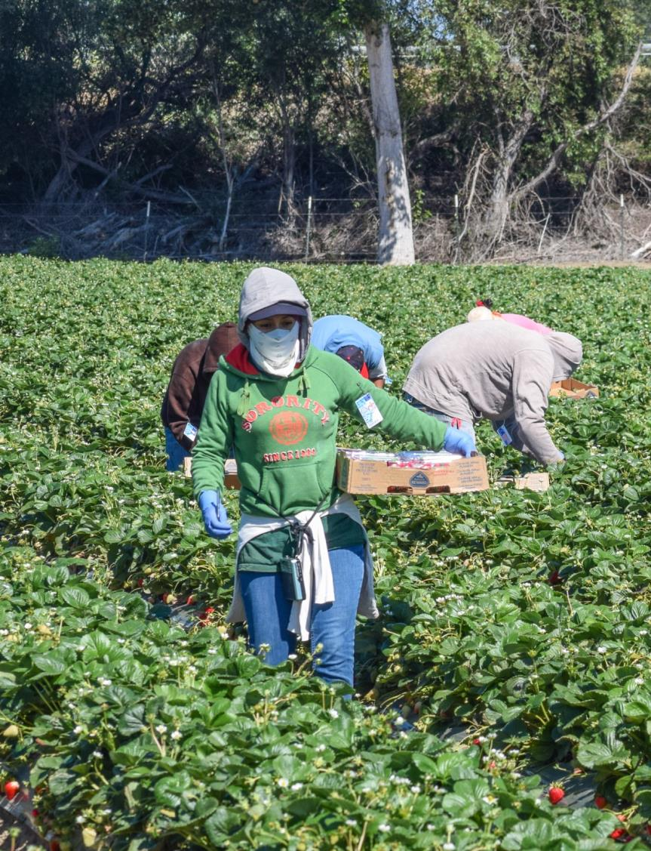

Dangerous for pregnant women!
Notes:
Point out the impact of pesticides on pregnant women.
Trainer: We know that there are many things that cause miscarriage or birth defects in children. It is important that we know that pesticides may also cause miscarriages and birth defects. There is a lot of confusion in translation with the word miscarriage. In Latin America we use the word “aborto espontáneo” to describe miscarriage. But the term “aborto” or abortion in the US can be interpreted that a woman chose to do this. Therefore, it is important that, if a woman loses a baby, and goes to the clinic or the social services office, she should carefully explain what happened.

Slide 23
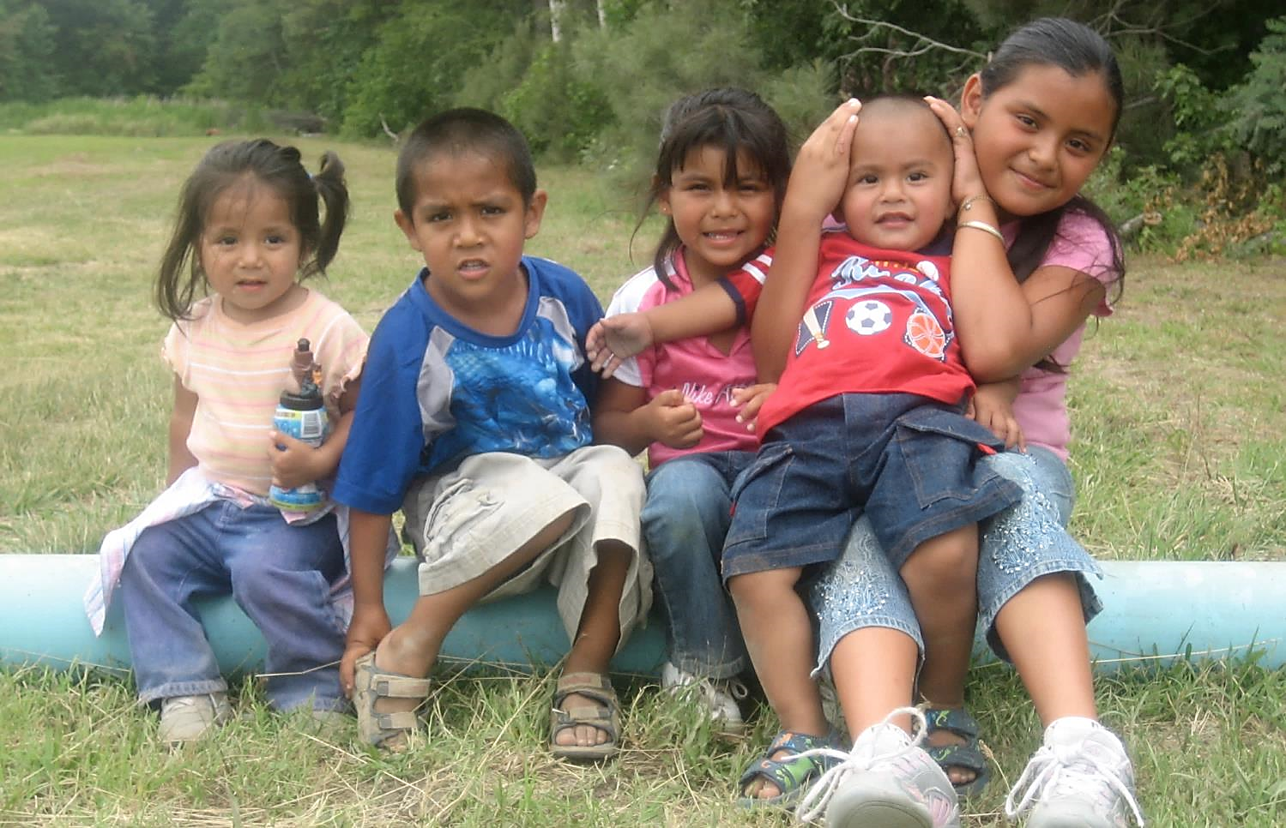
Keep children out of pesticide treated areas!
foto © Kate Bero
Notes:
Point out the impact of pesticides on children.
Trainer: Do not allow children to work or play in pesticide treated areas. Pesticides may cause children to have learning difficulties such as problems paying attention (attention deficit disorder) and problems with growth and development. Illnesses such as asthma and some cancers have been associated with pesticide exposure in children.
So, keep children and nonworking family members out of areas where pesticides have been applied and do not bring pesticides to your home.
One thing you can do to protect your children is to avoid bringing pesticides home, leave your work clothes and shoes outside the house and bathe immediately when you get home.

Slide 24
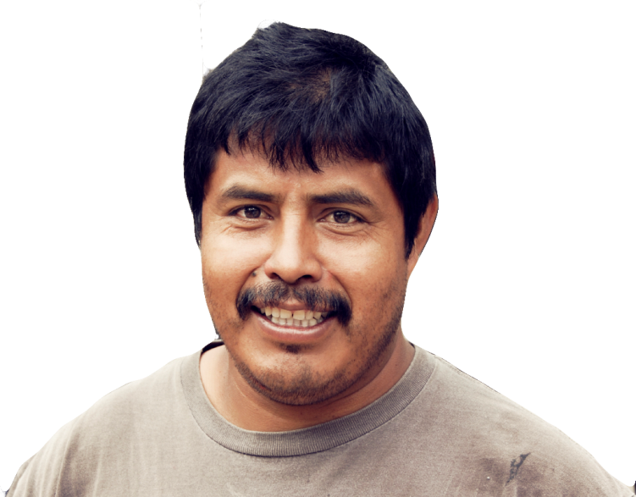
What is a Restricted Entry Interval?
Notes:
Ask the question on the slide. Allow participants to answer the question.

Slide 25
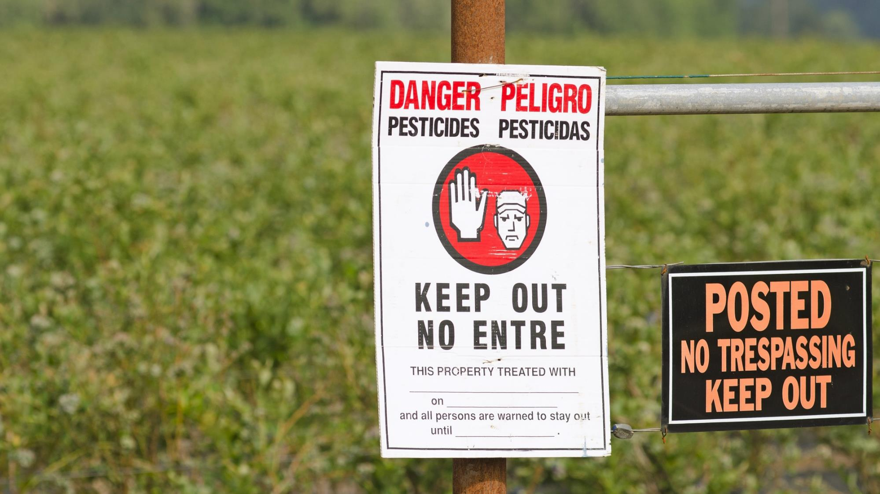
Notes:
Explain when REI is used in the field, and the regulations related to REI.
Trainer: A restricted entry interval area or REI the time immediately after a pesticide has been applied when entry into that treated area is not allowed or is limited. It’s restricted. Different pesticides have different REIs Some may have one hour, others four hours and some have several days. That depends on the pesticide. The employer has to put a sign that tells the amount of time a worker has to wait. Some workers who have their PPE (Personal Protective Equipment) and special training can enter. All workers under the age of 18 cannot enter even with PPE.

Slide 26
Warnings
Oral
Sign
Or both…
Notes:
Introduce two types of warnings of restricted areas.
Trainer: There are two types of warnings used to inform farmworkers of where a pesticide application has taken place or where there are restricted entries.
Your employer or supervisor can warn you by telling you that a pesticide has been applied and when it will be ok to enter. This is an oral warning.
Your employer or supervisor can also post a warning sign that says a pesticide has been applied and you have to stay away until the sign has been removed. These signs should boarder all the areas where pesticides are being applied or were applied. These signs warn not enter the area until your supervisor tells you it is okay and all signs have been removed.
Your employer or supervisor can do both, post a warning sign and give you an oral warning, by telling you about the restrictions. Some pesticides require both forms of warming on their label.

Slide 27
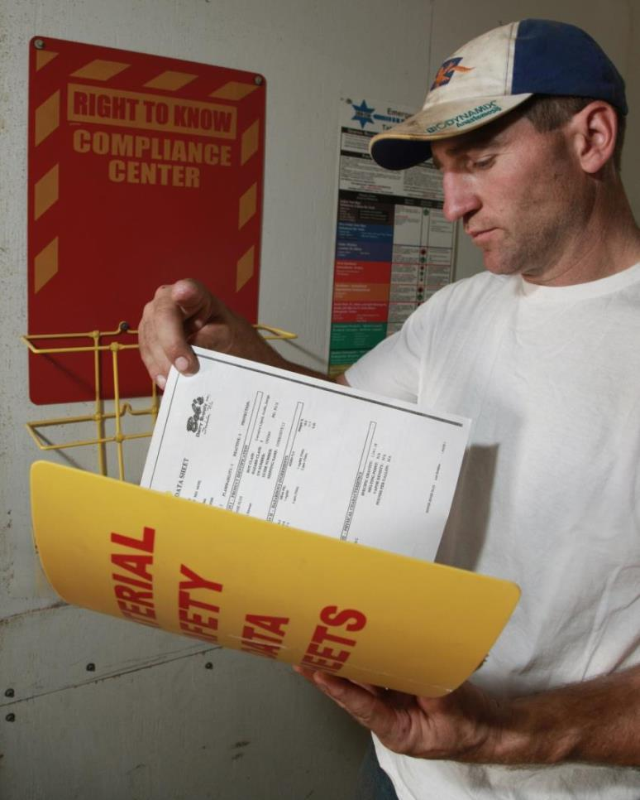
Safety
Data Sheet
(SDS)
©Earl Dotter- NFMC
Notes:
Show participants how to read Safety Data Sheet (SDS). (Slides 27-33)
Trainer: Another thing that you need to know is that your employer is required to have safety data sheets or SDS for all pesticides used on the job site. SDSs provide information on the hazards of substances and how to use them safely, such as storing, transporting and disposing of them. These SDSs also provide information on what to do in case of an emergency related to the chemical.
The employer is required to:
1) to make the SDS (and the application information) available during the workers’ normal working hours, and
2) The employer not only is required to place SDSs at a central location but also has to tell the workers where the central location is on his/her farm.

Slide 28
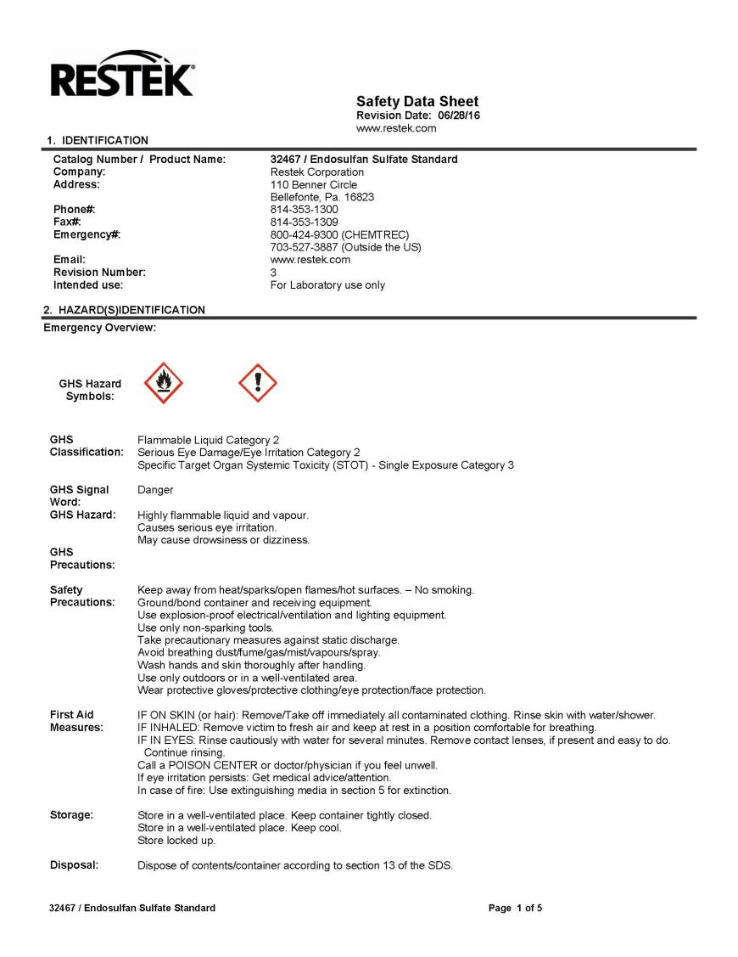
Notes:
Trainer:
Here we have an example of a Safety Data Sheet. It has:
Name of product
Hazard information
First aid information
Storage and handling information

Slide 29
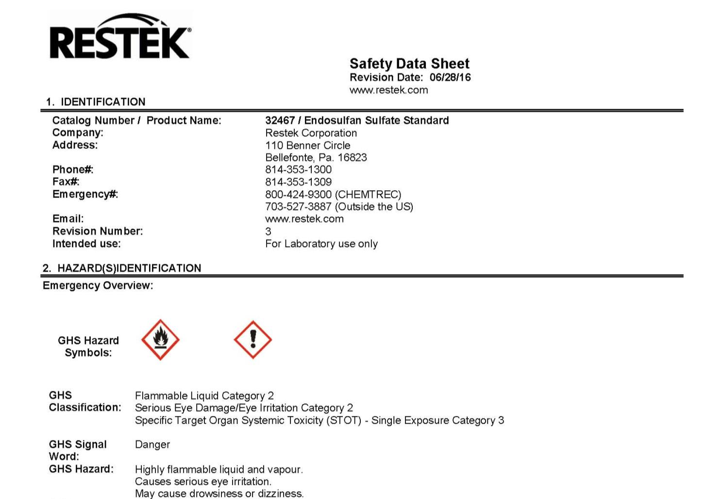
Notes:
Trainer: Here we can see the name of the pesticide.

Slide 30

Notes:
Trainer: Hazard information

Slide 31
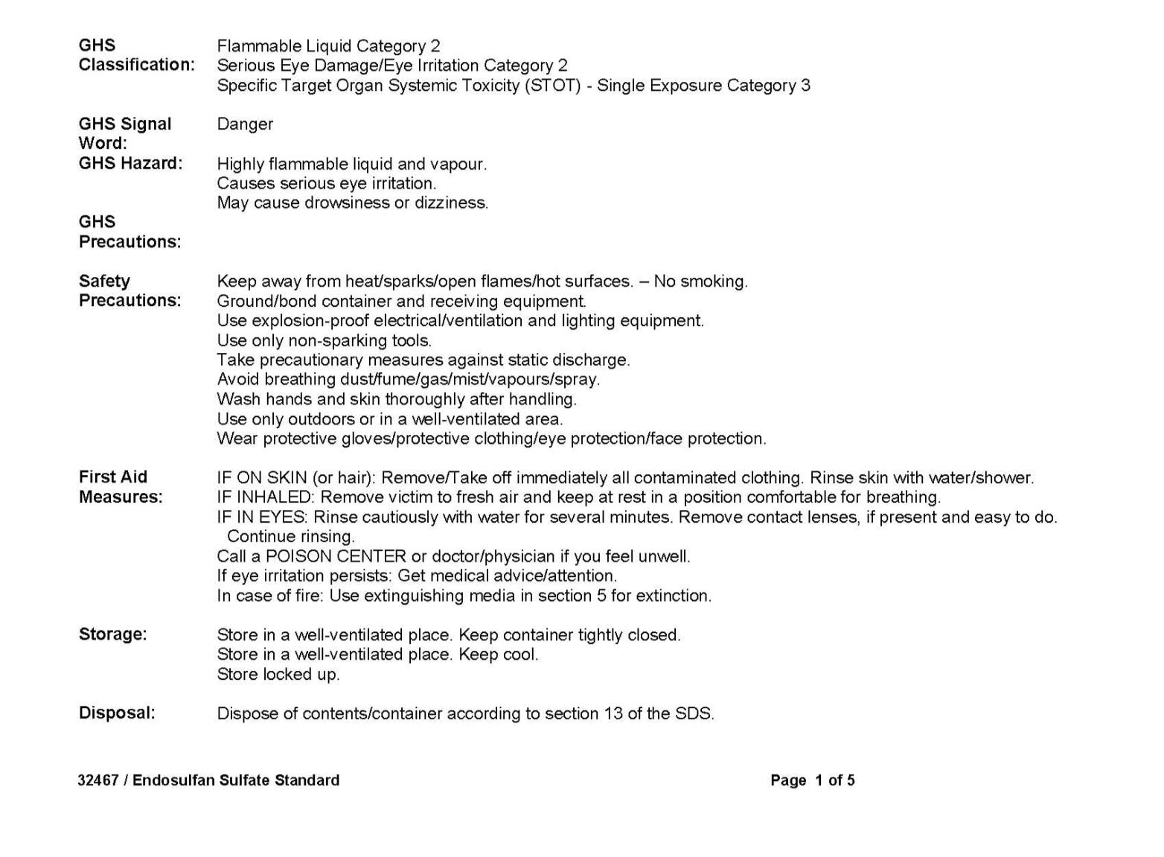

Notes:
Trainer: It includes first aid information.
Let me summarize the SDS information. If you want some information about the pesticides that are being used in the field, you can go to the safety data sheets and get most of that information there. If you want to know what to do in case of a poisoning, you look for it there. If you want to know about the dangers they present, you look for it there. In other words, the important things you need to know about the pesticide are on the SDS.

Slide 32
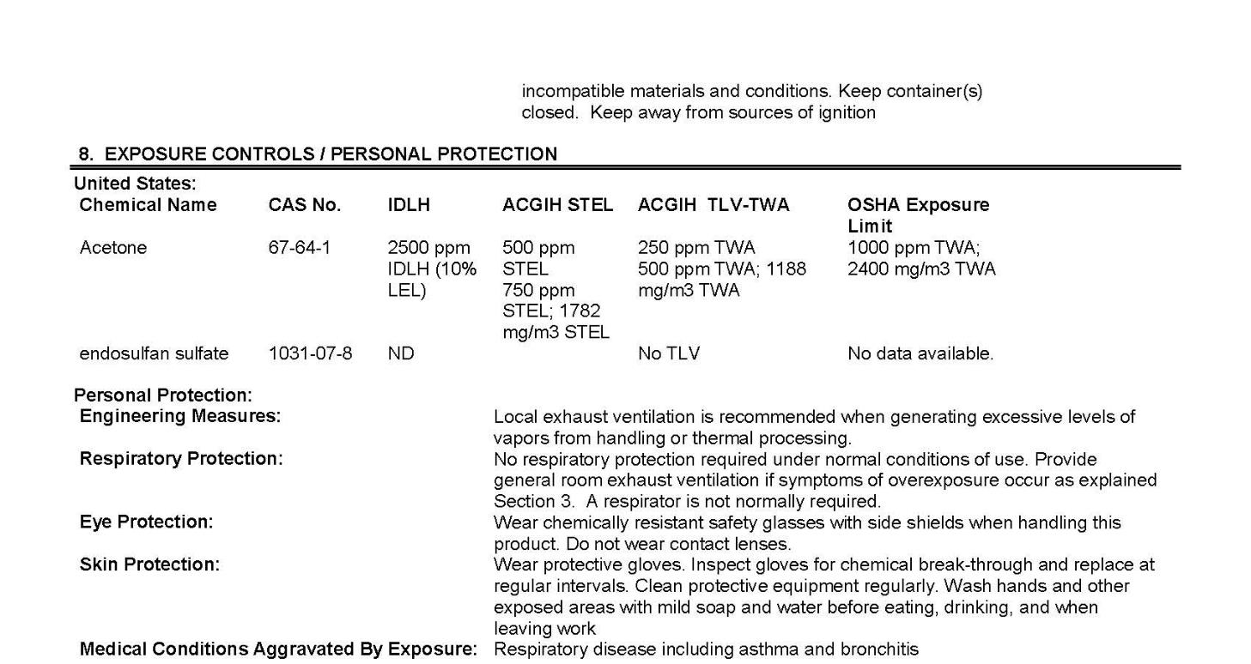
Notes:
Trainer: And it includes information about the type of personal protection equipment that is required.

Slide 33
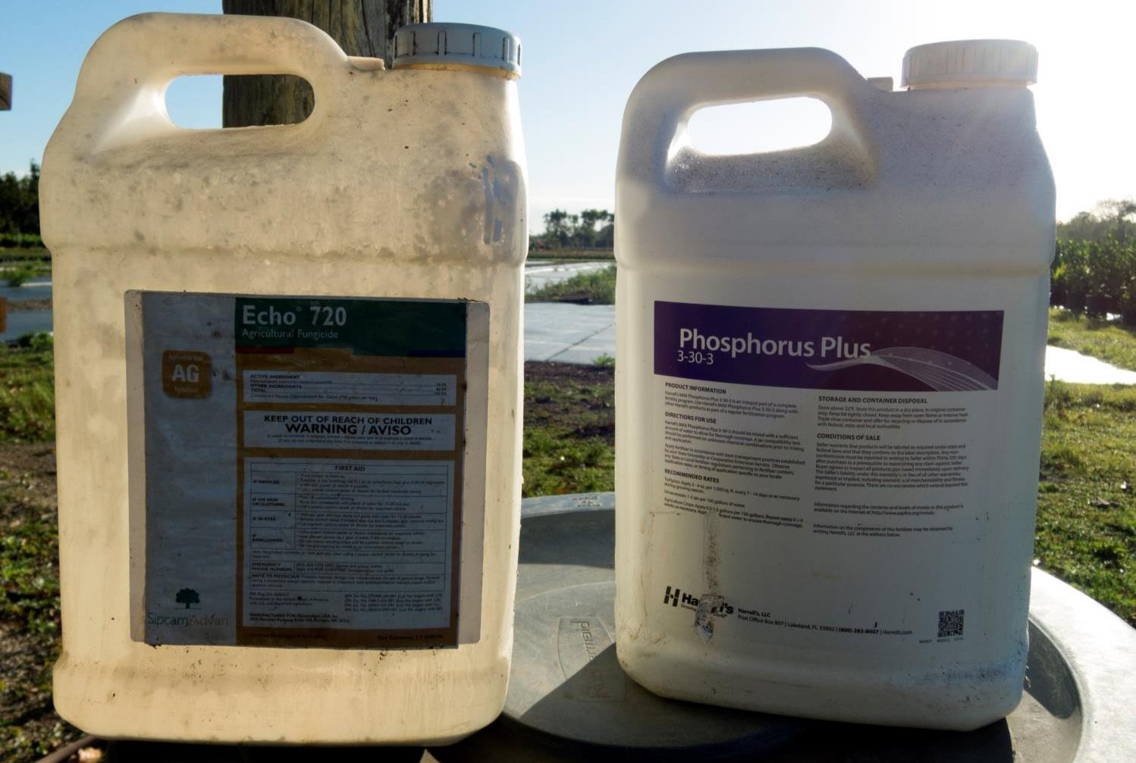
Notes:
Trainer: Your employer can’t force you to mix, load or apply pesticide BEFORE you have additional training to certify you as a pesticide handler. This training is not providing you with such information. The same is true for workers who have to enter treated fields before the restricted entry interval (REI) is lifted.

Slide 34
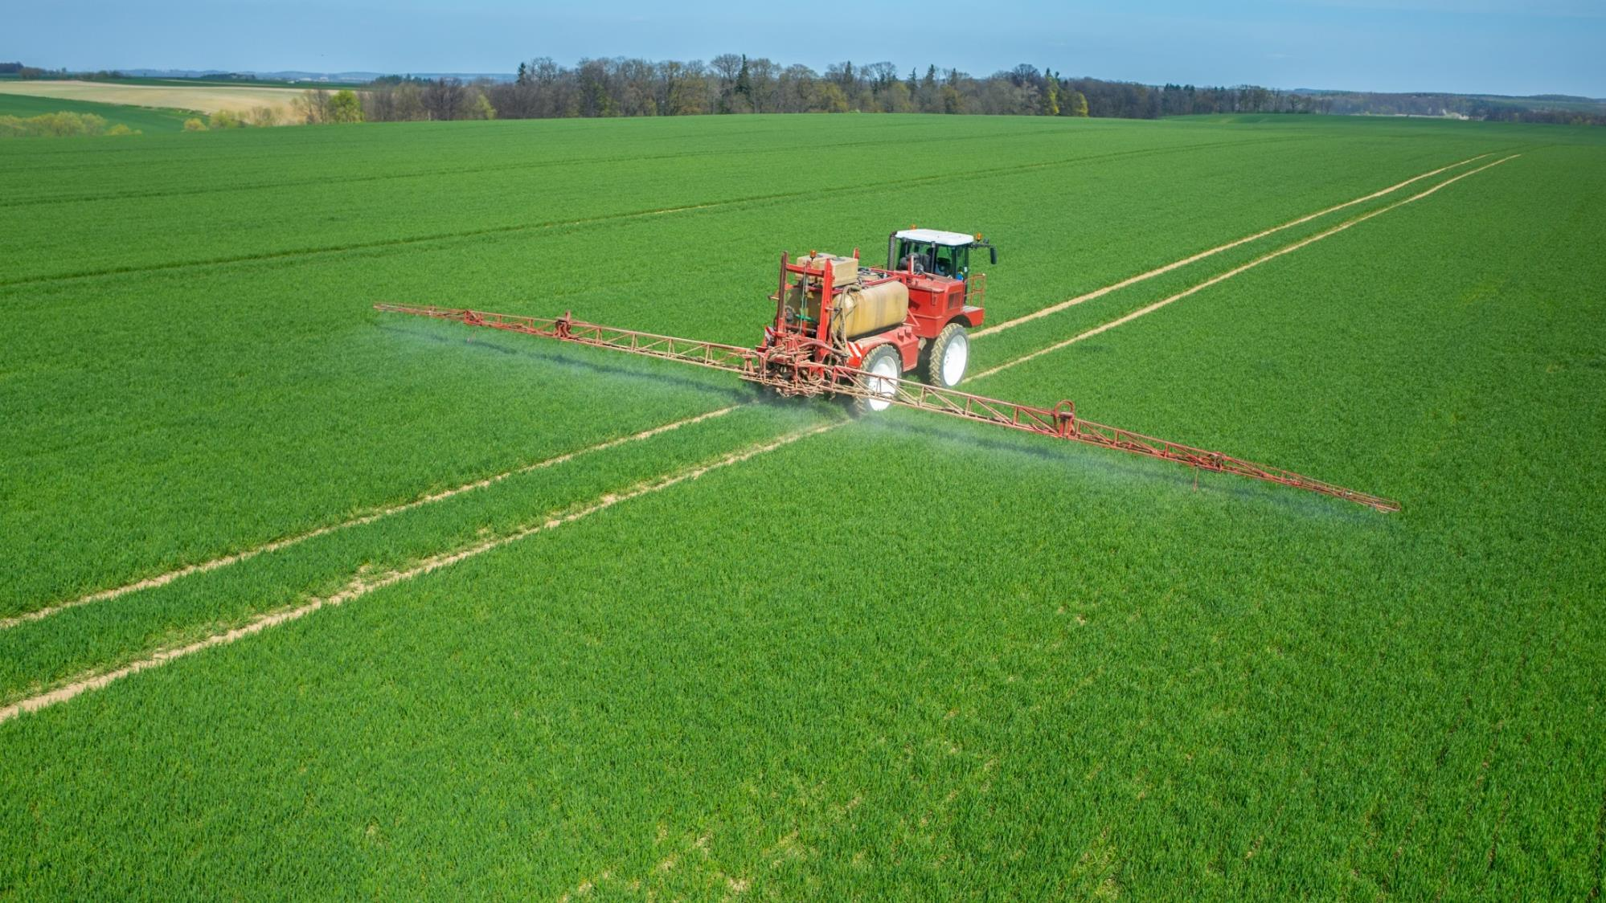
Notes:
Trainer: It is important to stay away from areas where pesticides are being applied. When pesticides are being applied, the applicator and the employer have to make sure that other workers are not in the areas where pesticides are being applied. If there are workers or other persons in the area surrounding the application equipment, the applicator must suspend the application. The official name of this zone is “Application Exclusion Zone” (AEZ). Employers must not allow or direct any worker or other persons to enter or to remain in the treated area.

Slide 35
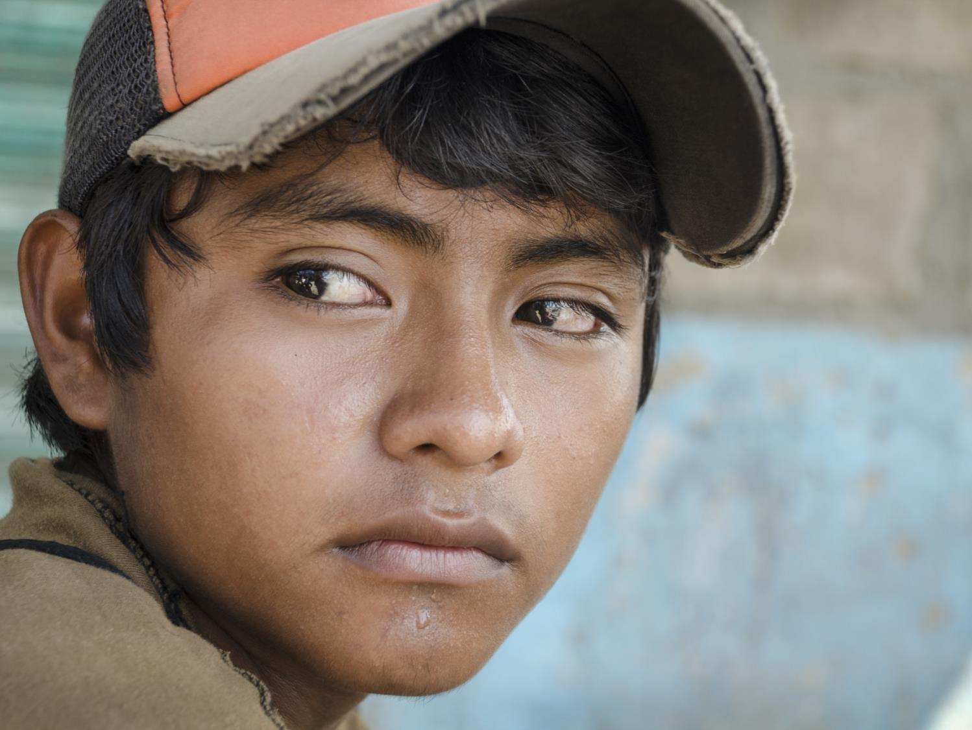
You cannot apply pesticides or enter a REI if you are under age 18
Notes:
Trainer: I suppose everyone here is over 18 years old. But if you are under 18 you cannot apply pesticides.
Remember, you can not apply pesticides or enter a restricted area if you are under 18 years old.

Slide 36
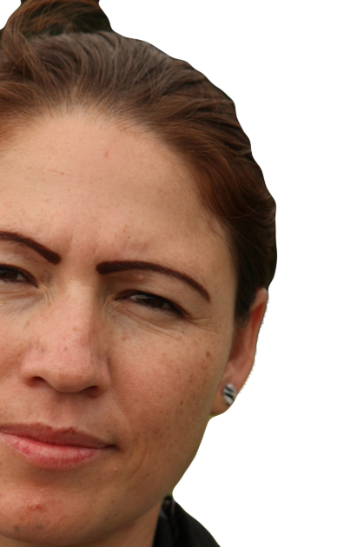
How can I protect myself while I am working?
foto ©www.earldotter.com
Notes:
Ask the question on the slide. Write responses on flip chart.
Trainer: We’ve talked about how you can get exposed to pesticides. We’ve talked about how pesticides enter your body and what can happen if exposed to pesticides. Now let’s talk about how you can protect yourself from pesticides. What do you think? How can you protect yourself from pesticides?

Slide 37
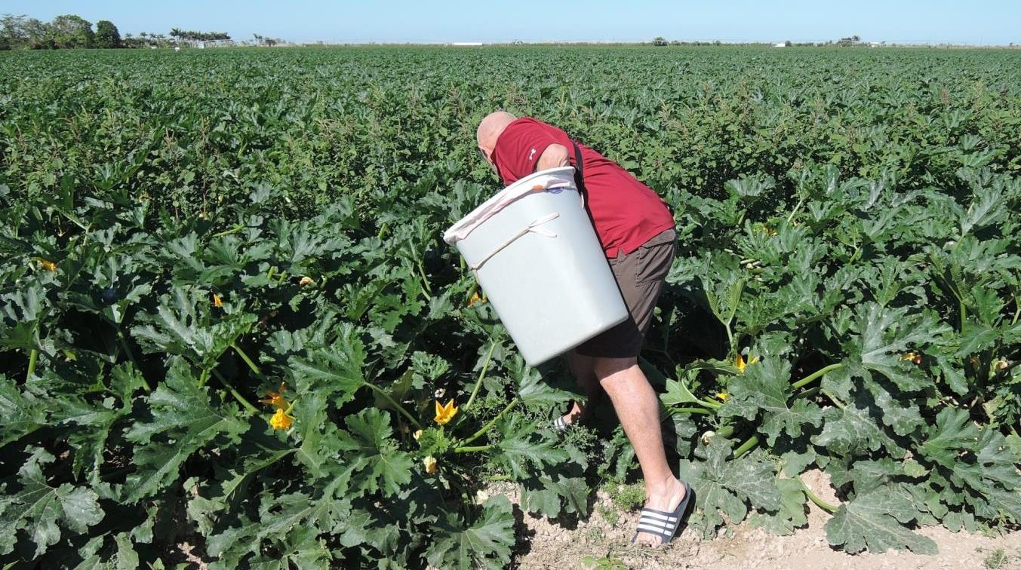
Is there anything wrong with what
this man is wearing?
Notes:
Ask the question on the slide. Allow participants to answer the question.
Trainer: Do you think there is something wrong with what this person is wearing?
We can see that this man is not dressed properly. He has flip-flops, he has shorts, he has a short-sleeved shirt and he's bald and has nothing on his head to protect himself. This person is not well protected.

Slide 38
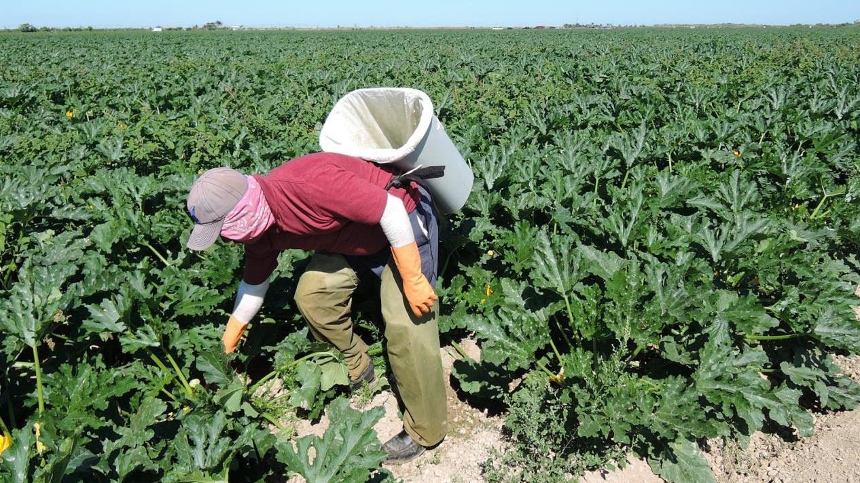
What about this person?
Notes:
Ask the question on the slide. Allow participants to answer the question.
Trainer: What do you think of this person?
This man is protecting himself against pesticide exposure. This man has his cap or hat, a bandana, gloves, long pants, and closed shoes. He is better protected and pesticides are not likely going to get on his skin. While the man in the previous photo was leaving his skin uncovered. You should wear clothing that protects you from pesticides. This includes long-sleeved shirt, long pants, caps, gloves. The bandana can also help a lot.

Slide 39
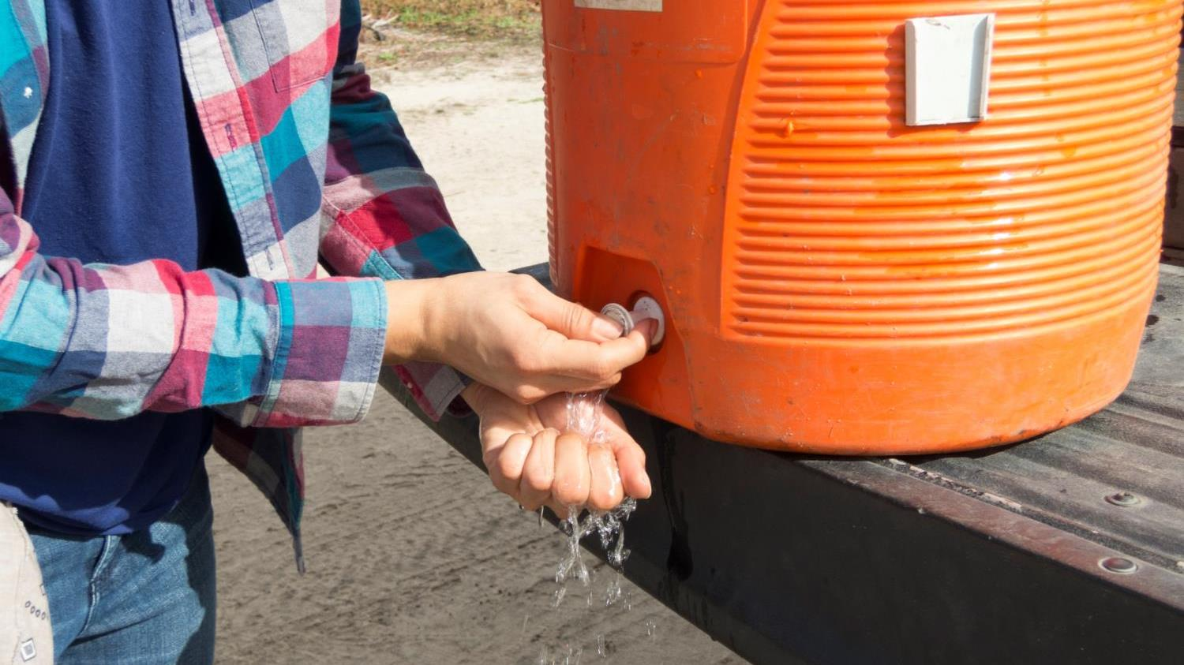
Wash your hands!
Notes:
Point out the importance of washing hands and discuss their concerns according to Hispanic culture.
Trainer: Another thing that is extremely important is to wash your hands. You should wash your hands before eating, drinking, smoking, using the bathroom, chewing gum or tobacco, touching your eyes or mouth and before getting in the car.
We know that many of us believe that washing your hands with water might make you sick. When we are hot and working with think that washing with water will cause problems like arthritis.
We understand that and our thinking that this is actually keeping us healthy. But remember that there are risks associated with pesticides. We recommend that you wash your hands because you are actually protecting yourself when you do this. It is responsibility of your employer to have water, soap, and paper towels near you.
And when you get home, you should bathe immediately, wash or shower with soap and shampoo, and put on clean clothes. Once again we know that many people come home from work and say “I cannot bathe because my body is hot. If I bathe, I will feel bad, I will get a headache, I will get rheumatism or something else”. Please remember that if you have children and you have pesticides on your body and the children come to hug you, the pesticide will get on your children and that is not good for your children. And if you bathe immediately and put on clean clothes, you avoid a potential danger for your family.

Slide 40
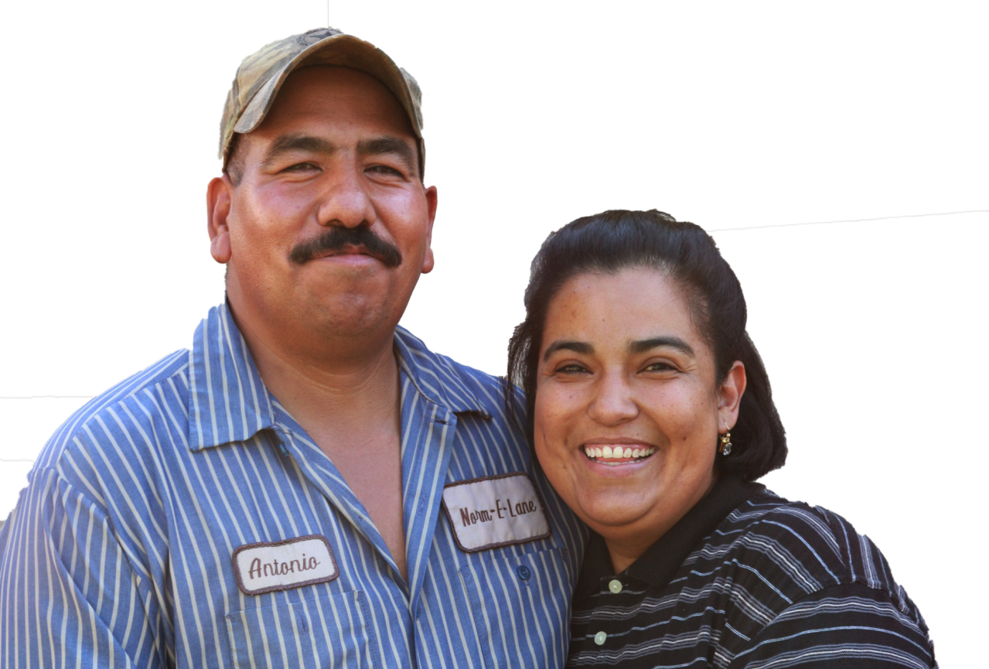
How can we protect ourselves and our family?
foto ©www.earldotter.com
Notes:
Ask the question on the slide. Allow participants to answer the question.
Trainer: How can we protect ourselves and our families?
We have to do everything we can to avoid being overexposed to pesticides. And that does not include only us, but we also have to protect our family. Overexposed means that you were exposed to enough pesticides that it impacts your health or leads to signs and symptoms of exposure.

Slide 41
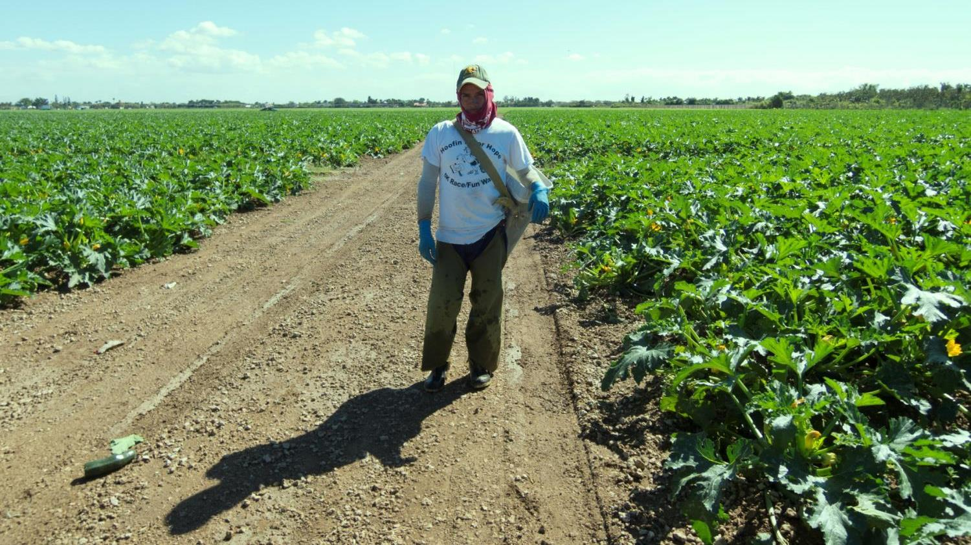
Work clothes and shoes
Notes:
Discuss the steps for farmworkers to protect themselves and their families. (Slides 41-46)
Leave work shoes outside
Bathing immediately after work
Keep work clothes separate. If possible, put them in plastic bags at the end of each working day
Never bring pesticide containers back home
Trainer: When you are working, pesticides can stick to your work clothes and shoes. Therefore, if possible, change out of your work clothes and shoes at work and put you work clothes in a plastic bag.

Slide 42
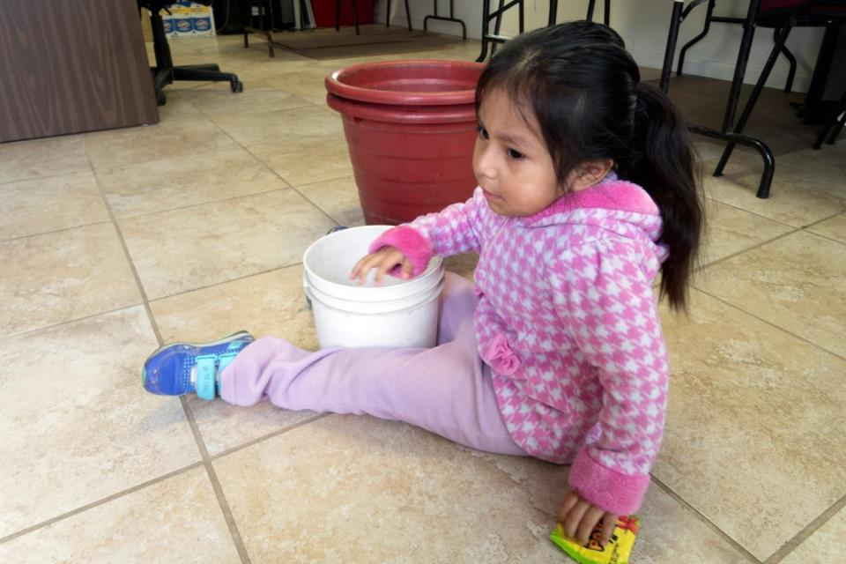
Notes:
Discuss the steps for farmworkers to protect themselves and their families. (Slides 41-46)
Leave work shoes outside
Bathing immediately after work
Keep work clothes separate. If possible, put them in plastic bags at the end of each working day
Never bring pesticide containers back home
Trainer: When you are working, pesticides can stick to your work clothes and shoes. Therefore, if possible, change out of your work clothes and shoes at work and put you work clothes in a plastic bag.

Slide 43
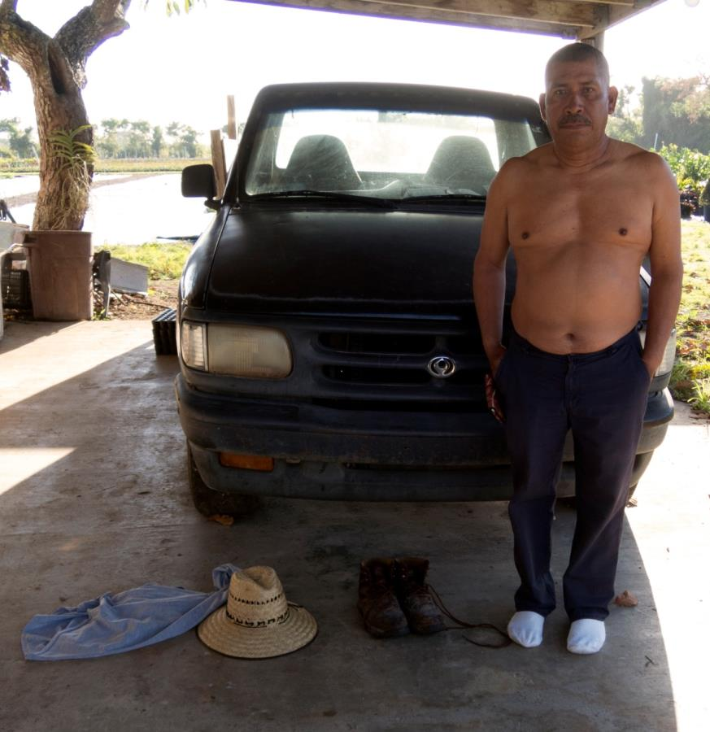
Leave your clothes and shoes outside.
Notes:
Trainer: Leave your shoes and work clothes outside the house.
This man here took off his shoes and clothes outside the house and is now ready to enter his house. Changing your work shoes and clothes before entering the home reduces the amount of pesticides you bring home. And this helps your family.

Slide 44

Shower
Notes:
Trainer: We talked about this before, but it is important to repeat. It is important to bathe immediately after work. Once again, we understand our beliefs about bathing after work and our thinking that we could get sick from getting out of the heat and into the cold. We recommend that you bathe immediately using soap and shampooing your hair, because that way you protect your children and your whole family.

Slide 45
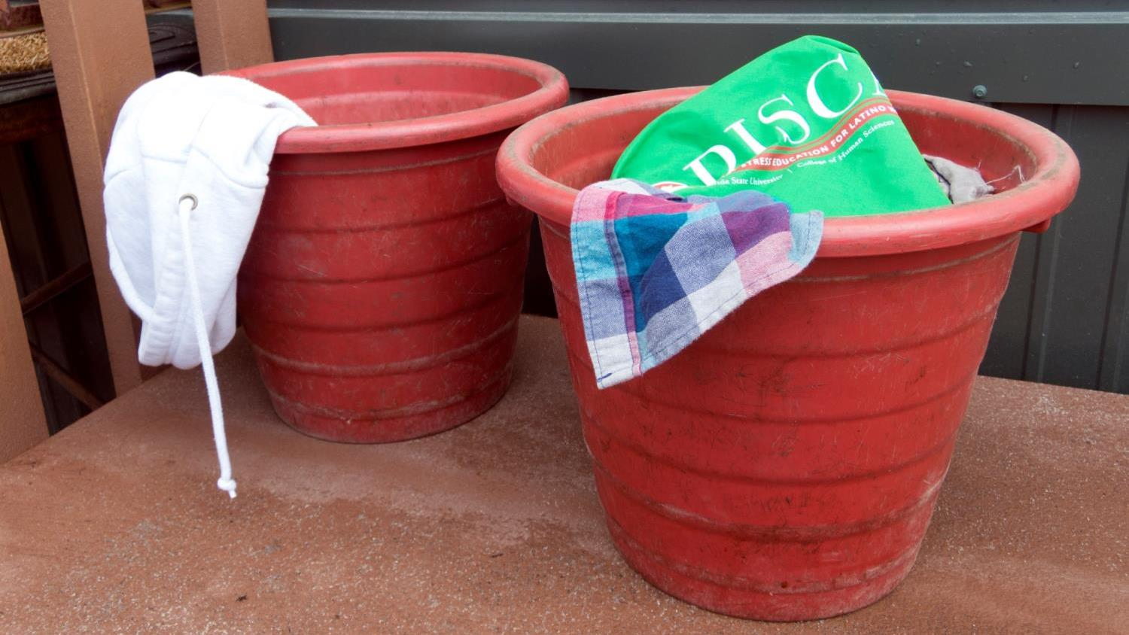
Keep work
clothes separate
Notes:
Trainer: Keep work clothes separate from other clothes.
Wash work clothes separately from other clothing. Take off your work clothes immediately upon arriving at the house. After you remove your work clothes, keep them separate from other laundry. Wash them separately, and if you can, dry them outside to let the sun and fresh air break down any pesticides still left on them. Wash work clothes before wearing them again.

Slide 46
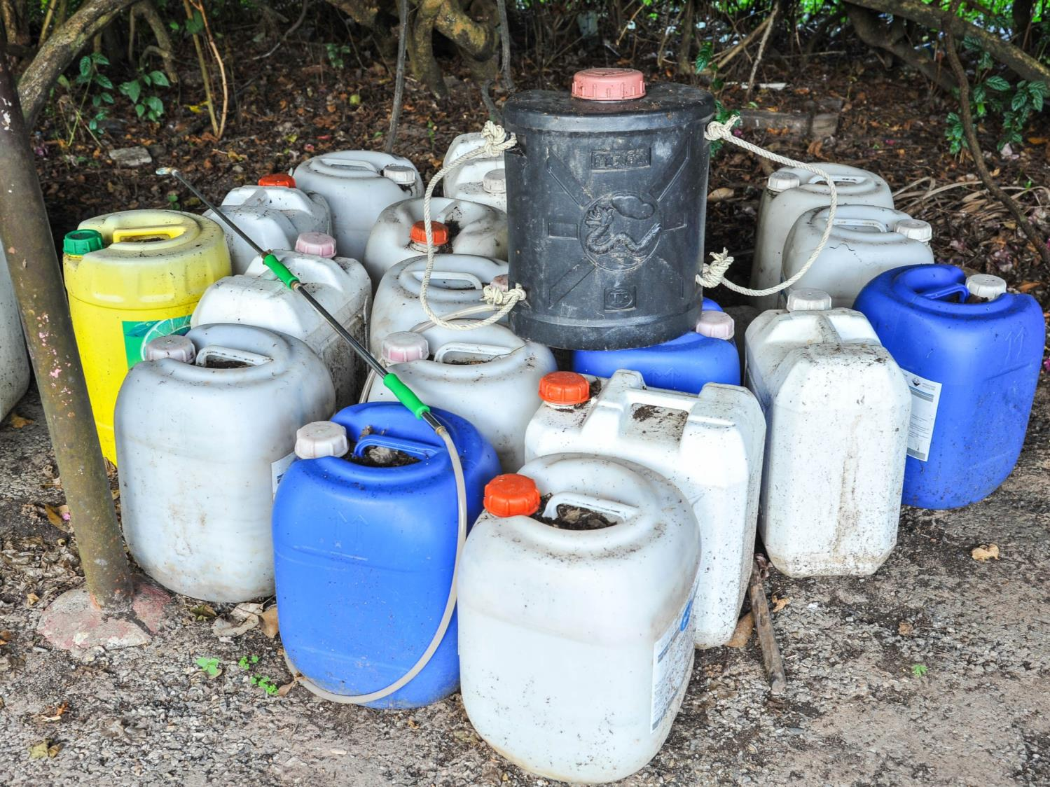

Notes:
Trainer: We know that many people bring empty pesticide containers to their homes and sometimes they bring the pesticides. We recommend that you never bring any pesticide that is used at work to your home or the place where you are staying. This could be very dangerous; pesticide use in the fields are not meant to be used around the home. They are very strong and can make you sick. And do not bring empty pesticide containers to your house either. As much as you wash them, they will always have pesticide residues in them. We recommend that, to protect your families and yourself, do not bring empty pesticide containers or pesticides home. The empty containers must be left to the employer to properly dispose or get rid of them.

Slide 47
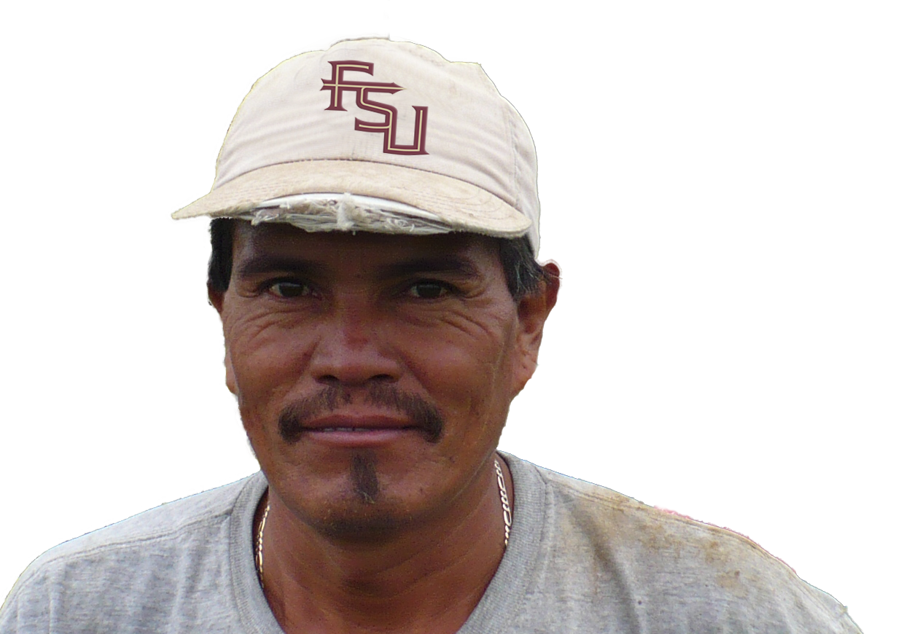
What do I
do in an emergency!?
foto ©www.earldotter.com
Notes:
Ask the question on the slide. Allow participants to answer the question.
Trainer: What can I do in case of an emergency?
We have talked a lot about how to prevent exposure to pesticides and how important it is to take measures to prevent that exposure. Now, let's talk about what to do in case of an emergency in the event that you or a coworker is exposed to a large amount of pesticides. That is, you got a lot of pesticides in your body or someone you work with was exposed. It is responsibility of your employer to have decontamination supplies all the time.

Slide 48
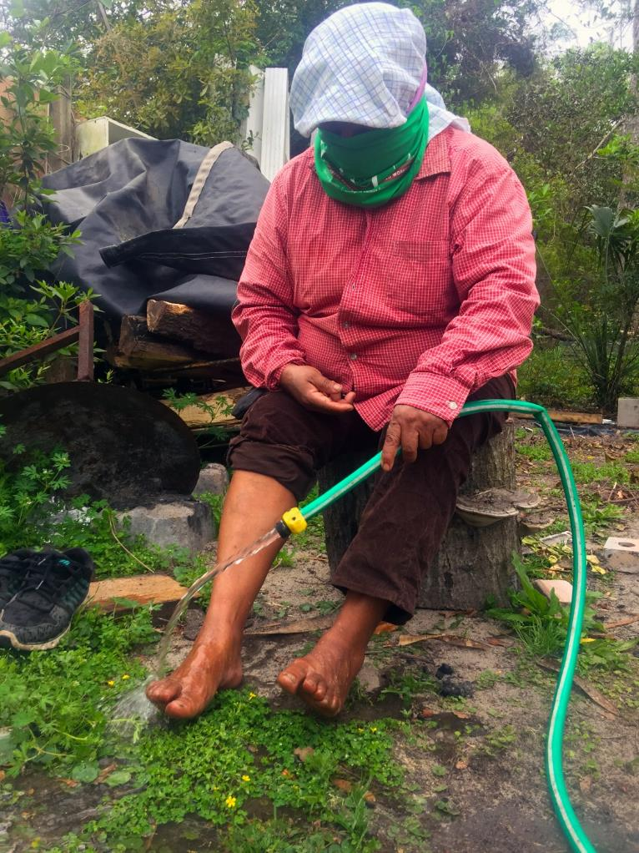
Notes:
Present the three steps when dealing with emergency clean-up.
Trainer: Emergency clean up should be initiated if a pesticide is spilled or sprayed on your clothing or skin.
Stop the exposure!
Stop work and leave the work area.
Remove the pesticide contaminated clothing right away and wash immediately with the decontamination supplies provided or in the nearest clean water.
As soon as possible, follow up with wash or shower with soap and water, shampoo hair, and change into clean clothes

Slide 49
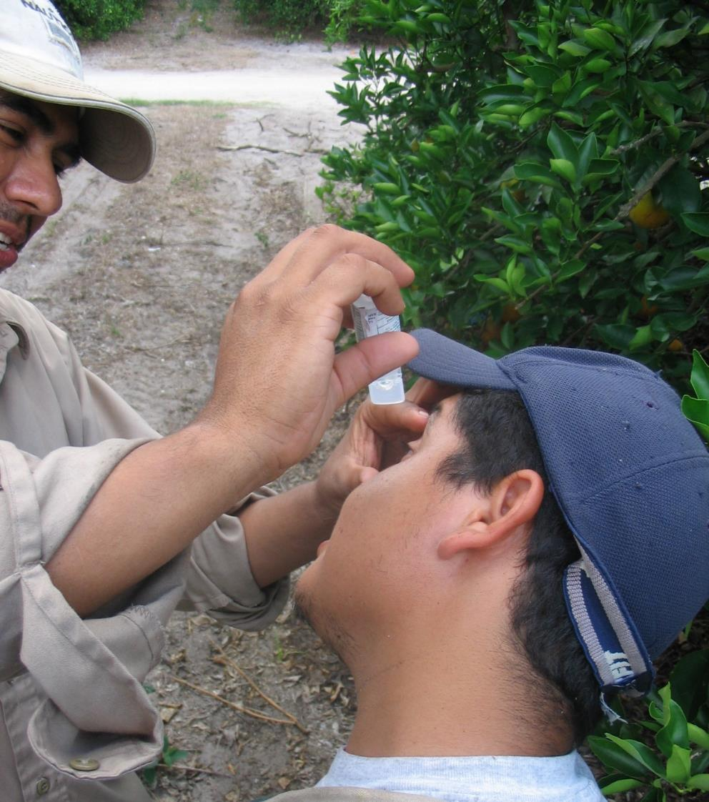
Eye Exposure
Notes:
Explain the first aid steps for pesticides exposure in the eyes.
Trainer: In the case of pesticide exposure in the eyes the following first aid steps must be taken:
Wash eye quickly but gently
Hold eyelid open and wash with a gentle drip of clean running water positioned so that it flows across the eye rather than directly into the eye
Rinse eye for 15 minutes or more
Do not use chemicals or drugs in the rinse water, they may increase the injury
Your employer is required to have water available to rinse your eyes

Slide 50
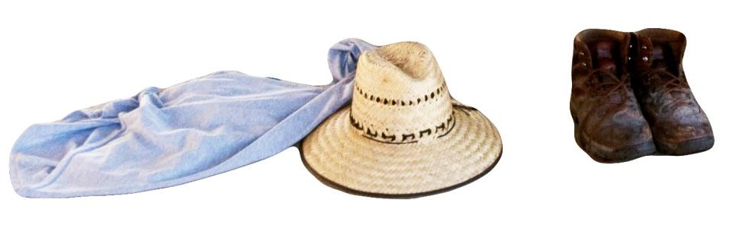
Remove contaminated
clothes
Notes:
Explain the first aid steps for pesticides exposure on the skin.
Trainer: In the case of pesticide exposure on the skin the following first aid steps must be taken:
Remove contaminated clothing
Rinse with decontamination supplies or in the nearest source of water
Take a shower with soap as soon as possible

Slide 51

Rinse and wash with soap and water
Notes:
Trainer:
If shower is not available, still ash with plenty of soap and water in the field

Slide 52
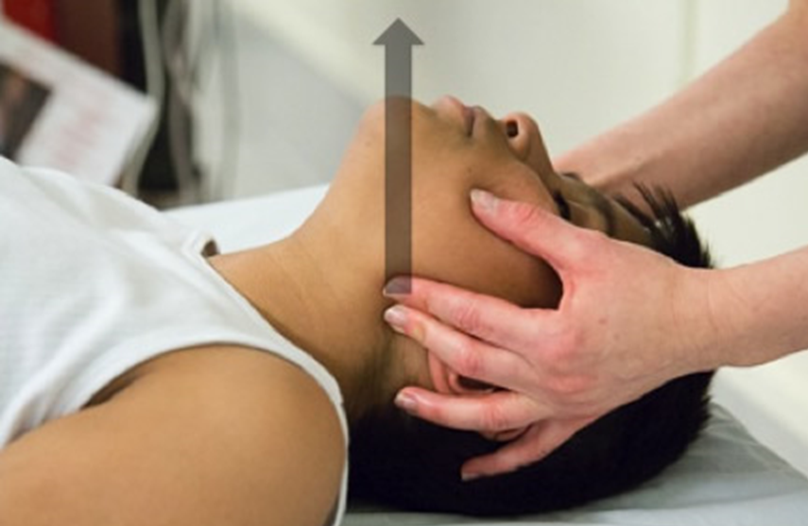
Notes:
Ask participants “What are the first aid steps for breathing difficulties?” Allow participants time to provide answers.
Trainer: In the case of breathing difficulties:
Get the person to fresh air
Remove any tight clothing
Open the airway
Seek medical attention
If the victim is in a greenhouse or other enclosed area, the rescuer should be careful to protect themselves before entering (such as wearing a respirator, or getting help) so they are not affected as well.
Only train workers on cardiopulmonary resuscitation (CPR) should try to help the victim if they are struggling.

Slide 53

If things get worse get help!
Notes:
Discuss the cases that need calling 911.
Trainer: You may need to call 911 depending on the severity of the exposure such as:
Difficulty breathing
Person is vomiting
Person has passed out
And whenever someone swallows the pesticide
These are urgent matters, get them to a facility IMMEDIATELY. Call 911!
Also, if decontamination at the worksite included removing clothes, the clothes should be bagged and be brought to the medical facility.

Slide 54

Notes:
Discuss the case that needs medical facility.
Trainer: If experiencing any pesticide poisoning signs or symptoms go to a medical facility immediately. Your employer is required to provide transportation to a medical center to receive care.

Slide 55

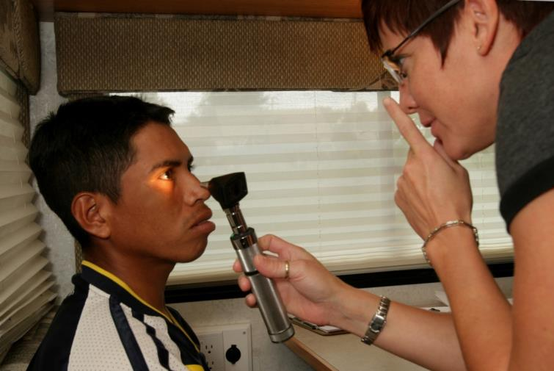
Medical Care and Your Employer
foto ©www.earldotter.com
Notes:
Discuss the information needed from employers when getting medical care.
Trainer: When a worker is taken to get medical attention, the employer is required by the EPA to provide certain information to the medical facility.
This includes:
Safety data sheet for the product – we talked about that before
Name of the product
Registration number Active ingredients
Circumstances of the use of the product and of the exposure.

Slide 56
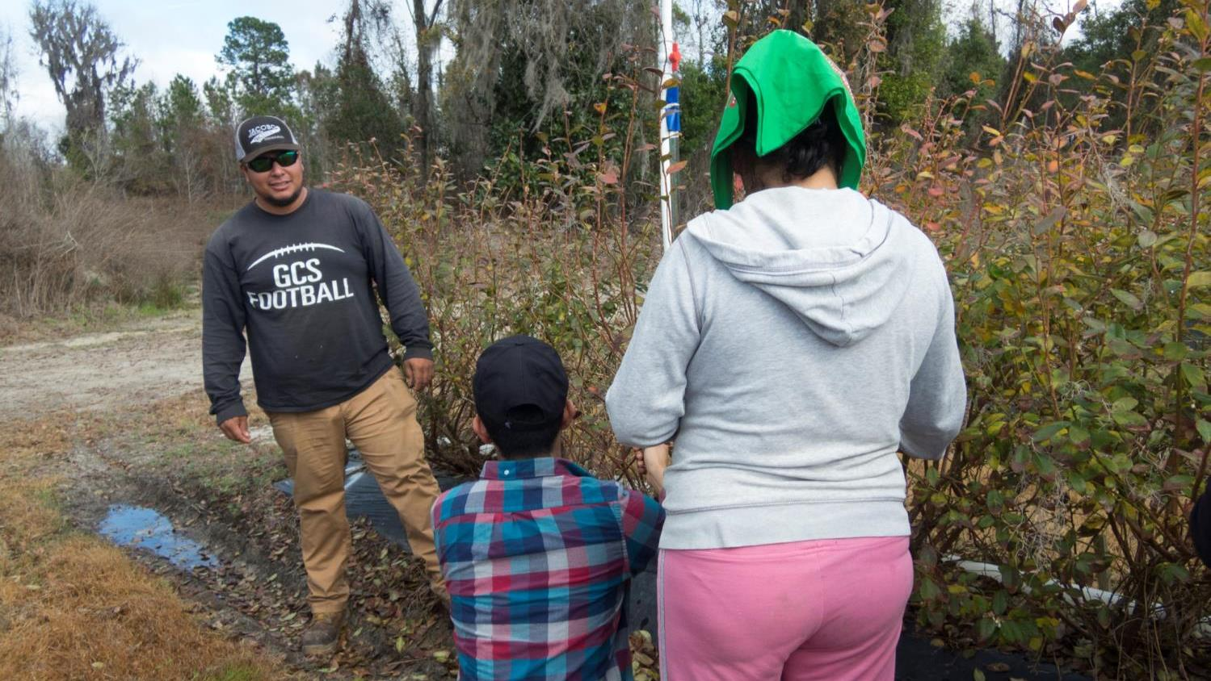
Responsibilities of Agricultural Employers
Notes:
Explain the responsibilities of employers.
(Slides 56-58)
Trainer: Now, let’s look at the things that your employers should do for you. First of all, your employer needs to train workers (those who do not apply pesticides) and handlers (those who apply pesticides) about pesticide safety and exposure prevention BEFORE starting work.

Slide 57
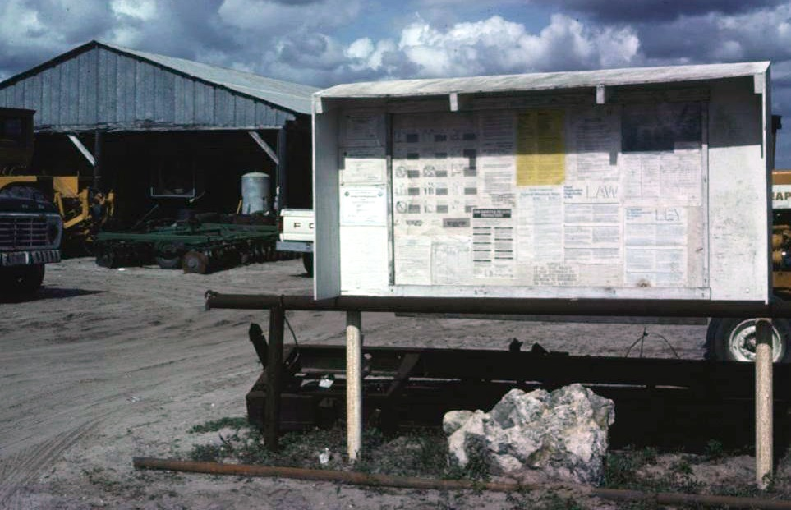
Posted in a Central Location
Notes:
Trainer: Your employer must display pesticide safety information in where is call the Central Location. The Central Location is a place where workers can access, pesticide application information, and hazard information during normal work hours. As we saw before in this location you will find the Safety Data Sheet (SDS): The SDS will tell you the name of the pesticide(s) used at the moment, want kind of risks present, and most importantly what to do in case of poisoning. Do not ignore Central Location, take it as a reminder of the main ways in which you can protect yourselves from pesticides.

Slide 58


Notes:
Trainer: The Central Location should include a poster like the one in here, in the left side of the poster employers should post information about where the nearest medical facility is located and of any changes to the emergency medical facility information.

Slide 59

Your Rights!
Notes:
Trainer: What are your rights as farmworkers?
Employers cannot intimidate, threaten, coerce, discriminate against, discourage, or fire any worker or handler from complying or attempting to comply with the WPS. In other words, they can not retaliate.
Trainer:
YOU can refuse to participate in any activity that you believe is violating the WPS.
YOU can report any WPS violations.
YOU can provide information to the EPA or any authorized representative of a Federal, State or Tribal government about the WPS compliance.
YOU have unrestricted access to posted information about pesticides including pesticide safety information, safety data sheets, and pesticide application information, but ONLY during normal work hours.
YOU can also designate another person to help you get the information you need about pesticides.

Slide 60

To report any violation to your state regulatory agency
In Florida, call the Florida Department of Agriculture & Consumer Services
  General calls: 850-617-7900
  Incident reporting: 850-617-7997
Notes:
Trainer: To report a violation here is the information you need.

Slide 61

To report any violation to your state regulatory agency
In Georgia, call the Georgia Department of Agriculture.
  Incident reporting:
  888-655-9340
Notes:
Trainer: To report a violation here is the information you need.

Slide 62

Notes:
Trainer: Thank your taking part in this training. We really want to encourage you to make sure you protect yourself and your family from pesticide exposure.

Slide 63





This curriculum would not have been possible without the helpful contributions of (in alphabetical order): Fiorella Chavez Carlos, Fernanda Correa, Jeannie Economos, & Guojuan Shang.
Suggested Citation: Liebman, A.K., Marin, A.J., Hopewell, J., Trejo, M., Tovar Aguilar, A., Ordaz Gudino, C., Garcia Rendon, M., & Grzywacz, J.G. (2018). Normas de Protección al Trabajador Agrícola, [Kit]. Tallahassee, FL: Florida State University.
This curriculum was made possible by a grant from the National Institute for Occupational Safety and Health (U54-OH011230). The Curriculum follows the requirements of the revised Worker Protection Standards of the United States Environmental Protection Agency, but the content, images, and facilitators’ guide are the authors’.

