Slide 1
TITLE OF YOUR COMIC STORY GOES HERE.
1
Add your Title
Type out the title of your story. Think of ways you can tie the campaign slogan into the title. Eg:
A story about how vaccination is protection.
3
Add text to your image
Once you paste your chosen images here and placing them in the right spot. Double click the text area to edit it to your story. Please don’t change the font size/font to retain legibility and consistency.
2
Add your images
Head to the image bank in the next few slides and follow the copy instructions there. Once you’re back here press Command + v or Ctrl + V to paste the image here within the the dotted areas.
Move your image to fit in the dotted lines. Don’t size up/down the images for legibility once printed.
4
Add website & logo
Direct your readers to a website that has further vaccine information or a form to sign up to receive the vaccine by editing the this text box.
Also feel free to add a logo at the bottom right corner by going to Insert→ Image. Drag and drop your logo image to the right bottom corner, and resize it by dragging the corner in/out with the shift key pressed to retain the proportions.
5
Export as a JPG using Google Slides:
File → Download → JPEG Image (Current Slide)
Use the saved image in your social media profile picture
Export as a JPG using PPT:
Select slide. File → Save As → JPEG Image
Add your website here

Slide 2
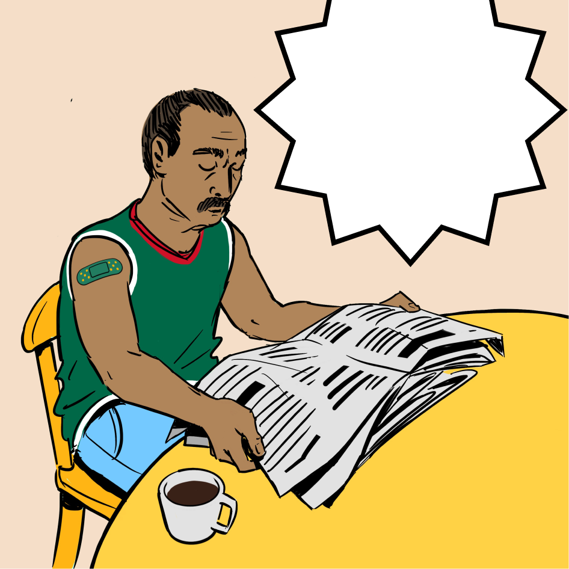
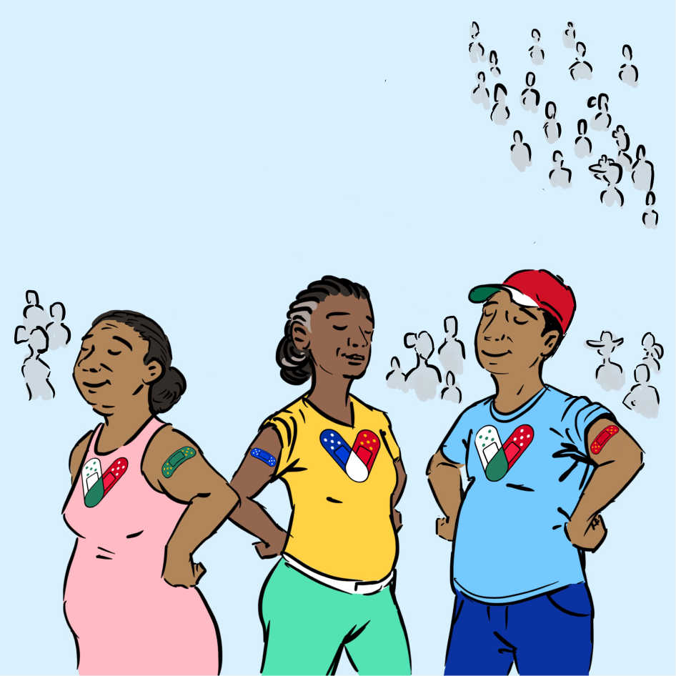
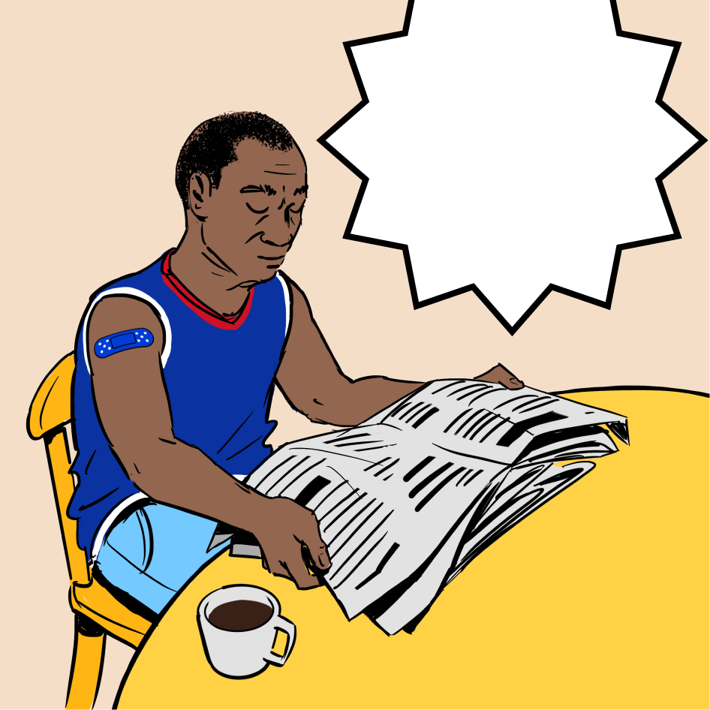
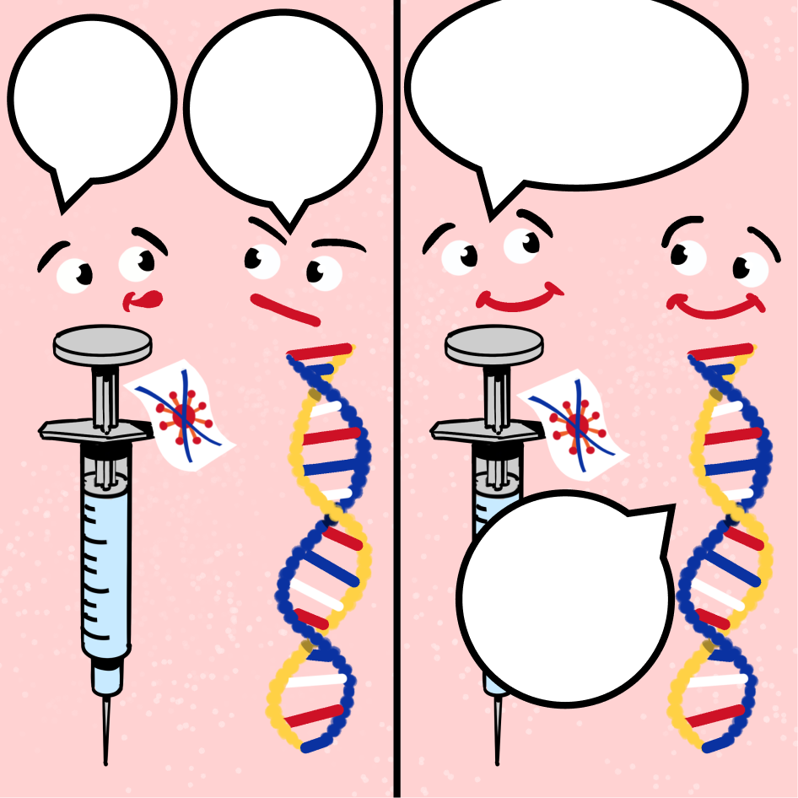
IMAGE BANK
i
1/3
Image Selection
Think of which image/s convey/illustrate the story you’d like to tell before selecting any.
There are more images in the next slides to choose from.
Think of your story and what you want to express. Copy the images needed from here and place them in your template to match the sequence of your story.
Type your text in here after you copy the image to your template
Type your text in here after you copy the image to your template
1
Copy and Paste
Click on the image you’d like to place in your template. Press Command + C or Ctrl + C to copy the image.
Please don’t edit any text or delete any images from here. this is an image bank that’s meant to remain as is for others to use.
Type your text in here after you copy the image to your template
text
text
text
text

Slide 3
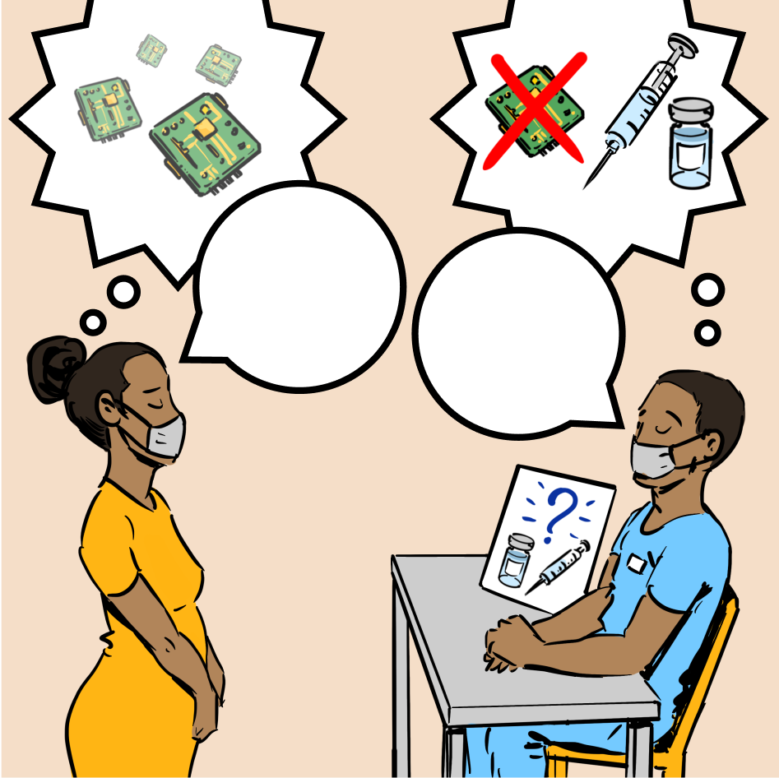
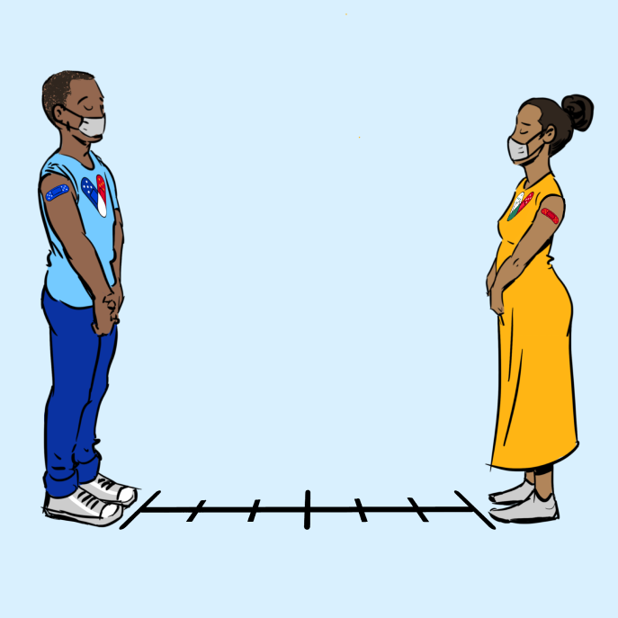
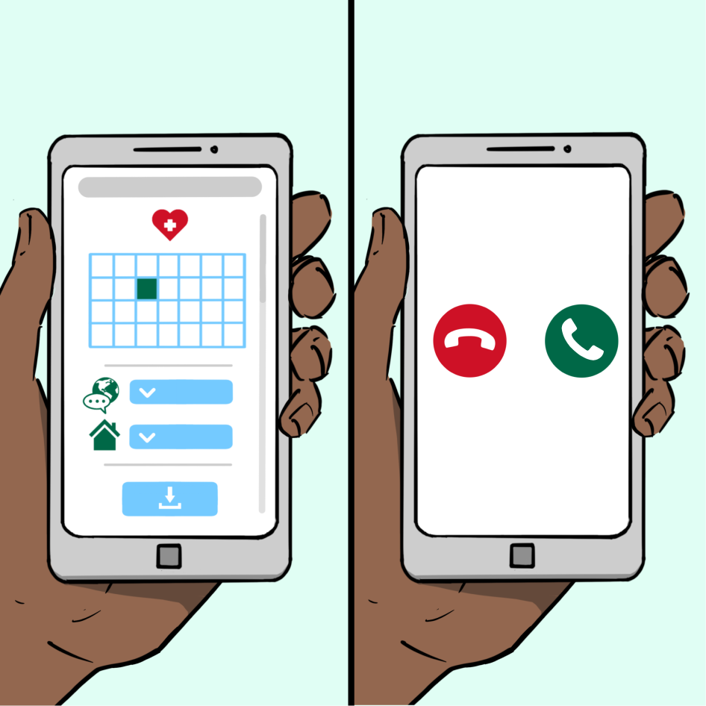
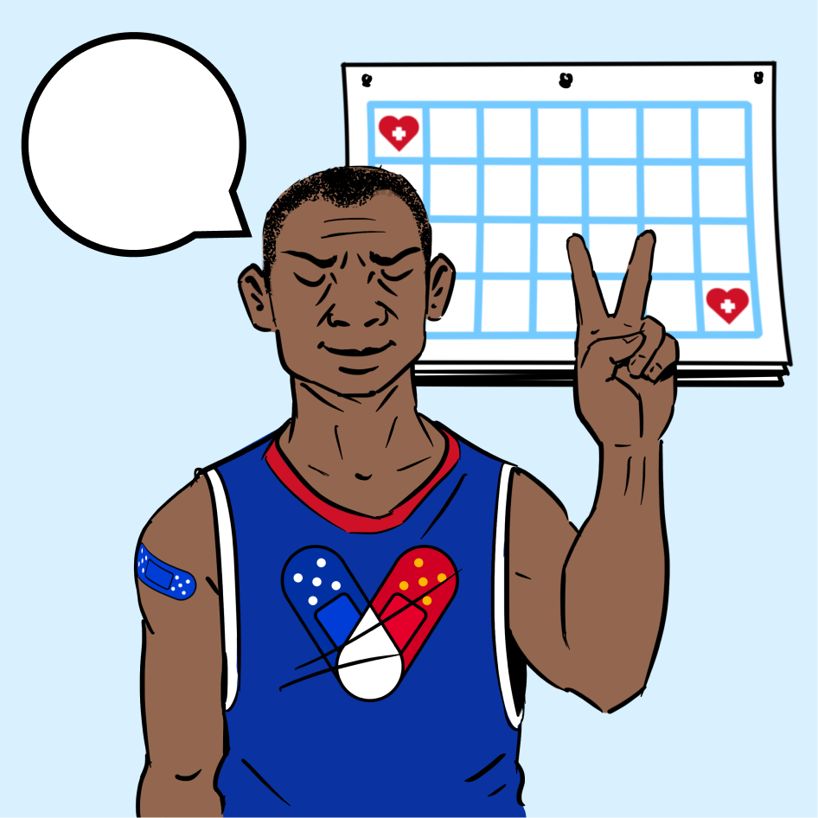
IMAGE BANK
i
2/3
Image Selection
Think of which image/s convey/illustrate the story you’d like to tell before selecting any.
There are more images in the next slides to choose from
Think of your story and what you want to express. Copy the images needed from here and place them in your template to match the sequence of your story.
Type your text in here after you copy the image to your template
text
text
1
Copy and Paste
Click on the image you’d like to place in your template. Press Command + C or Ctrl + C to copy the image.
Please don’t edit any text or delete any images from here. this is an image bank that’s meant to remain as is for others to use.
Type your text in here after you copy the image to your template
Type text here
Url here
Text indicating caller ID or phone number

Slide 4
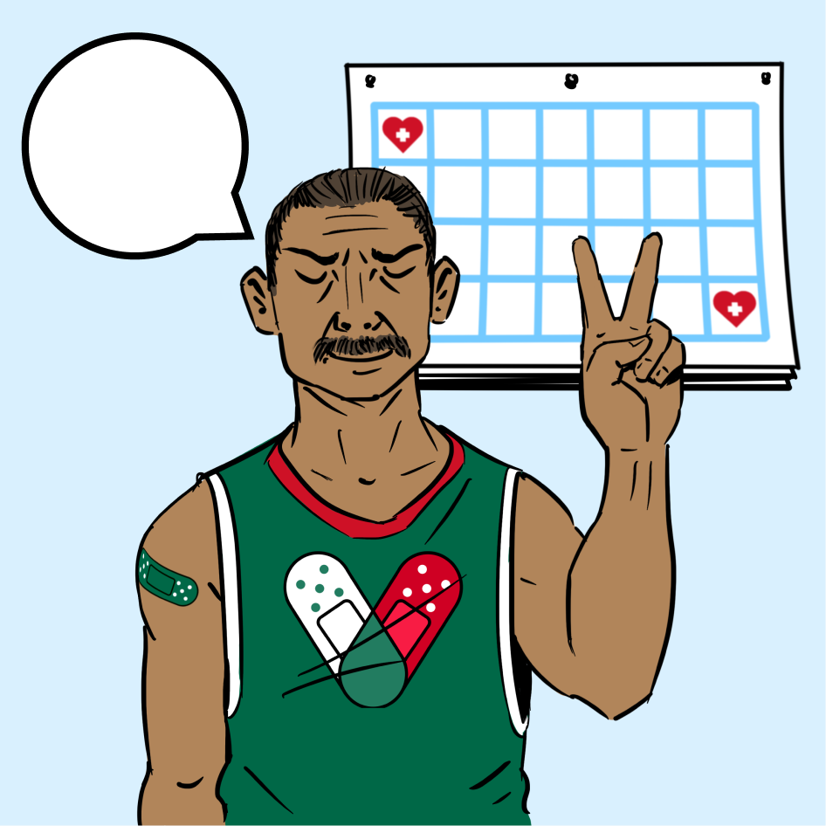
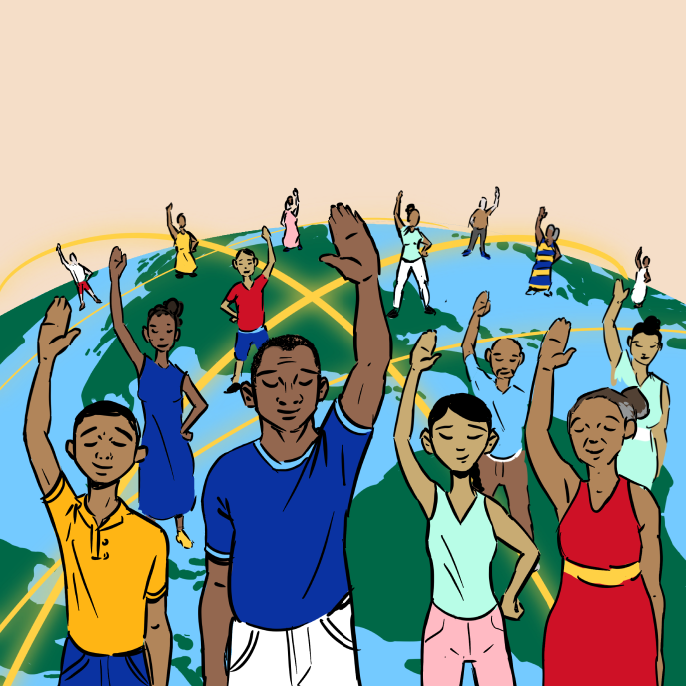
IMAGE BANK
i
3/3
Image Selection
Think of which image/s convey/illustrate the story you’d like to tell before selecting any.
There are more images in the next slides to choose from
Think of your story and what you want to express. Copy the images needed from here and place them in your template to match the sequence of your story.
Type text here
Type your text in here after you copy the image to your template
1
Copy and Paste
Click on the image you’d like to place in your template. Press Command + C or Ctrl + C to copy the image.
Please don’t edit any text or delete any images from here. this is an image bank that’s meant to remain as is for others to use.

Slide 5
EXAMPLE OF
TEMPLATE IN USE
ON NEXT SLIDE

Slide 6
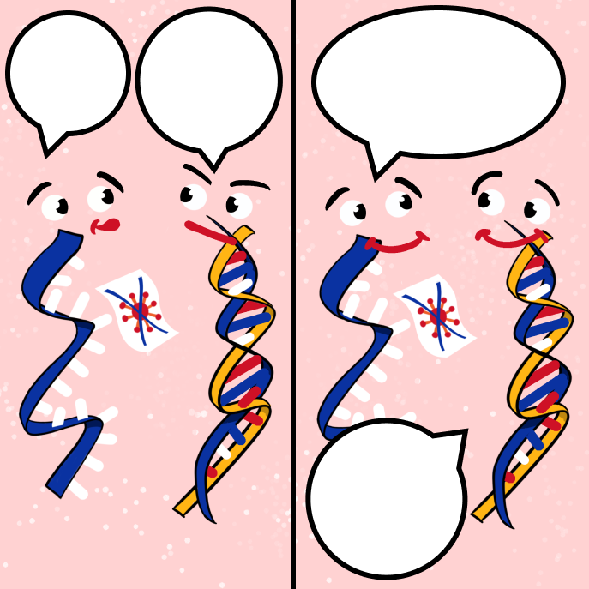

VACCINATION IS
SAFE AND EFFECTIVE
The vaccine was tested on millions of people already and has proved to be safe and effective.
Side effects tend to be mild and they should go away in a few days.
Anybody can experience these side effects regardless of gender or race
Hi! I’m MRNA
And i’m DNA! Are you here to change me?
No! I just came to deliver instructions on how to fight COVID-19 and then I’ll be gone.
Phew! Ok, great! You can chat with
the immune system
Learn more on www.cdc.gov

Slide 7
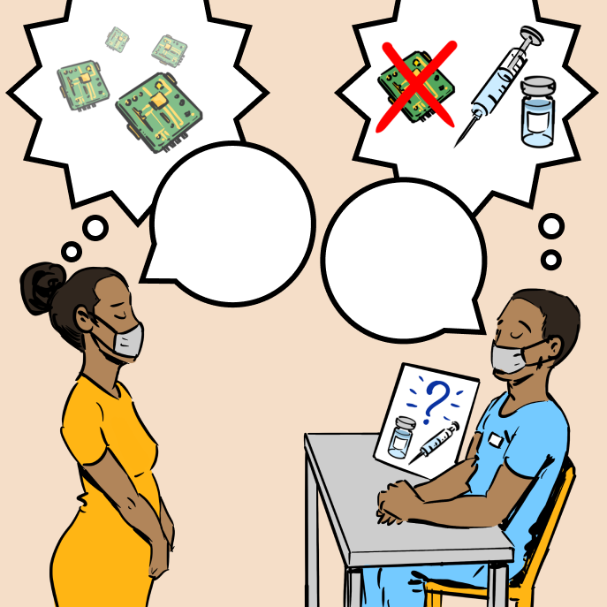
VACCINATION IS
PROTECTION
Side effects tend to be mild and they should go away in a few days.
I’m worried you’re going to put a chip in my body
Have a look the vaccine is just liquid no chips involved
The vaccine was tested on millions of people already and has proved to be safe and effective.
Hi! I’m MRNA
And i’m DNA! Are you here to change me?
No! I just came to deliver instructions on how to fight COVID-19 and then I’ll be gone.
Phew! Ok, great! You can chat with
the immune system
Learn more on www.cdc.gov

