Slide 1

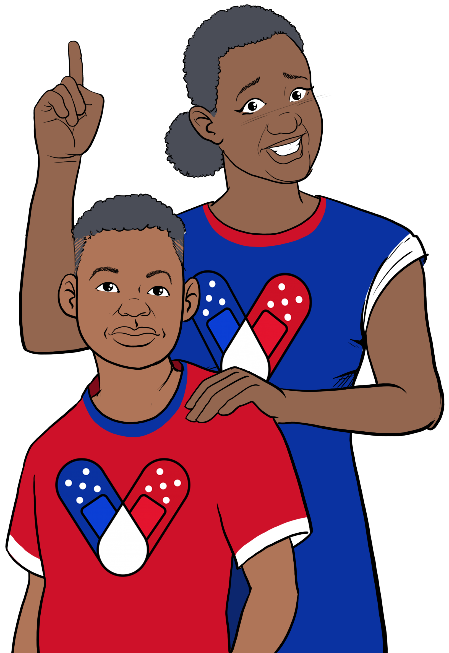





Why should we vaccinate children?
HOW CAN I GET MY CHILD A COVID-19 VACCINE?
Some children get very sick from coronavirus. COVID-19 is a leading cause of death in children. It is #1 in deaths caused by infections/respiratory diseases. Thousands of children have been hospitalized for COVID. Most were not vaccinated. About 1/3 had no preexisting condition like diabetes or obesity.
Most children don't become as sick as adults, but they can still spread it. COVID-19 vaccines prevent grandparents, younger siblings, and others from severe disease, hospitalization, and death.
Getting kids vaccinated helps prevent outbreaks that cause school closures.
Contact your local health department to make an appointment or ask them where mobile vaccine clinics are located.
Contact your local community health center to make an appointment.
Ask your child's pediatrician if they offer COVID-19 vaccines.
Check with your local pharmacy. They will likely offer vaccines.
Speak with your child's school about getting a COVID-19 vaccine. They may offer in-school vaccine clinics.
In some places, parents are required to be present when their child is vaccinated. Look for after-hour and pop-up clinics to make it easier for working parents.
Is the vaccine safe for children?
As of June 2022, 8.5 million children under 12 have been fully vaccinated in the US (that is 30% of that population in the US). Nearly 60% of children 12-17 are fully vaccinated. Not one child has died due to the vaccine.
Risks from COVID-19 greatly outweigh any potential risks from the vaccine.
FOR MORE INFORMATION
Children and
the COVID-19 Vaccine
How do we keep children under six months old safe?
Visit Centers for Disease Control and Prevention:
www.cdc.gov/coronavirus/2019-ncov/index.html
Currently, there is not an approved COVID-19 vaccine for children under 6 months old. But you can protect children from being infected and spreading the virus to others.
For answers to Frequently Asked Questions, visit Migrant Clinicians Network (MCN):
https://bit.ly/3ki1xAI
GET VACCINATED!
Wear a mask
Social distancing
Wash your hands
Ensure all household members aged 6+ months
are vaccinated.
Breastfeeding moms can get vaccinated to help pass antibodies to their baby.
Encourage indoor masking wearing and social distancing especially among the unvaccinated.
Wash hands.
Updated: July 11, 2022
COVID-19 Vaccine Awareness Campaign

Slide 2
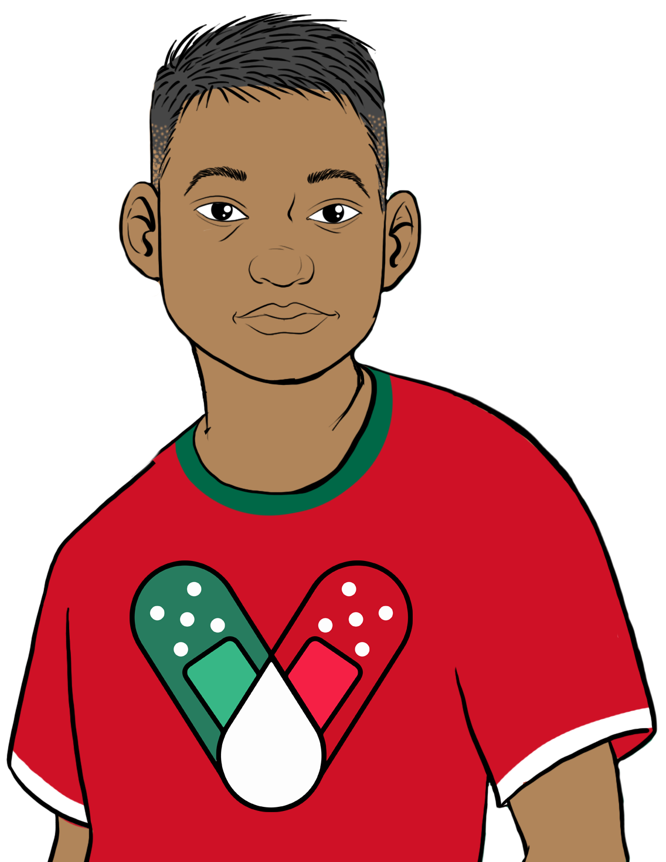
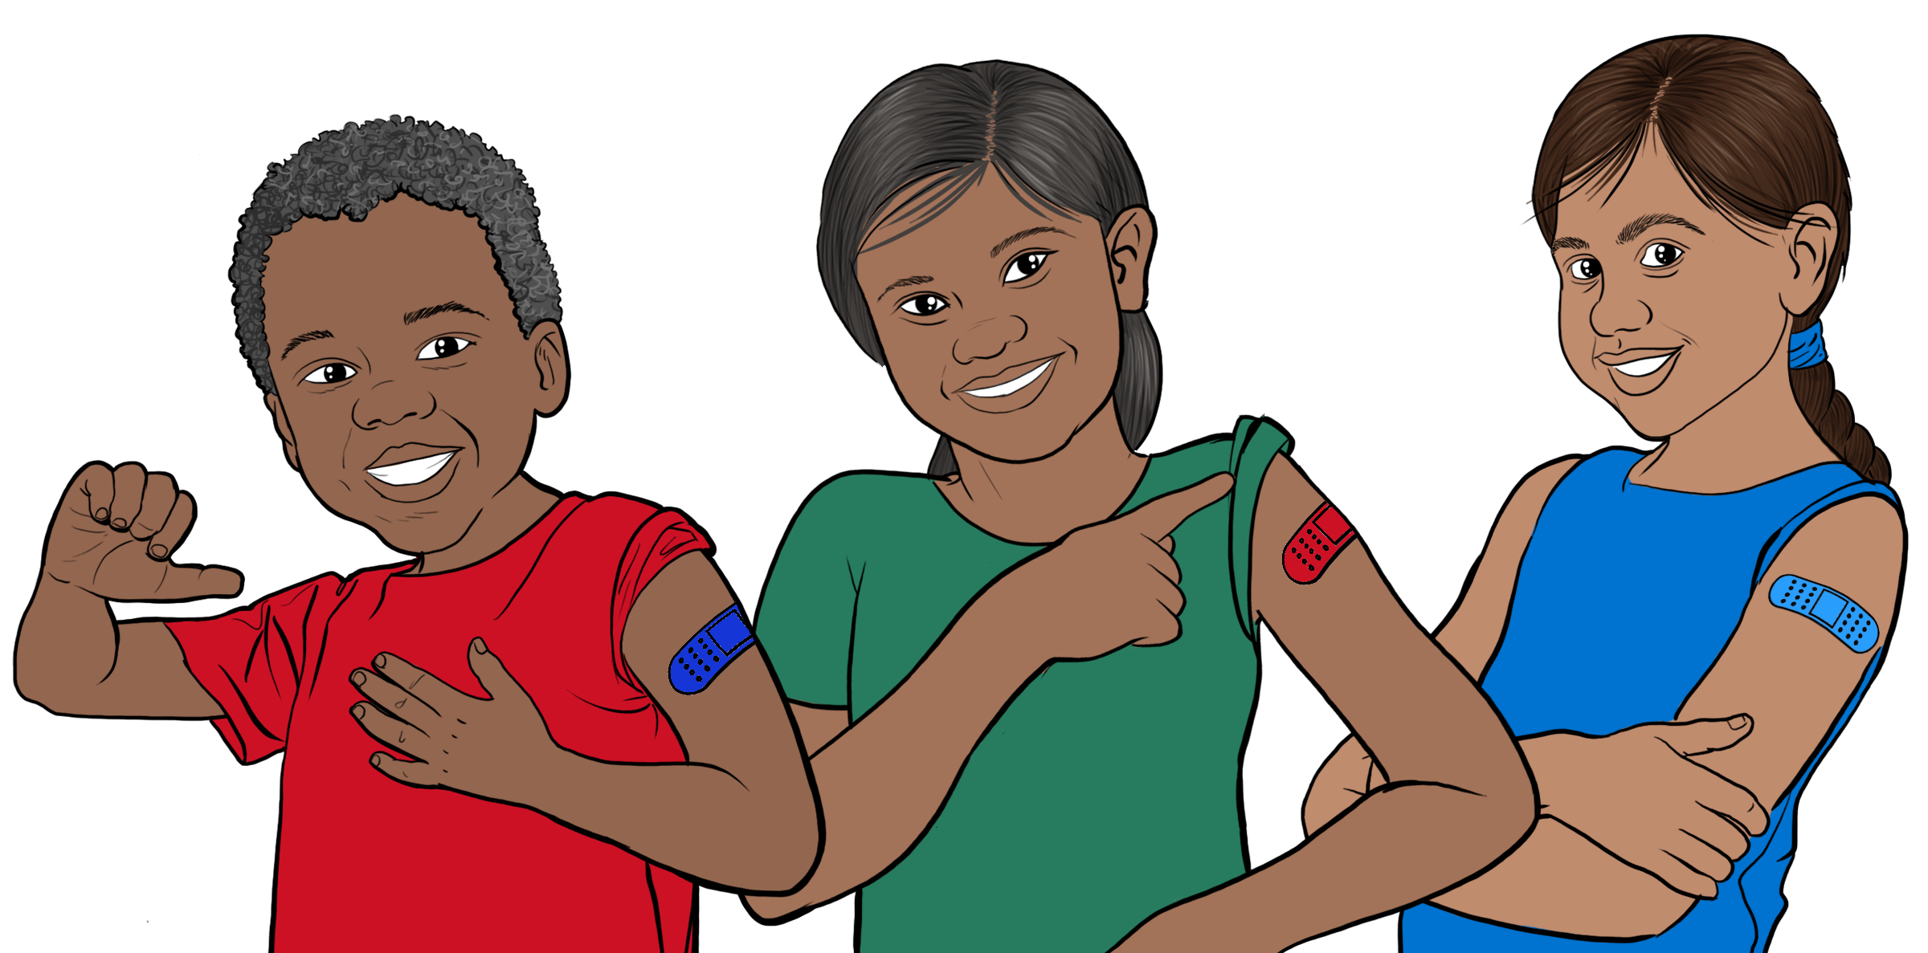



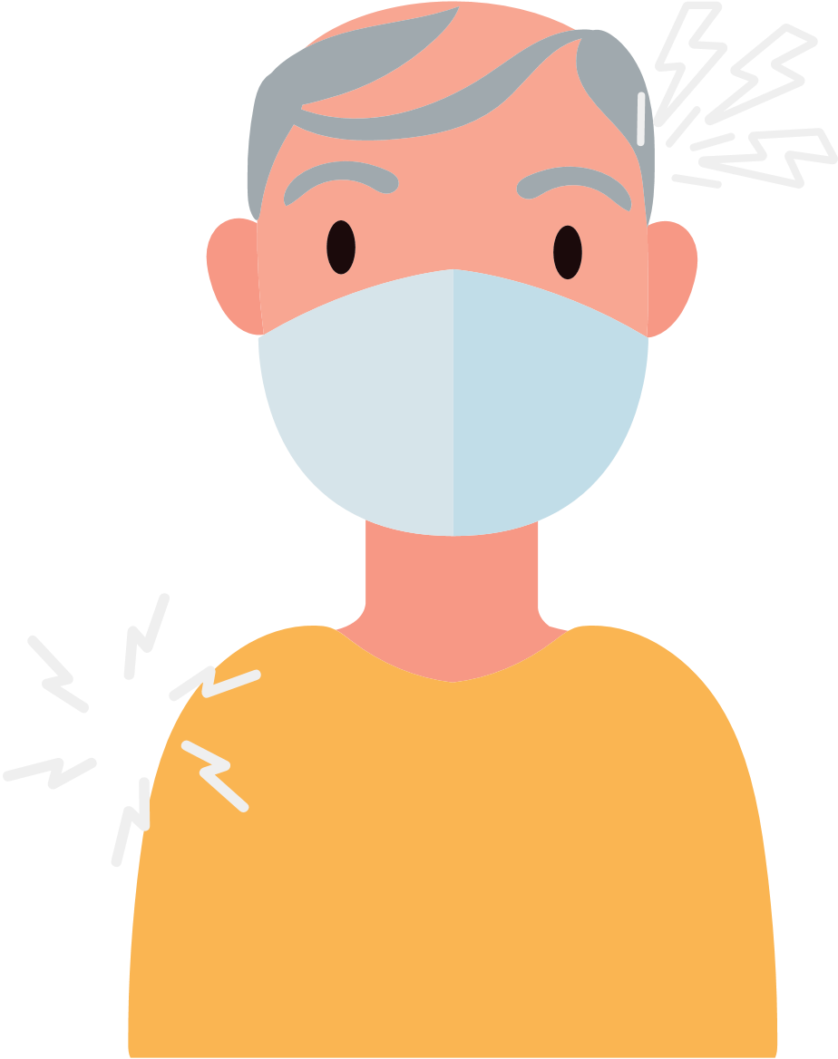


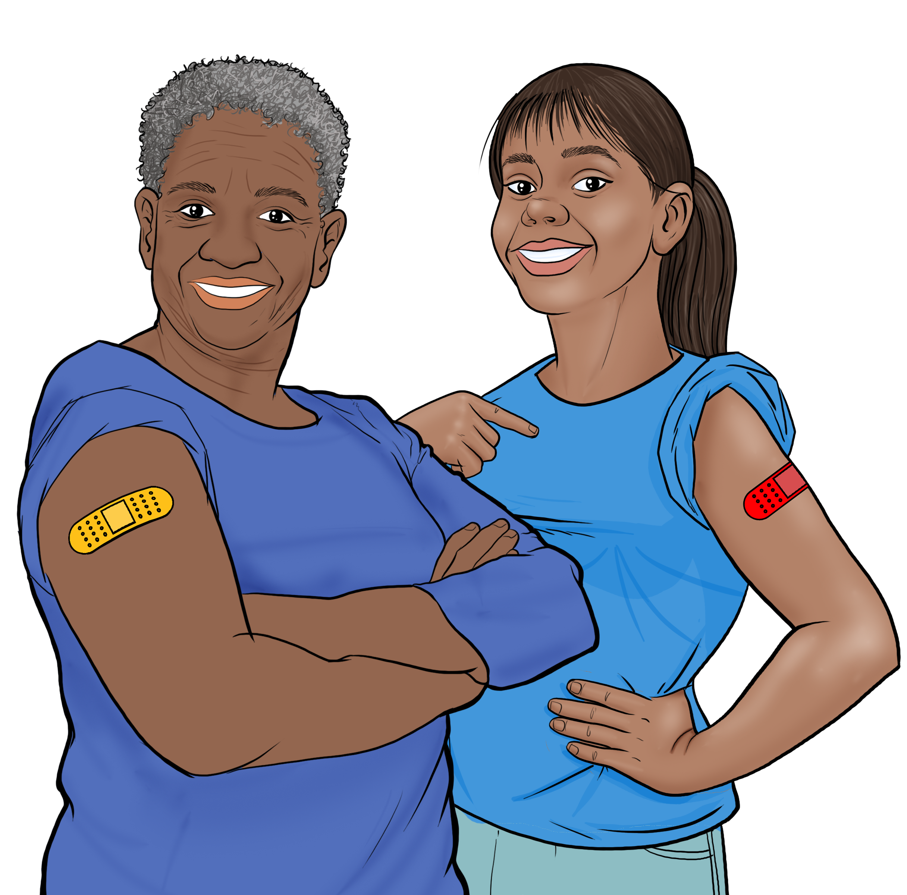
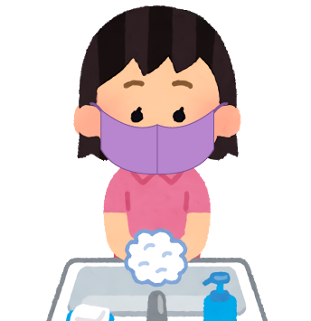

COVID-19 VACCINES
FOR CHILDREN
WHAT TO EXPECT AFTER CHILDREN ARE VACCINATED?
Children 6 mos. to 4 yrs: 3 doses for Pfizer, 2 doses for Moderna. No booster at this time.*
Children 5+: 2 doses. Pfizer, 1 booster.*
Immunocompromised children:
5-11: 3 doses, plus one booster.
12-17: 3 doses plus 2 boosters.
Spacing between doses varies, but for boys 12-17: 2 doses, 8 weeks apart.** Visit the CDC's page for spacing: https://bit.ly/3zcBgwT
BENEFITS OF VACCINATION
It is important for children to get vaccinated, even if they've had COVID-19.
It is completely FREE and does NOT require any form of identification.
Vaccination protects children and their families from becoming seriously ill and being hospitalized.
Vaccination decreases the number of severe and deadly COVID-19 cases in
your community.
Vaccination protects hospitals and clinicians from being overwhelmed with severely ill COVID-19 patients.
The more vaccinated individuals in our community, the less we need to worry about new variants.
Children can return to normal activities sooner if more people get vaccinated.
*Moderna’s booster for both age groups is expected soon.
** The CDC recommends this altered schedule to reduce the very small risk of myocarditis among adolescent boys.
HOW TO PROTECT YOUR CHILDREN
The COVID-19 vaccine
is safe and effective
for children.
After vaccination kids may experience: arm pain, headache, fever, or chills.
Get vaccinated and get your children who are 6 months and older vaccinated.
Wear a mask when indoors even when you are up to date on your vaccines.
If your child is up to date on their vaccination and is exposed to COVID-19, the child does not need to quarantine. Get them tested 5-7 days after exposure.
They feel better
a few days after
the injection.
Kids are considered fully vaccinated two weeks after their final dose.
RISKS FOR UNVACCINATED
For
women:
Higher risk of COVID-19 infection.
Higher risk of serious infection, hospitalization, and death.
Higher risk of developing long-term symptoms of COVID-19 if infected.
Higher risk of being exposed to new forms of the virus that are more contagious and dangerous.
For women of any age who are pregnant, breastfeeding, or trying to get pregnant, vaccines are critical for keeping moms and their babies healthy.
For adults and teens between 18-60 years old, we recommend getting Pfizer or Moderna.
Continue to wear a mask in crowded indoor spaces and wash your hands.
Getting vaccinated helps protects kids and others from getting very sick from COVID-19!

