Slide 1
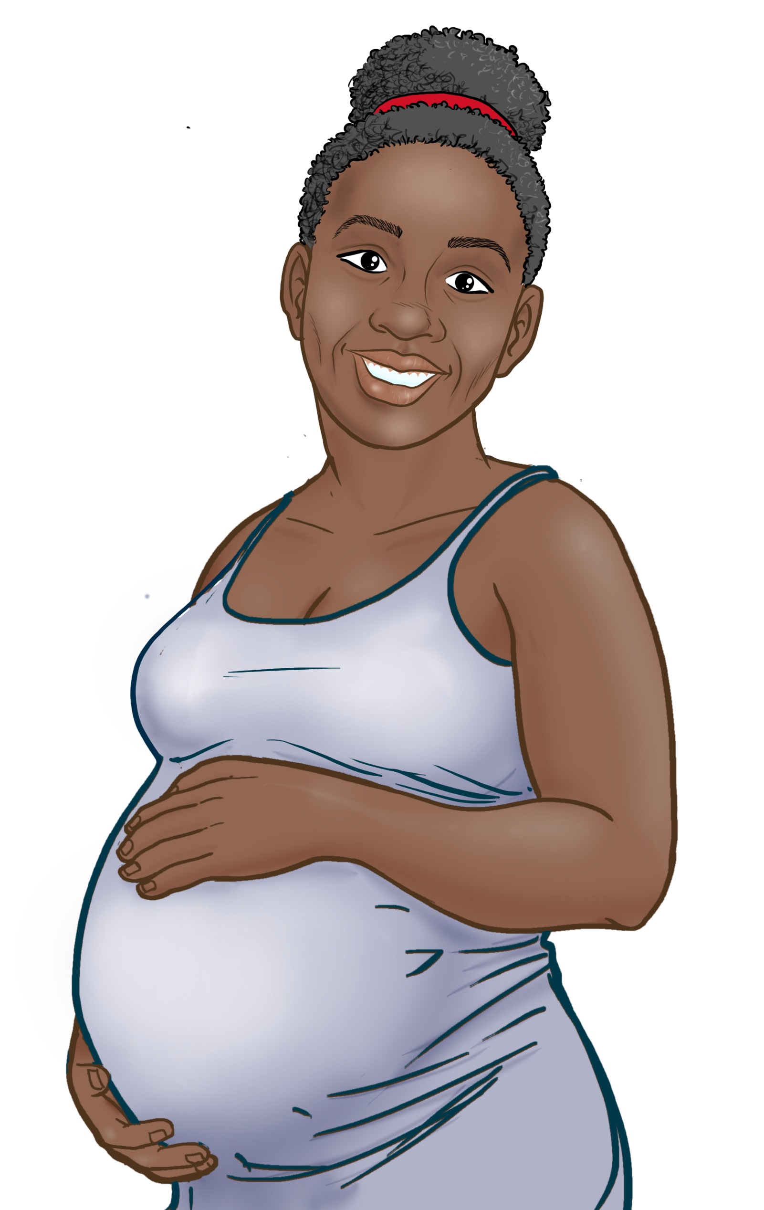
2
Include information on local vaccination efforts
Use the top portion back cover of the brochure to provide resources and links out to more information on vaccination in the area.
The text on this panel is completely editable and new text can be added by right clicking on the border of a text box → selecting copy from the menu → right click where you want the new text box → select Paste from the menu
1
Eske vaksen an san danje pou mwen ak bebe mwen? Kisa ki te chanje ofilditan?
KIJAN POUM GEN VAKSEN COVID-19
Add an image and scale it
Go to Insert → Image → Upload from Computer and select an image of you that you’d like on the brochure cover.
To scale, grab bottom right corner of image and hold the clicker down. Drag your mouse or finger across diagonally until it’s the same size/slightly bigger than the slide.
Send your image back
Once you size your image and scale it proportionally to the size of the slide or slightly bigger, right click on the image and go to Order → Send to back
Crop your image
If the image is larger than the brochure cover, you can crop it by right clicking on the image and selecting the Crop tool that appears in the pop-up menu. You can then drag the black bars at the edges of the image to trim it to the right size. Click outside of the image to apply the changes.
Nan komansman pandemi an, nou pat konnen efè vaksen yo nan fanm ansent ak bebe yo.
Kounye a, nou genyen anpil done, e nou kapab di avèk konfidans: Vaksen COVID-19 yo pap koze okenn danje pou ou ak pitit ou!
Depi fevriye 2022, plis pase 200,000 fanm ansent te pran vaksen kont COVID-19.
Pat genyen okenn rapò de risk ogmante nan foskouch, pwoblèm de kwasans, oswa defo nesans.
Vaksen COVID-19 yo se vaksen ki vivan,konsa, fanm ansent yo ak bebe yo papkapab trape COVID-19 de vaksen an.
Kontakte depatman sante lokal la pou fè yon randevou oswa mande ki kote klinik vaksen mobil la lokalize.
Pale avèk doktè OB/GYN ou.
Tyeke avèk famasi lokal ou. Petèt yo kapab ofri vaksen yo.
Kontakte Sant sante kominote lokal la pou fè yon randevou.
Pale avèk anplwayè ou konsènan resevwa vaksen COVID-19 la. Yo kapab ede'w fè aranjman pou resevwa vaksen an.
Tcheke pou wè si yo ofri vaksen yo gratis nan depatman sante lokal oswa eta a oswa nan famasi lokal ou a. Tcheke pou wè si yo ka anile frè yo.
Anefè, vrè risk la se lè yon fanm ansent chwazi poul PA vaksine.
Gwosès ak
Vaksen
COVID-19 la
POU PLIS ENFÒMASYON
Fanm yo ki vin malad avèk COVID-19 pandan gwosès:
Gen anpil chans pou yo malad pi grav akòz COVID-19 parapò ak fanm ki pa ansent yo.
Gen anpil chans pou yo bezwen swen nan Inite Swen Entansif (Intensive Care Unit, ICU).
Gen anpil chans pou yo bezwen tib pou yo respire.
Gen gwo risk pou yo mouri.
Gen gwo risk pou yo akouche yon ti bebe ki enfekte ak COVID-19.
Vizite Sant Kontwòl Maladi yo ak Pwevansyon: https://www.cdc.gov/ coronavirus/2019-ncov/index.html
Mete mask
Distans sosyal
Lave men ou
PRAN VAKSEN AN
Pou Repons ak Keksyon yo poze souvan, vizite Migrant Clinicians Network: https://bit.ly/3ki1xAI
Mizajou: 18 dawout 2022
Kanpay Sansibilizasyon Vaksen COVID-19
3
Add information on your organization and other relevant resources
The bottom portion of the back cover allows you to include organizational links, phone numbers, and other information useful to your community.
Be sure to include a date on the brochure as information changes quickly.

Slide 2
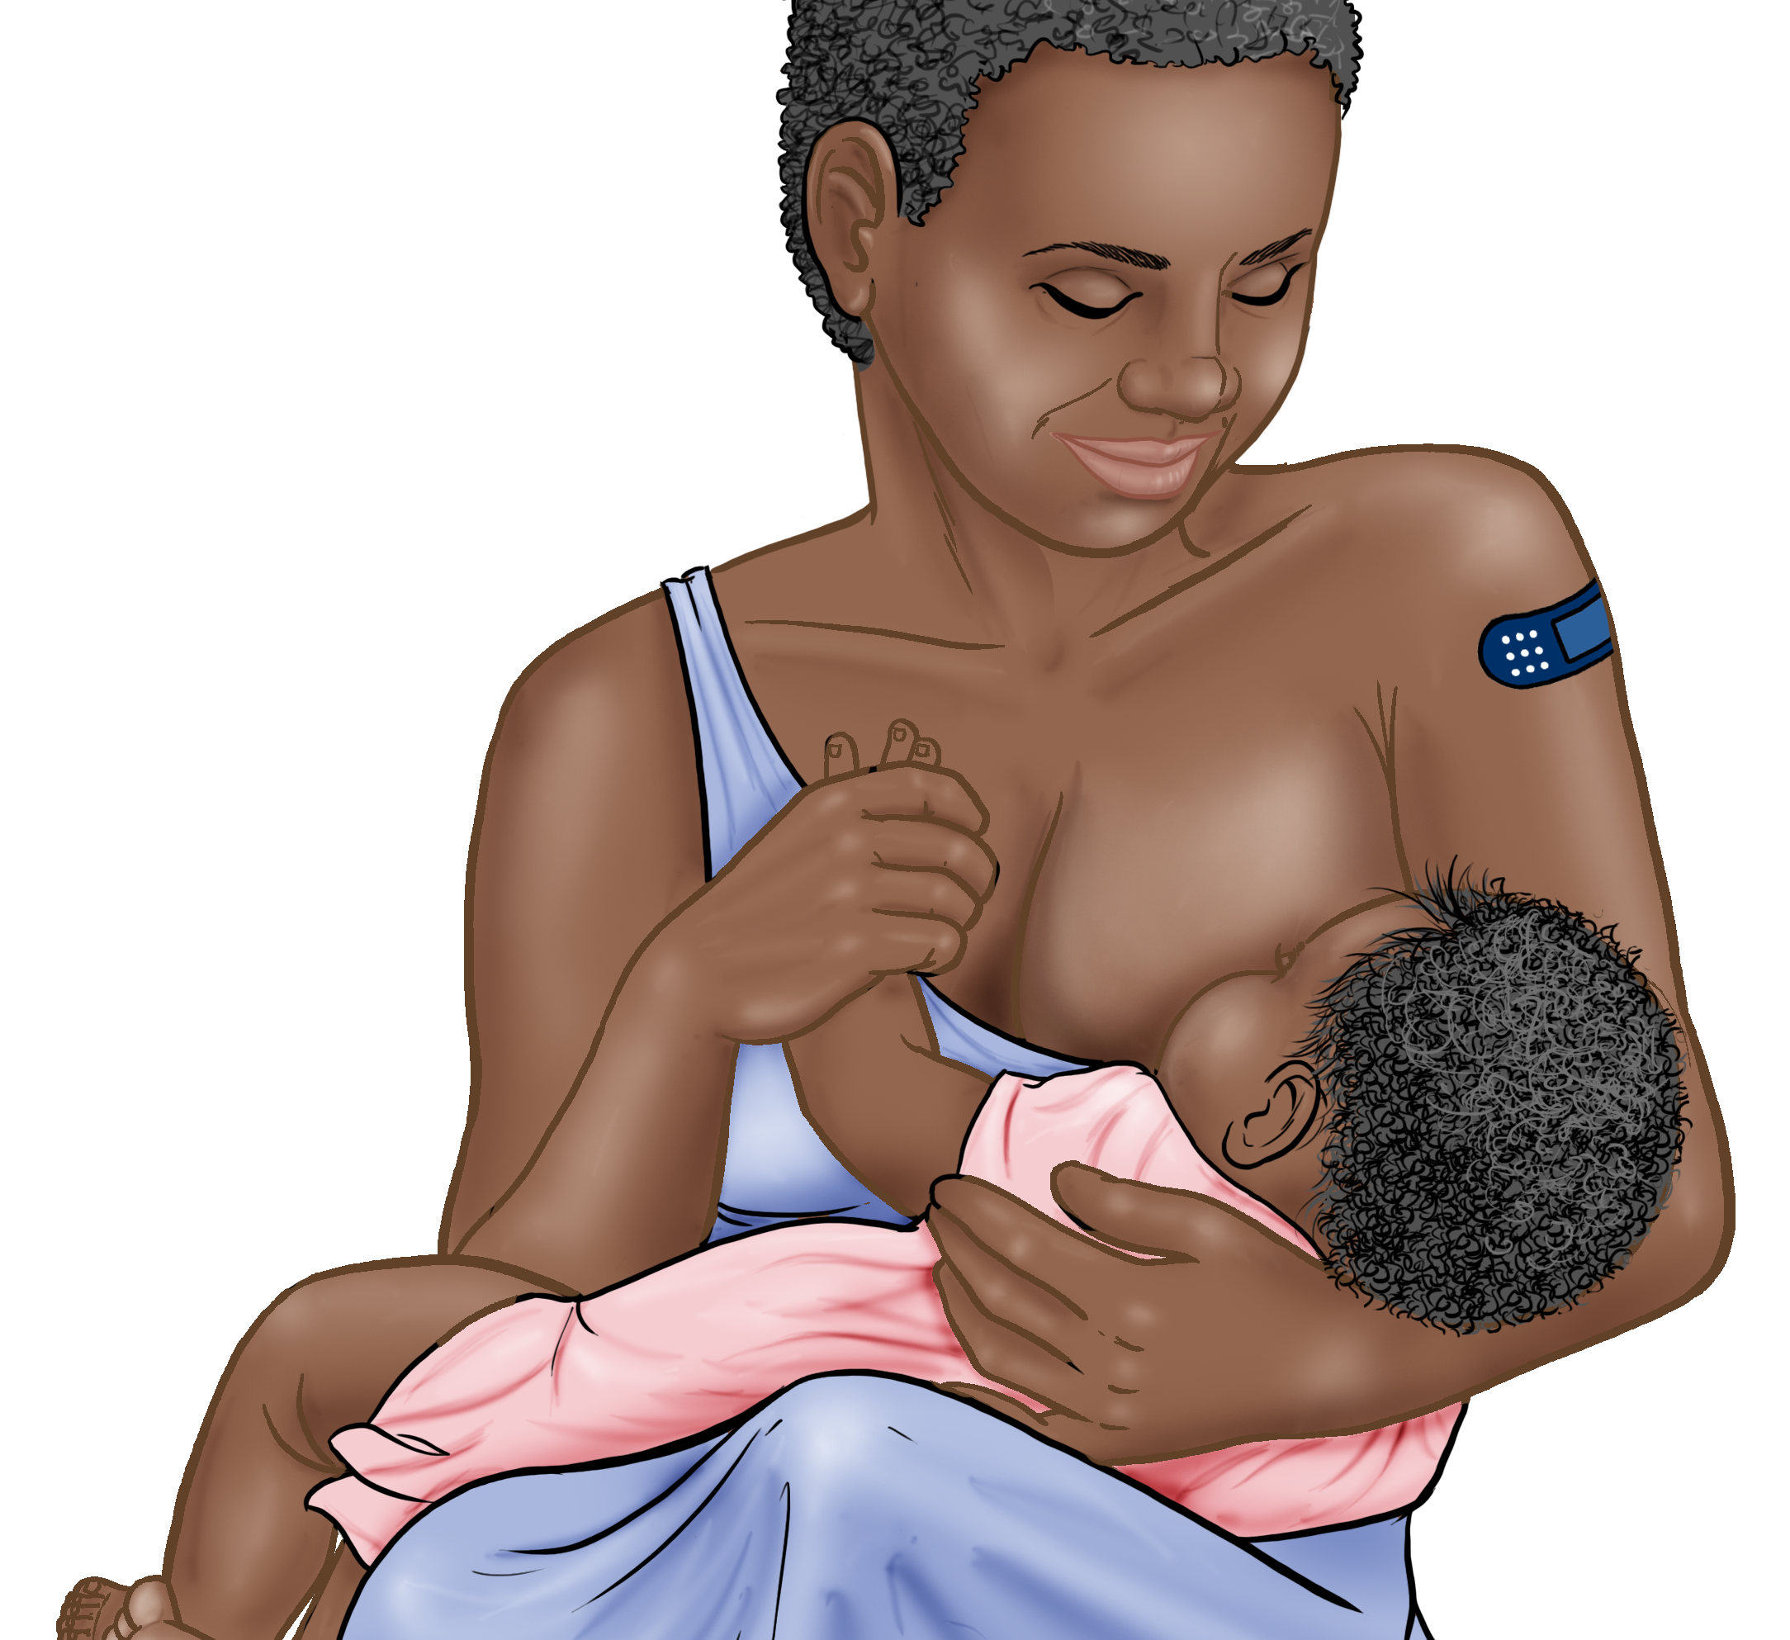
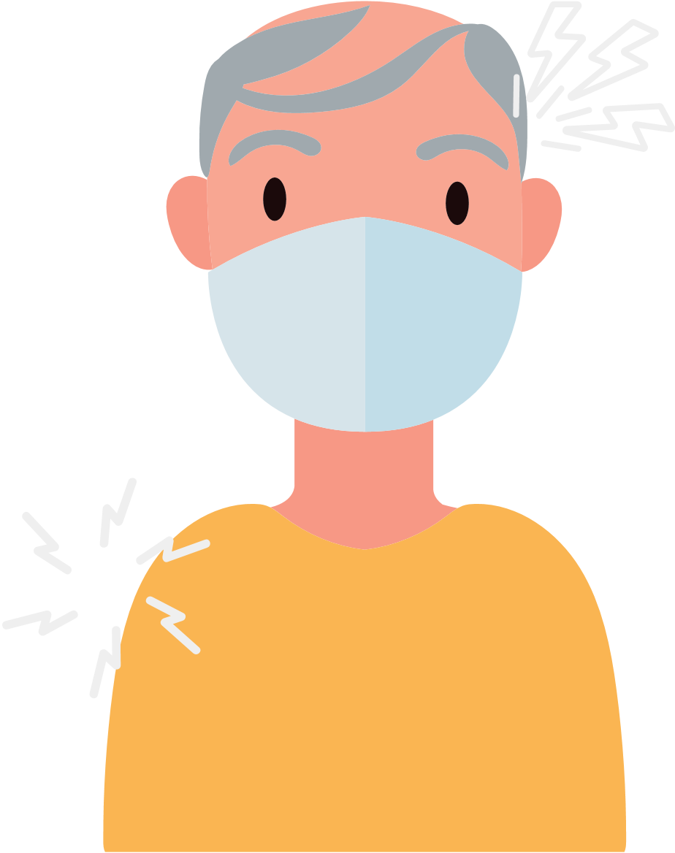
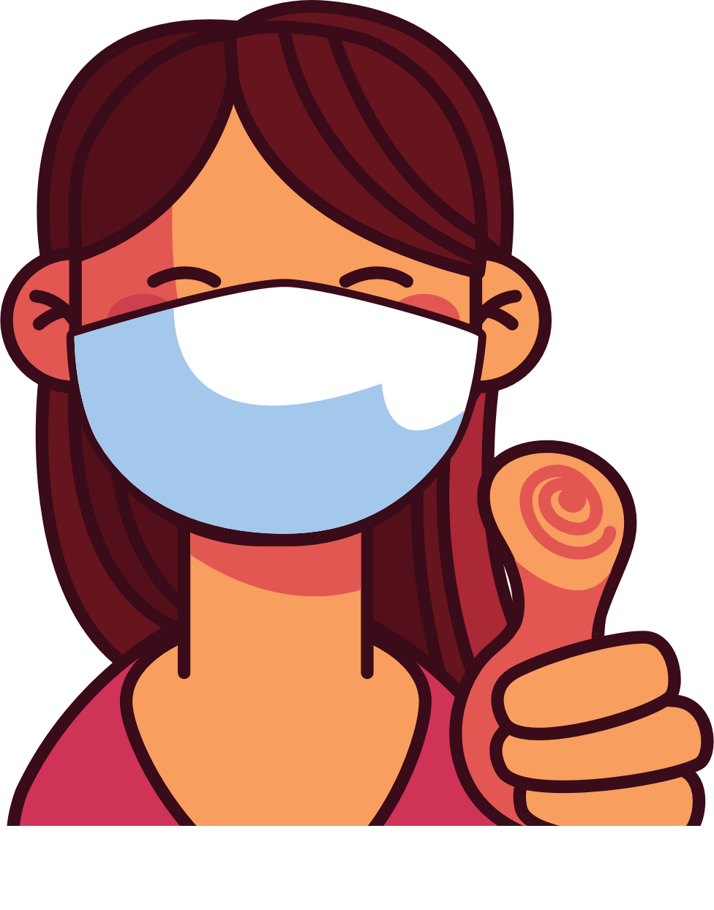
4
Address Concerns in the Community
This panel is intended to provide information addressing the concerns specific to the community receiving the brochure.
The text boxes with the questions and answers can be edited, copied or deleted so you can customize this panel to fit your needs.
Here you can include links to relevant resources or more information addressing the community’s concerns.
VAKSEN COVID-19 YO YO SAN DANJE E EFIKAS
KISA POU KONNEN LÈ W AP PRAN VAKSEN COVID
Kalite vaksen ki disponib nan peyi Etazini:
Pfizer
Moderna
Johnson & Johnson (J&J)
Novavax
Ou ka bezwen youn oswa plizyè dòz rapèl plizyè mwa apre ou fin resevwa premye dòz ou yo dapre laj ou, vaksen ou resevwa ak lòt faktè.
AVANTAJ VAKSINASYON AN
Li enpòtan pou'w pran vaksen an menm lè’w te deja trape COVID-19.
Ou PA bezwen okenn fòm idantifikasyon
Vaksinasyon an ap pwoteje'w, fanmi’w, pitit ou, ak kolèg nan travay ou pou yo vin malad grav e pou yo pa etène lopital.
Vaksinasyon an ap diminye risk pou manman yo ansanm ak bebe yo.
Vaksinasyon an ap diominye risk de nonb nouvo de ka grav ak ka lanmò de COVID-19 nan kominote ya.
Vaksinasyon an ap pwoteje lopital yo ak founisè swen yo pou yo pa sichaje avèk pasyan ki malad grav ak COVID-19.
Plis gen moun ki pran vaksen an nankominote ya, mwens nap bezwenenkyete konsènan nouvo varyan yo.
REKÒMANDASYON YO
Pran vaksen an.
Menm si ou ajou ak vaksin ou, mete yon mask lè w anddan. Mete yon mask le w nan anviwònman kote ki gen anpil moun.
Si ou ajou ak vaksin ou, e ou ekspoze ak COVID-19, fè tès la 5-7 jou apwè ekspoze a kòm rekomande pa CDC.
Si w ajou nan vaksen ou yo epi w trape COVID-19:
Si w santi sentòm yo: Fè tès la touswit. Si tès la negatif, refè tès la ankò nan 48 èdtan.
Si w pa santi sentòm yo: Fè tès la, pou pi piti, 5 jou apre w fin trape COVID-19. Si tès ou a negatif, refè tès la ankò apre 48 èdtan, epi fè sa ankò apre yon lòt 48 èdtan si dezyèm rezilta w la negatif. Chache wè yon doktè si w panse w malad.
Pou fanm ki ansent, kapbay tete, oswa kap eseye vin ansent, vaksen yo enpòtan anpil pou kenbe manman ak bebe yo an sante.
Pou fanm migran yo ant 18-60 tan daj, nou rekomande'w pou pran vaksen Pfizer oswa Moderna, sil disponib nan zòn nou an.
Genyen divès kalite vaksen. Tout vaksen ki kont COVID-19 la yo san danje e yo efikas.
Apwè vaksinasyon an, ou kapabsoufri avèk:ponyèt fèmal, tèt fèmal, lavyèv, oswa frison.
5
Save the file as a PDF
Once the content of the brochure has been finalized, you can save the file as a PDF for printing and distribution.
Export as a PDF using PPT:
Select slide. File → Save As Adobe PDF
Export as a PDF using Google Slides:
File → Download → PDF Document
Ou pral santi'w pi byen kèk jou apwè vaksen an.
W'ap konsidere tèt ou konplètman vaksine 2 semèn apwè dènye dòz final ou.
RISK AK MOUN SAN VAKSEN
Risk ki piwo nan enfeksyon COVID-19.
Risk ki piwo nan enfeksyon grav, nan etène lopital ak lanmò.
Risk ki piwo pou ekspoze a nouvo mytasyon ki kontajye ak danjere.
Kontinye pote mask nan espas anndan kote ki chaje moun epi lave men nou.
Ou te fè pati pa'w la pou te pwoteje tèt ou ak lòt moun de COVID-19 la!

