Slide 1
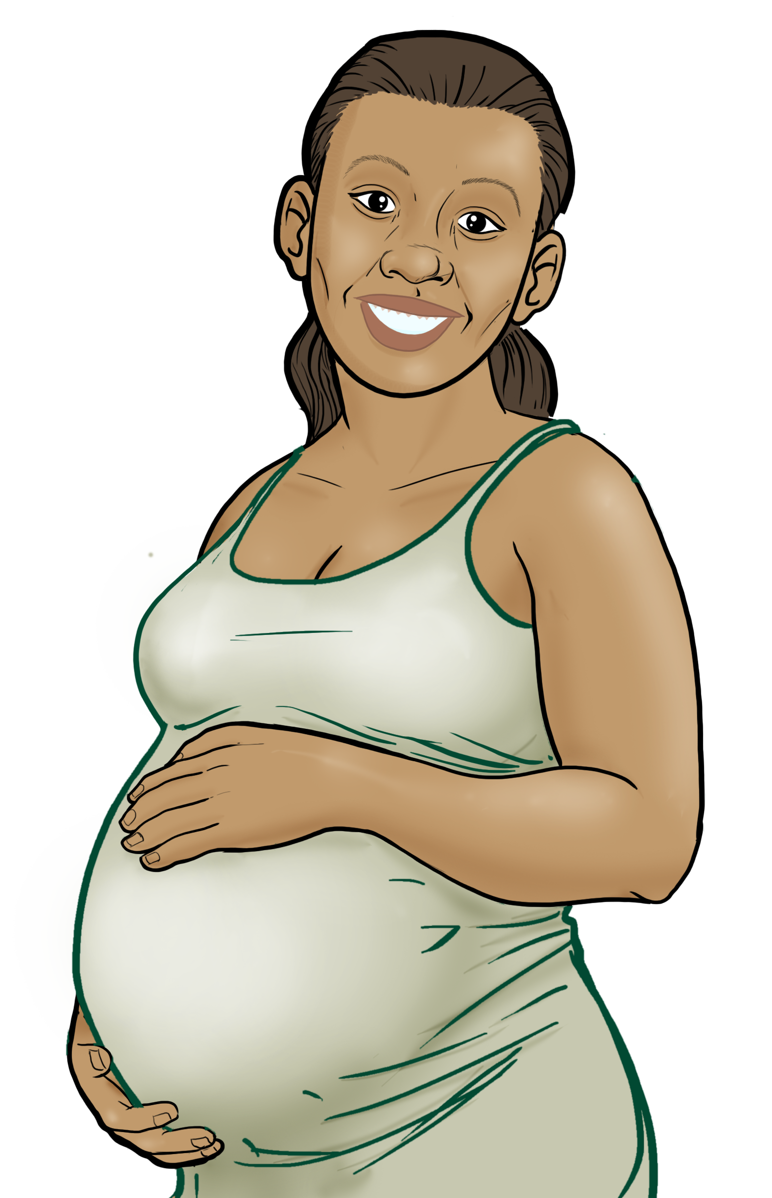
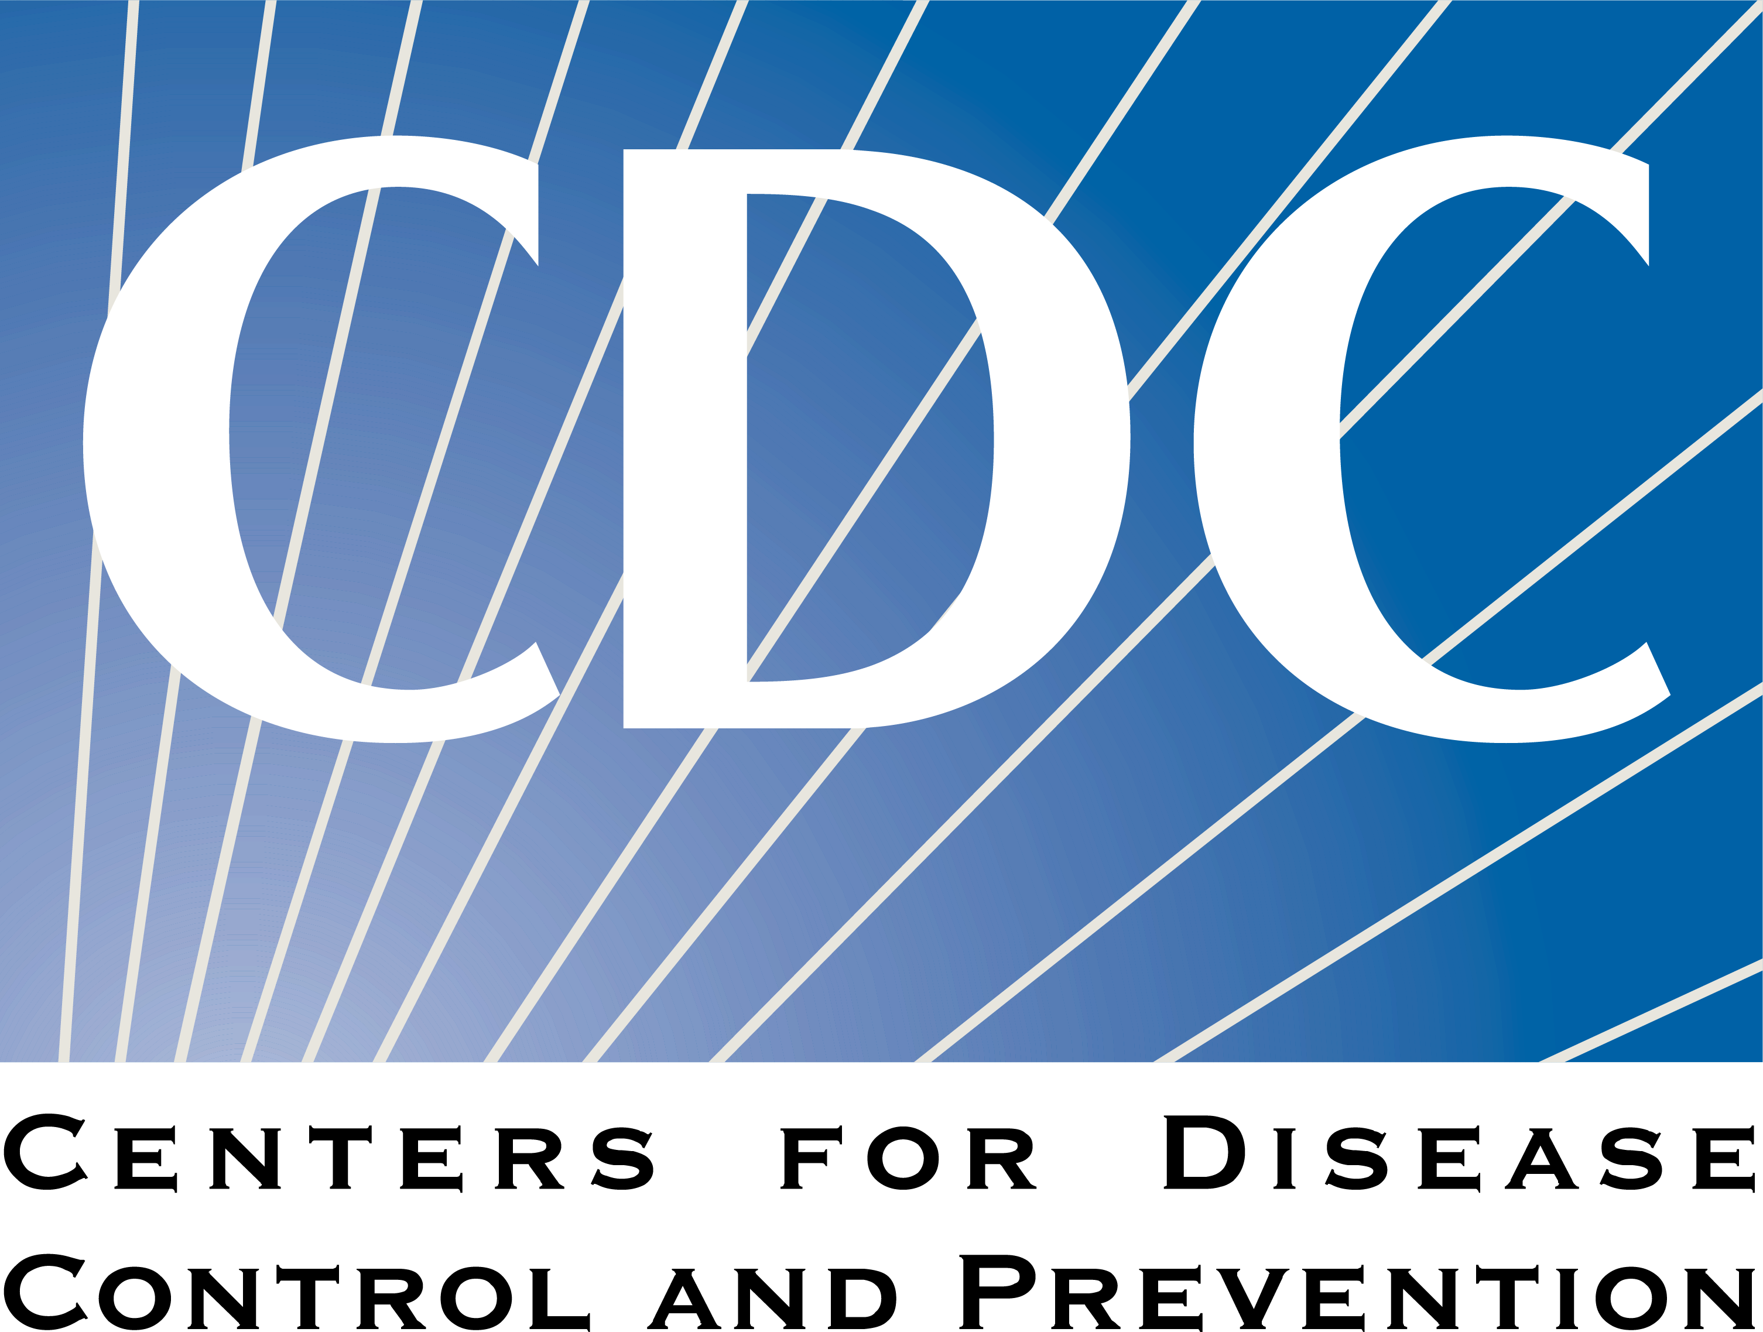
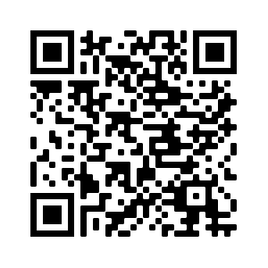
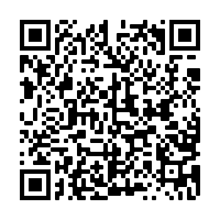
2
Include information on local vaccination efforts
Use the top portion back cover of the brochure to provide resources and links out to more information on vaccination in the area.
The text on this panel is completely editable and new text can be added by right clicking on the border of a text box → selecting copy from the menu → right click where you want the new text box → select Paste from the menu
1
Is the vaccine safe for me and my baby? What has changed over time?
HOW DO I GET A COVID-19 VACCINE?
Add an image and scale it
Go to Insert → Image → Upload from Computer and select an image you would like to use on the brochure cover.
To scale, grab bottom right corner of image and hold the clicker down. Drag your mouse or finger across diagonally until it’s the same size/slightly bigger than the slide.
Send your image back
Once you size your image and scale it proportionally to the size of the slide or slightly bigger, right click on the image and go to Order → Send to back
Crop your image
If the image is larger than the brochure cover, you can crop it by right clicking on the image and selecting the Crop tool that appears in the pop-up menu. You can then drag the black bars at the edges of the image to trim it to the right size. Click outside of the image to apply the changes.
Early in the pandemic, we didn't know the effects of the vaccine on pregnant and breastfeeding women and their babies.
Now, we have lots of data, and we can confidently say: the COVID-19 vaccines are very safe for you and your baby, before, during, and after your pregnancy!
As of February 2022, more than 200,000 pregnant women have been vaccinated against COVID-19.
There have been no reports of any increased risk of pregnancy loss, growth problems, or birth defects.
COVID-19 vaccines are not live vaccines, and pregnant and breastfeeding women and their babies cannot get COVID-19 from the vaccine.
There is no need to 'pump and dump' when getting a vaccine while breastfeeding.
Contact your local health department to make an appointment or ask them where mobile vaccine clinics are located.
Talk to your OB/GYN.
Check with your local pharmacy. They will likely offer vaccines.
Contact your local community health center to make an appointment.
Speak with your employer about getting a COVID-19 vaccine. They may be helpful in making arrangements to get a vaccine.
Check to see whether vaccines are offered for free at your state or local health department or local pharmacy. Check to see if fees can be waived.
In fact, the real risk is when a pregnant woman chooses NOT to get vaccinated.
FOR MORE INFORMATION
Pregnancy, Breastfeeding, and the COVID-19 Vaccine
Visit Centers for Disease Control and Prevention:
www.cdc.gov/coronavirus/2019-ncov/index.html
Women who become ill with COVID-19 and have symptoms during pregnancy:
Are more likely to get very sick from COVID-19 compared to those who are not pregnant.
Are more likely to need ICU care.
Are more likely to need a breathing tube.
Are at an increased risk of dying.
Are at an increased risk of having a stillbirth or preterm birth.
Are at an increased risk of having a baby infected with COVID-19.
GET VACCINATED!
Wear a mask
Social distance
Wash your hands
For answers to Frequently Asked Questions, visit Migrant Clinicians Network (MCN): https://bit.ly/3ki1xAI
COVID-19 Vaccine Awareness Campaign
Updated: October 11, 2022
3
Add information on your organization and other relevant resources
The bottom portion of the back cover allows you to include organizational links, phone numbers, and other information useful to your community.
Be sure to include a date on the brochure as information changes quickly.

Slide 2
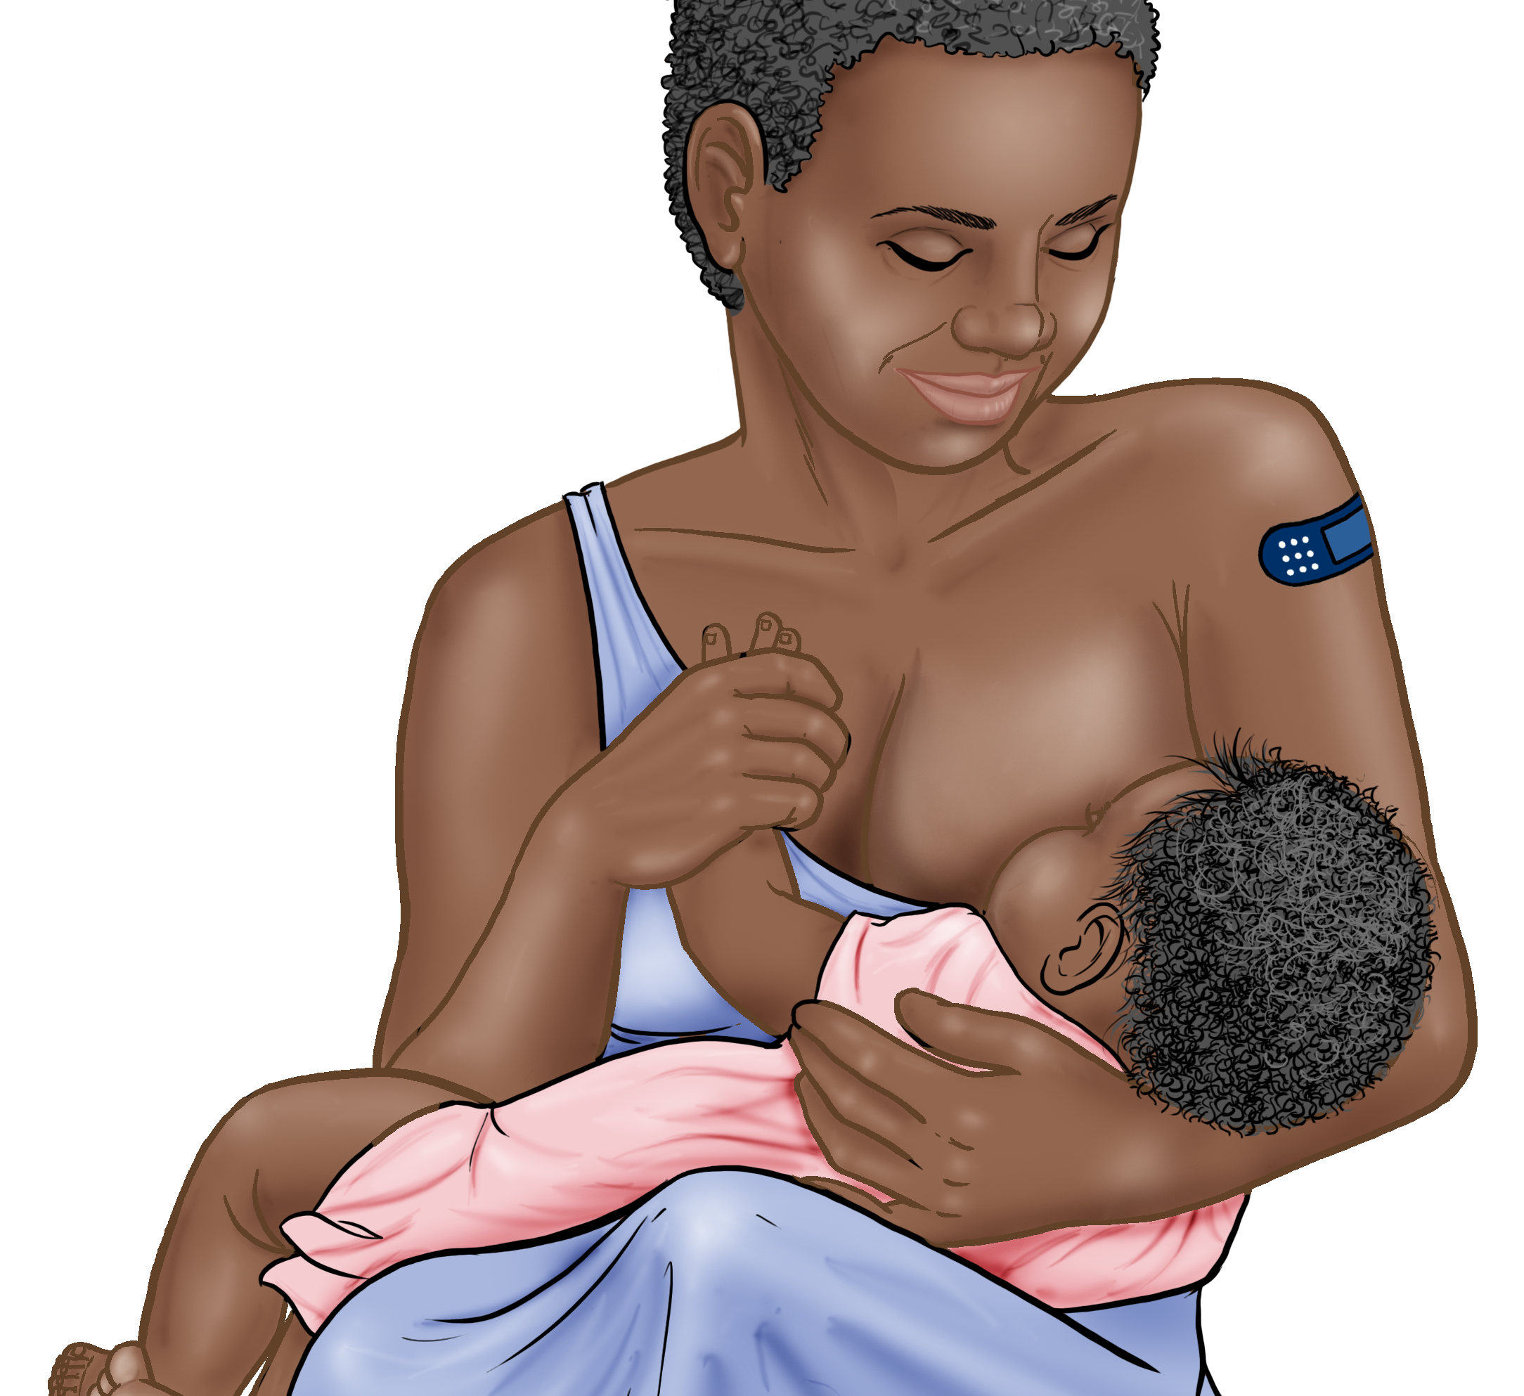
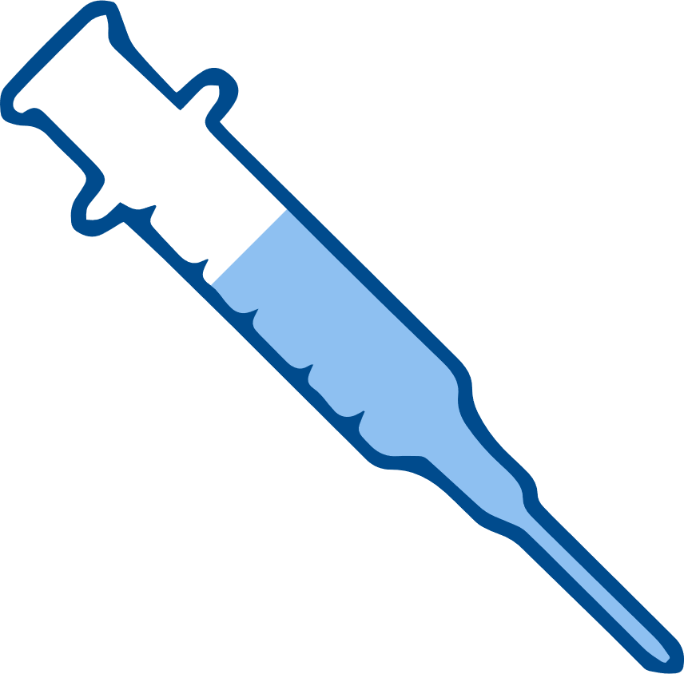
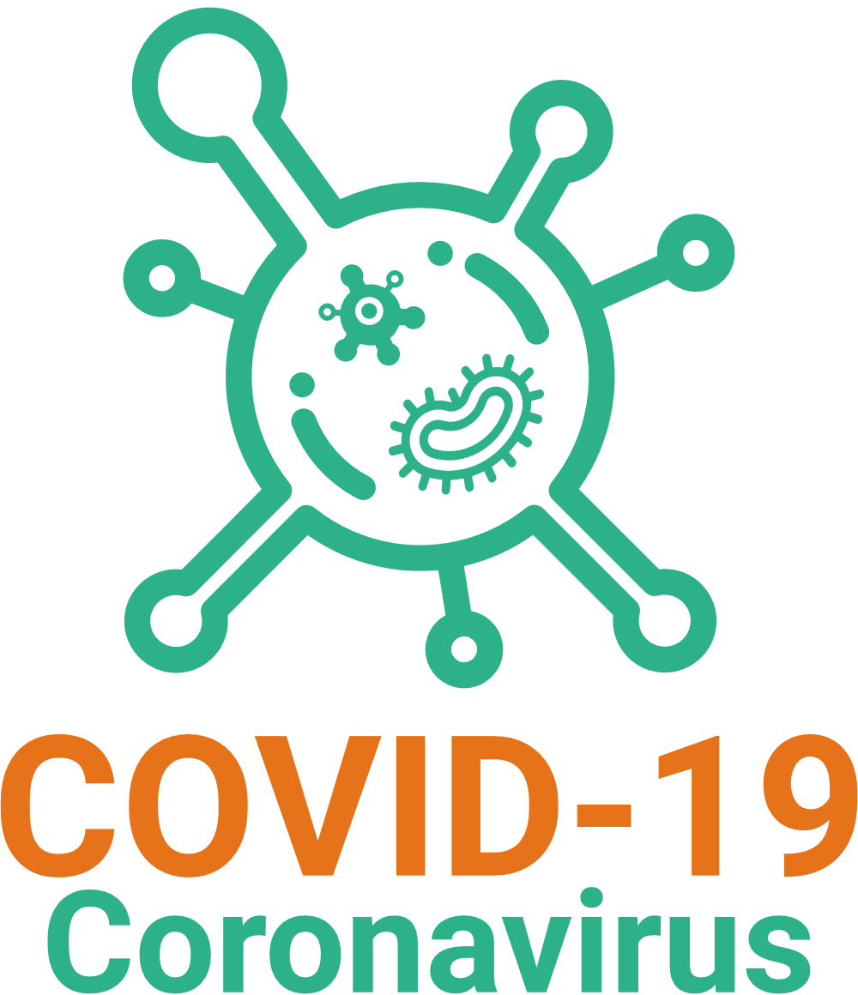
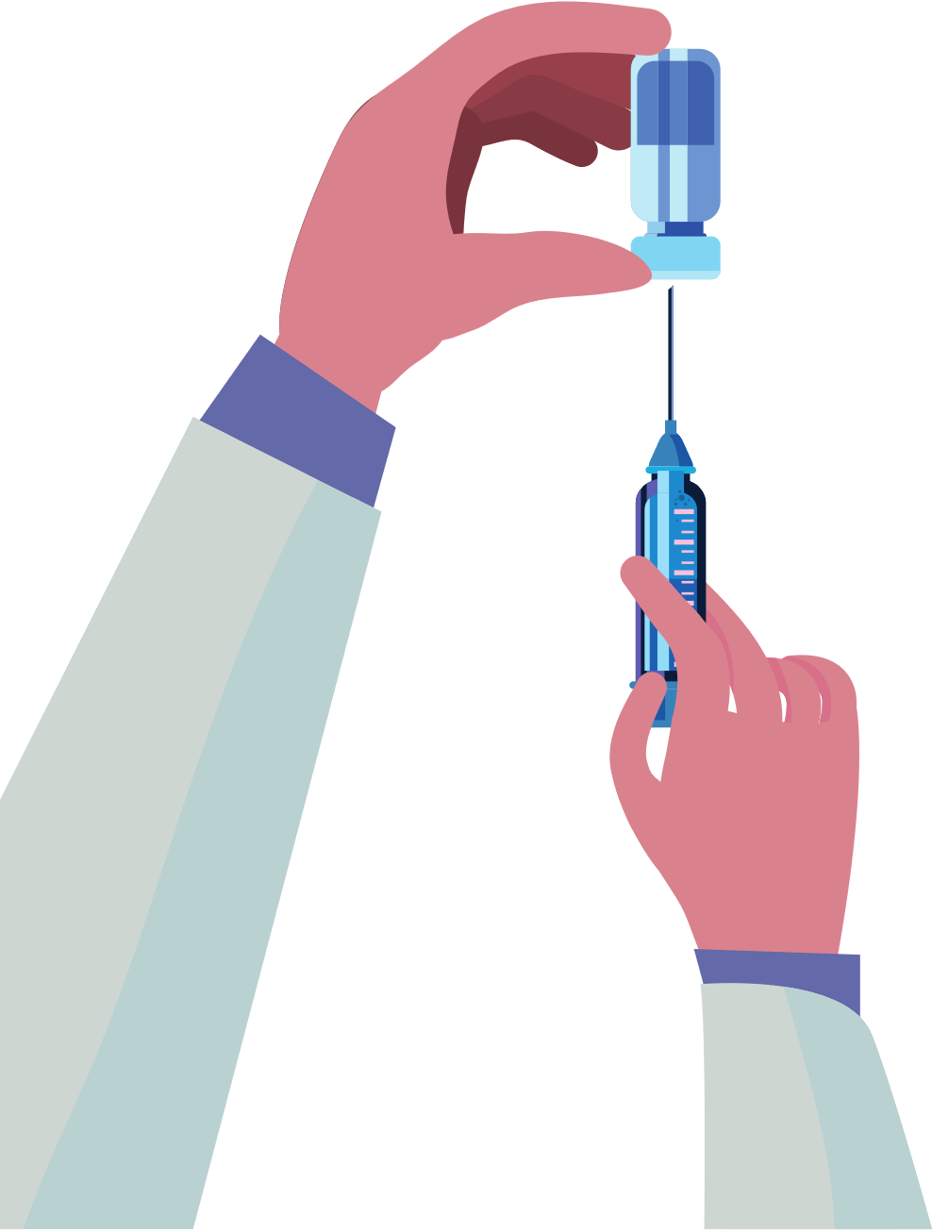
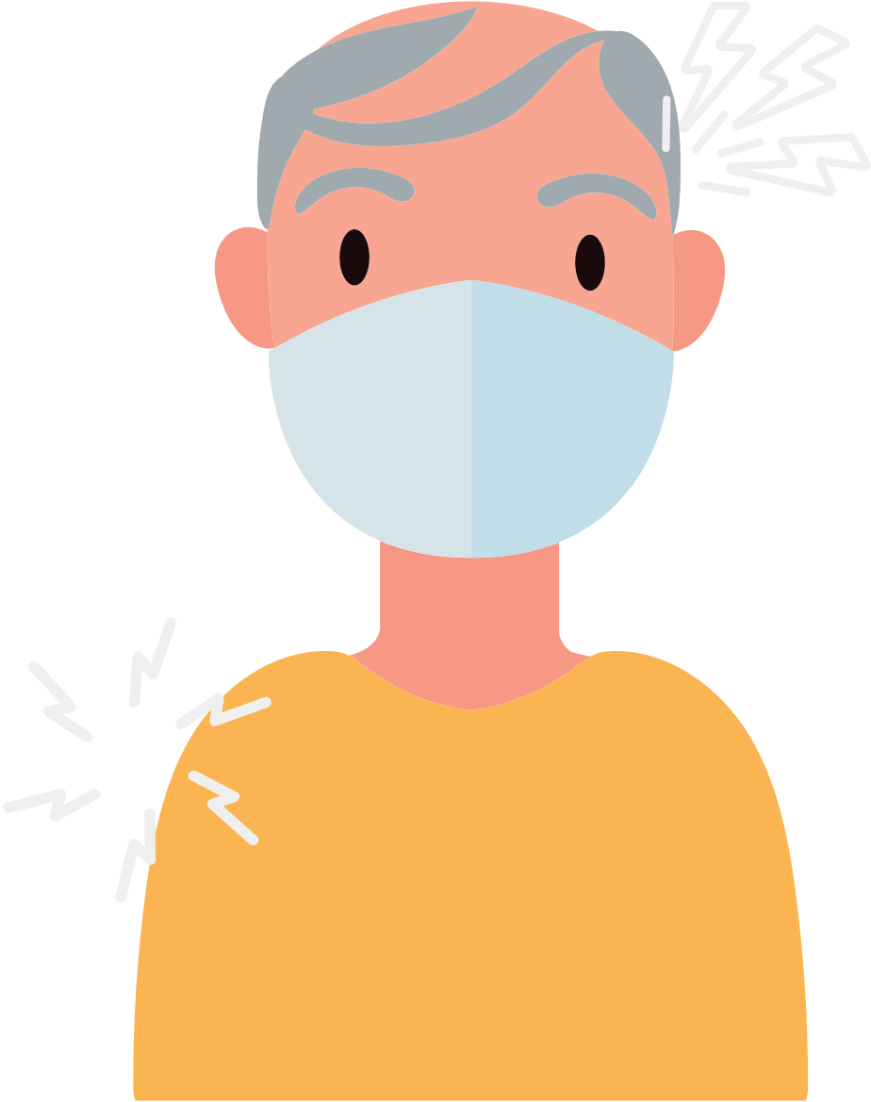
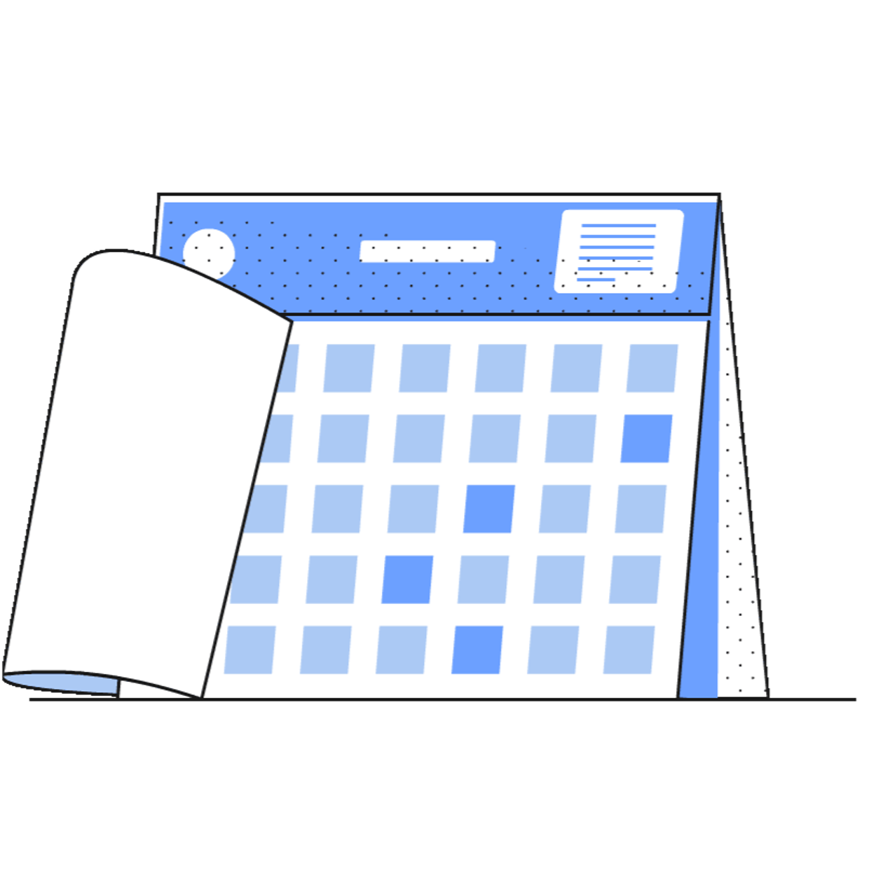
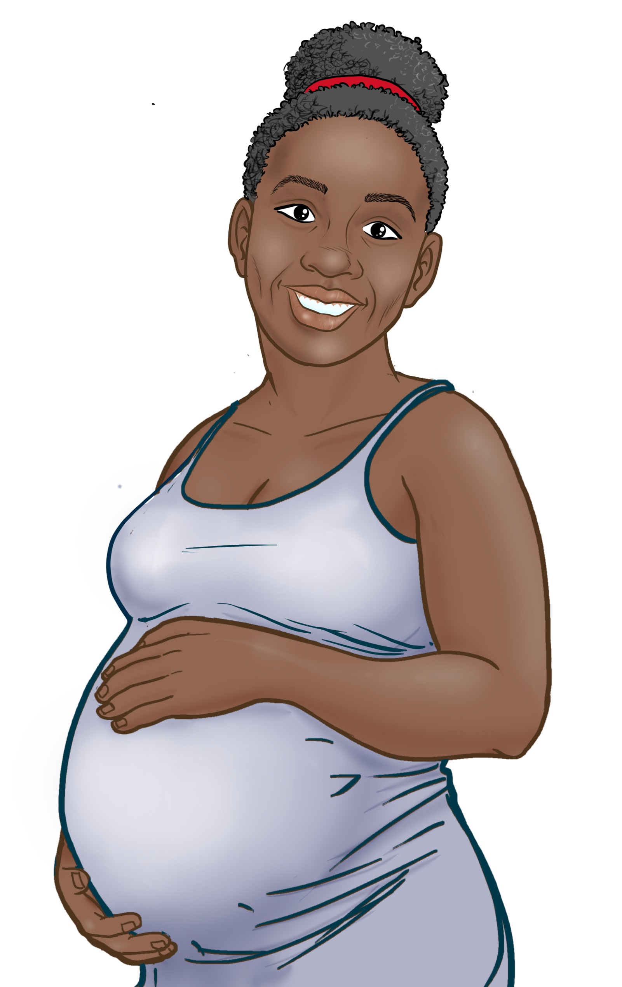
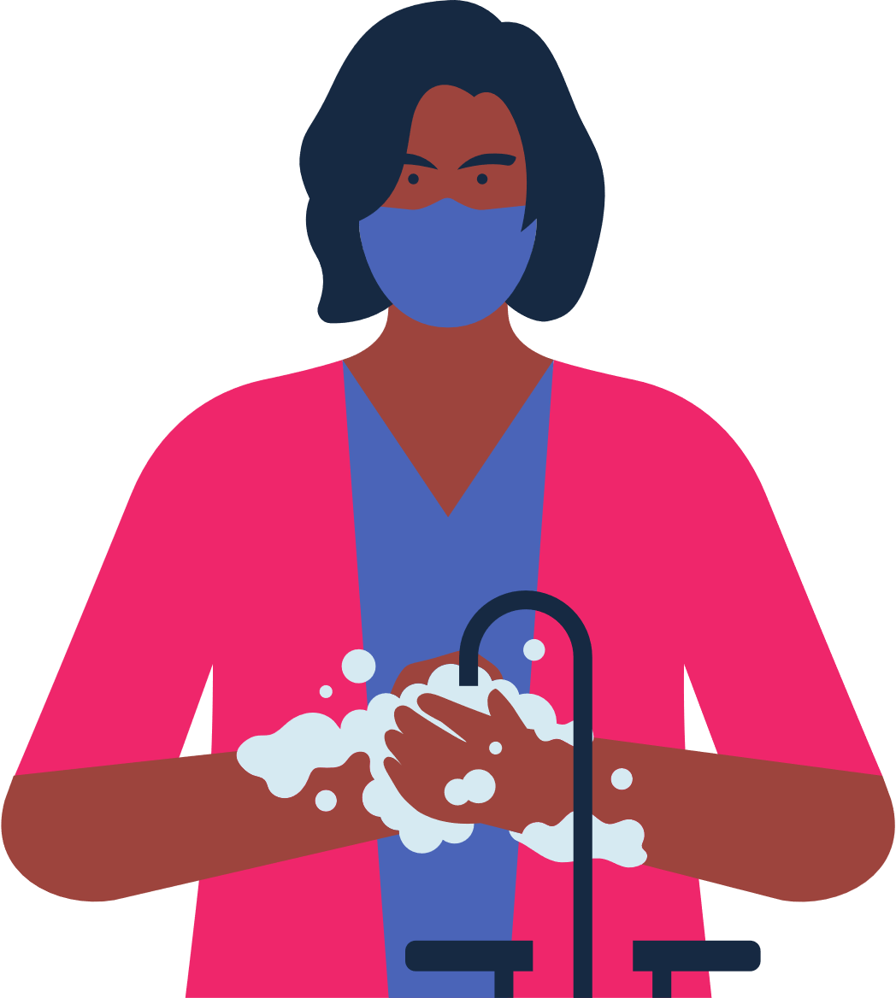
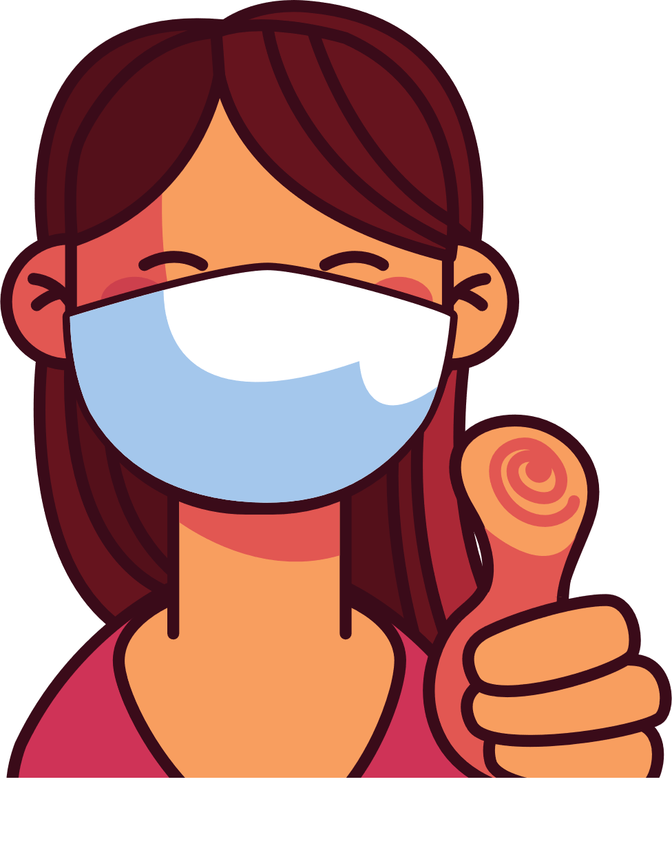
4
COVID-19 VACCINES ARE SAFE AND EFFECTIVE
WHAT TO KNOW WHEN GETTING THE COVID VACCINE
Save the file as a PDF
Once the content of the brochure has been finalized, you can save the file as a PDF for printing and distribution.
Export as a PDF using PPT:
Select slide. File → Save As Adobe PDF
Export as a PDF using Google Slides:
File → Download → PDF Document
Types of vaccines available in the US:
Pfizer
Moderna
Johnson & Johnson (J&J)
Novavax
Get your primary series doses. 2 months later, get one bivalent booster.
BENEFITS OF VACCINATION
It is important to get vaccinated, even if you have had COVID-19.
It does NOT require any form of identification.
Vaccination protects you, your family, your children, and your co-workers from becoming seriously ill and being hospitalized.
Vaccination decreases risks for moms and their babies.
Vaccination decreases the number of new, severe and deadly COVID-19 cases in your community.
Vaccination protects hospitals and healthcare providers from being overwhelmed with patients severely ill with COVID-19.
The more people vaccinated in our community, the less we need to worry about new variants.
Reduces the risk of stillbirth by 15%
Antibodies from vaccinated women can pass to their babies and possibly protect babies from COVID-19.
RECOMMENDATIONS
Get vaccinated. Get Boosted.
Get your family vaccinated and boosted.
Wear a mask when indoors even when you are up to date on your vaccines. Wear a mask in crowded outdoor settings.
If you are up to date on your vaccines and are exposed to COVID-19:
If you have symptoms: Test immediately. If you have a negative test, test again in 48 hours.
If you do not have symptoms: Test at least 5 days after exposure. If you have a negative test, test again after 48 hours, and then again after another 48 hours if your second results are negative. Get medical advice if you think you are ill.
There are various types of vaccines. All vaccines against COVID-19 are safe and effective.
After vaccination you may experience: arm pain, headache, fever, or chills.
You will feel better a few days after your injection.
You are considered fully vaccinated two weeks after your final dose.
RISKS FOR UNVACCINATED
For women who are pregnant, breastfeeding, or trying to get pregnant, vaccines are critical for keeping moms and their babies healthy.
Higher risk of COVID-19 infection.
Higher risk of serious infection, hospitalization, and death.
Higher risk of being exposed to new mutations that are more contagious and dangerous.
For women between 18-60 years old, we recommend getting Pfizer or Moderna.
Continue to wear a mask
in crowded spaces
and wash your hands.
You did your part to protect yourself and others from COVID-19!

