Slide 1

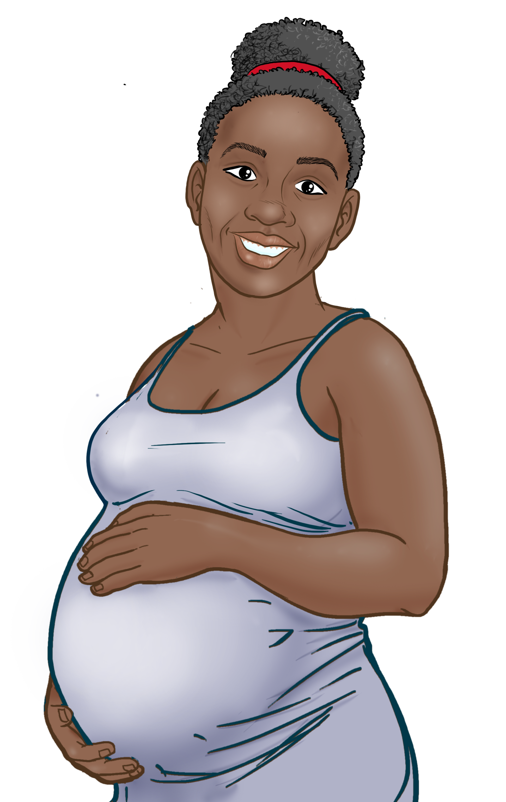






2
Include information on local vaccination efforts
Use the top portion back cover of the brochure to provide resources and links out to more information on vaccination in the area.
The text on this panel is completely editable and new text can be added by
right clicking on the border of a text box → selecting copy from the menu →
right click where you want the new text box → select Paste from the menu
1
Eske vaksen an san danje pou mwen ak bebe mwen? Kisa ki te chanje ofilditan?
KIJAN POUM GEN
VAKSEN COVID-19
Add an image and scale it
Go to Insert → Image → Upload from Computer and select an image of you that you’d like on the brochure cover.
To scale, grab bottom right corner of image and hold the clicker down. Drag your mouse or finger across diagonally until it’s the same size/slightly bigger than the slide.
Send your image back
Once you size your image and scale it proportionally to the size of the slide or slightly bigger, right click on the image and go to Order → Send to back
Crop your image
If the image is larger than the brochure cover, you can crop it by right clicking on the image and selecting the Crop tool that appears in the pop-up menu. You can then drag the black bars at the edges of the image to trim it to the right size. Click outside of the image to apply the changes.
Nan kòmansman pandemi an, nou pa te konnen efè vaksen an sou fanm ansent, sou fanm nouris ak sou ti bebe yo.
Kounye a, nou genyen anpil done, epi nou ka di avèk konfyans: Vaksen KOVID-19 la san danje pou ou menm ak ti bebe w la, anvan, pandan, ak apre gwosès ou a!
Depi septanm 2023, plizyè santèn mil fanm ansent te pran vaksen kont KOVID-19.
Pat genyen okenn rapò de risk ogmante
nan foskouch, pwoblèm de kwasans, oswa
defo nesans.
Vaksen KOVID-19 la pa yon vaksen ki fèt ak viris vivan, epi fanm ansent ak fanm nouris ansanm ak ti bebe yo pa kapab trape KOVID-19 nan vaksen an.
Li pa nesesè pou tire lèt tete w pou konsève l nan veso nan kèk èdtan apre w fin pran vaksen an lè w se yon fanm nouris.
Vaksen an gratis pou pifò moun, menm pou moun ki pa gen asirans.
Chèche konnen ki kote ou ka jwenn aksè gratis ak vaksen kont KOVID la gratis:
Pale avèk doktè OB/GYN ou.
Mande si pa genyen klinik mobil ak ekspozisyon sou sante
Depatman sante
Sant Sante Kominotè
Famasi bò lakay ou
Pale avèk patwon w lan sou fason ou kapab jwenn vaksen kont KOVID-19 la. Yo ka ede w nan aranjman w ap fè pou jwenn yon vaksen.
Jwenn vaksen: https://www.vaccines.gov/search/
Anefè, vrè risk la se lè yon fanm ansent chwazi poul PA vaksine.
Gwosès, bay tibebe tete ak Vaksen kont COVID-19
POU PLIS ENFÒMASYON
Fanm yo ki vin malad avèk COVID-19
pandan gwosès:
Gen anpil chans pou yo malad pi grav akòz COVID-19 parapò ak fanm ki pa ansent yo.
Gen anpil chans pou yo bezwen swen nan Inite Swen Entansif (Intensive Care Unit, ICU).
Gen anpil chans pou yo bezwen tib pou yo respire.
Gen gwo risk pou yo mouri.
Gen gwo risk pou yo akouche yon ti bebe ki enfekte ak COVID-19.
Vizite Sant Kontwòl Maladi yo ak Pwevansyon:
https://www.cdc.gov/coronavirus/2019-ncov/
Pou Repons ak Keksyon yo poze souvan, vizite Migrant Clinicians Network:
https://bit.ly/3ki1xAI
Pran yon Vaksen kont KOVID ki ajou
Mizajou: 19 septanm 2023
Kanpay Sansibilizasyon Vaksen COVID-19
3
Add information on your organization and other relevant resources
The bottom portion of the back cover allows you to include organizational links, phone numbers, and other information useful to your community.
Be sure to include a date on the brochure as information changes quickly.

Slide 2

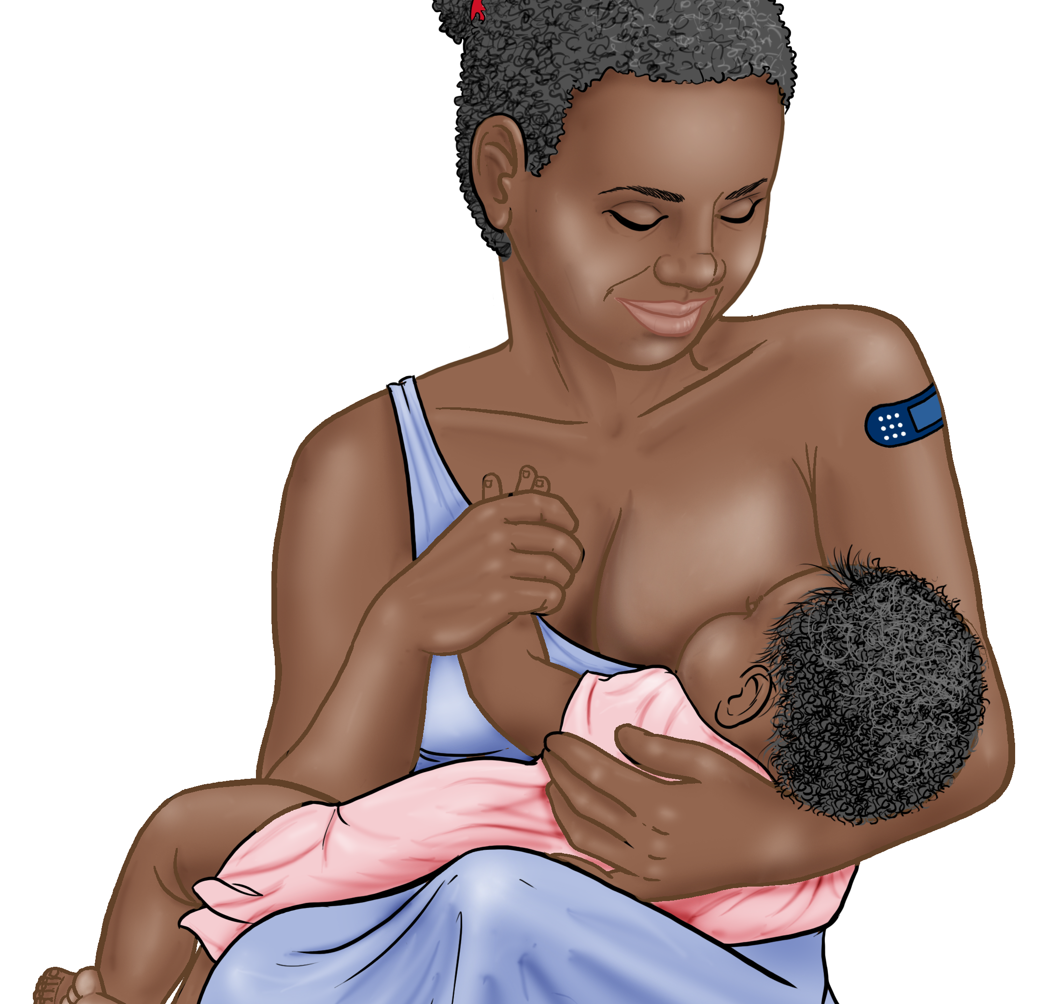



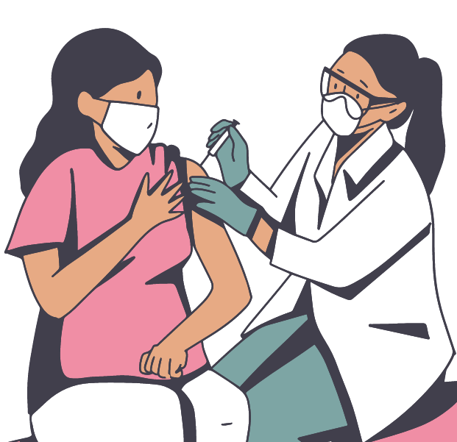
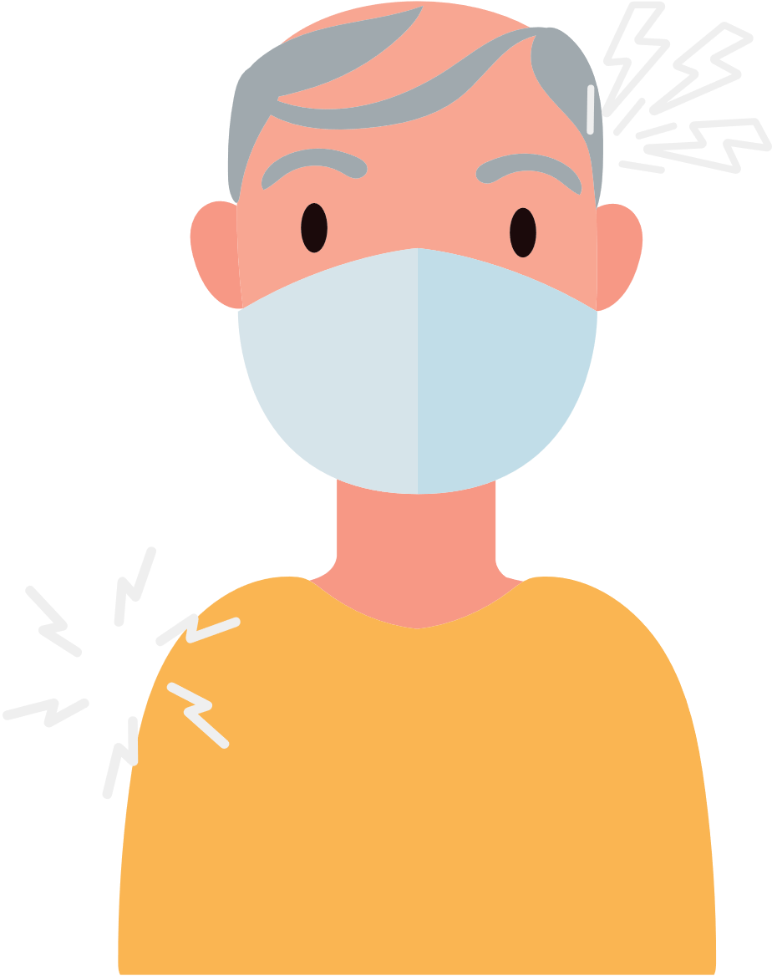



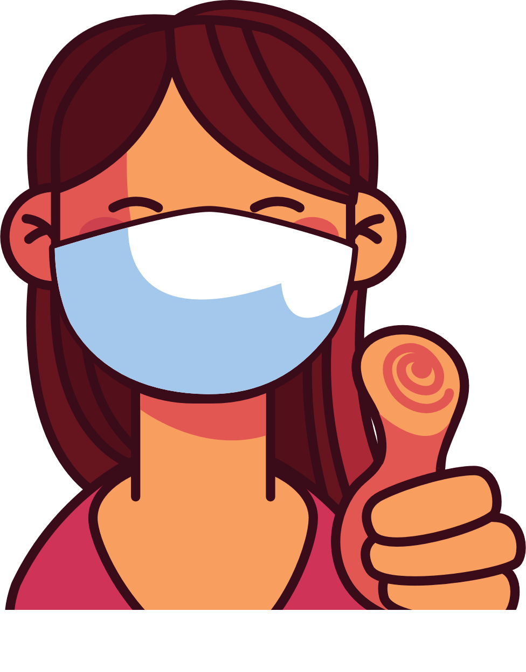
4
Address Concerns in the Community
This panel is intended to provide information addressing the concerns specific to the community receiving
the brochure.
The text boxes with the questions and answers can be edited, copied or deleted so you can customize this panel to fit your needs.
Here you can include links to relevant resources or more information addressing the community’s concerns.
VAKSEN COVID-19 YO YO SAN DANJE E EFIKAS
KISA POU KONNEN LÈ W AP PRAN VAKSEN COVID
Tout moun ki gen sis mwa oswa plis ta dwe pran yon vaksen kont COVID-19 ki ajou!
Moun ki te pran vaksen anvan oswa ki poko janm pran vaksen ap pran sèlman yon vaksen.
Gen kèk moun ki pran plis pase yon vaksen: timoun ki gen sis mwa rive 5 an, ki gen sistèm iminitè ki fèb, epi moun ki gen 65 an oswa plis ta dwe pale ak doktè yo.
AVANTAJ VAKSINASYON AN
Li enpòtan pou'w pran vaksen an menm lè’w
te deja trape COVID-19.
Genyen divès kalite vaksen. Tout vaksen ki kont COVID-19 la yo san danje e yo efikas.
Vaksinasyon an ap pwoteje'w, fanmi’w, pitit ou, ak kolèg nan travay ou pou yo vin malad grav e pou yo pa etène lopital.
Vaksinasyon an ap diminye risk pou manman yo ansanm ak bebe yo.
Vaksinasyon an ap diominye risk de nonb nouvo de ka grav ak ka lanmò de COVID-19 nan kominote ya.
Vaksinasyon an ap pwoteje lopital yo ak founisè swen yo pou yo pa sichaje avèk pasyan ki malad grav ak COVID-19.
Plis gen moun ki pran vaksen an nankominote ya, mwens nap bezwenenkyete konsènan nouvo varyan yo.
Diminye risk foskouch yo
Tibebe a kapab pran antikò ki soti nan fanm nouris ki pran vaksen an epi gen posiblite pou yo pwoteje tibebe a kont COVID-19.
REKÒMANDASYON YO
Pran dènye dòz vaksen ou an.
Fè fanmi ou pran dènye dòz vaksen yo.
Mete yon mas nan espas anndan oswa deyò ki gen anpil moun, menm si ou deja pran dènye dòz vaksen yo.
Si w te ekspoze ak KOVID-19, swiv etap sa yo, menm si w pran vaksen:
  Pote yon mas pandan 10 jou.
  Si w vin malad: Fè tès la touswit. Si tès la negatif, refè tès la ankò nan 48 èdtan.
  Si w pa vin malad: Fè tès la, pou pi piti, 5 jou apre w fin ekspoze. Si tès ou a negatif, refè tès la ankò apre 48 èdtan, epi fè sa ankò apre yon lòt 48 èdtan si dezyèm rezilta w la negatif. Si tès pozitif, antre nan izolman!
  Si tès ou a pozitif, gade gid Sant pou Kontwòl Maladi a (Centers for Disease Control, CDC) pou konnen kijan pou antre nan izolman.
Tcheke pou wè si yo ofri vaksen yo gratis nan eta kote ou ye a oswa nan depatman sante lokal la oswa nan famasi lokal ou a.
Apwè vaksinasyon an, ou kapabsoufri avèk:ponyèt fèmal, tèt fèmal, lavyèv, oswa frison.
5
Save the file as a PDF
Once the content of the brochure has been finalized, you can save the file as a PDF for printing and distribution.
Export as a PDF using PPT:
Select slide. File → Save As Adobe PDF
Export as a PDF using Google Slides:
File → Download → PDF Document
Ou pral santi'w pi byen kèk jou apwè vaksen an.
Yo konsidere ou ajou depi w resevwa dòz ou bezwen an (yo).
RISK AK MOUN SAN VAKSEN
Risk ki piwo nan enfeksyon COVID-19.
Risk ki piwo nan enfeksyon grav, nan etène lopital ak lanmò.
Risk ki piwo pou ekspoze a nouvo mytasyon ki kontajye ak danjere.
Pou fi ki gen tout laj ki ansent, k ap bay tete, oswa k ap eseye ansent, vaksen yo enpòtan anpil pou kenbe manman yo ak tibebe yo an sante..
Kontinye mete mask nan espas kote ki chaje moun epi lave men ou.
Ou te fè pati pa'w la pou te pwoteje tèt ou ak lòt moun de COVID-19 la!

