Slide 1
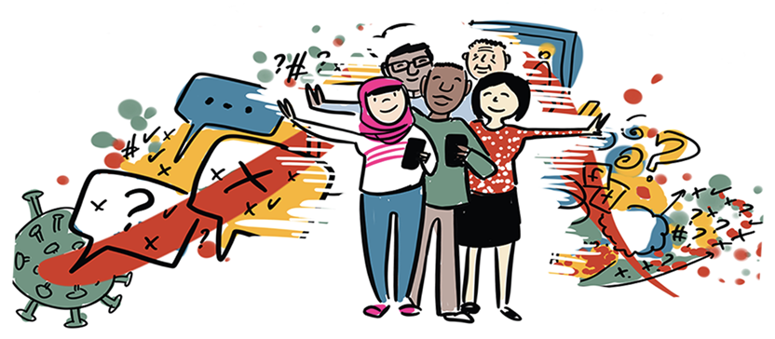

Image credit:
WHO/Sam Bradd
Misinformation and Disinformation
Protecting yourself and others during an ‘infodemic’

Slide 2
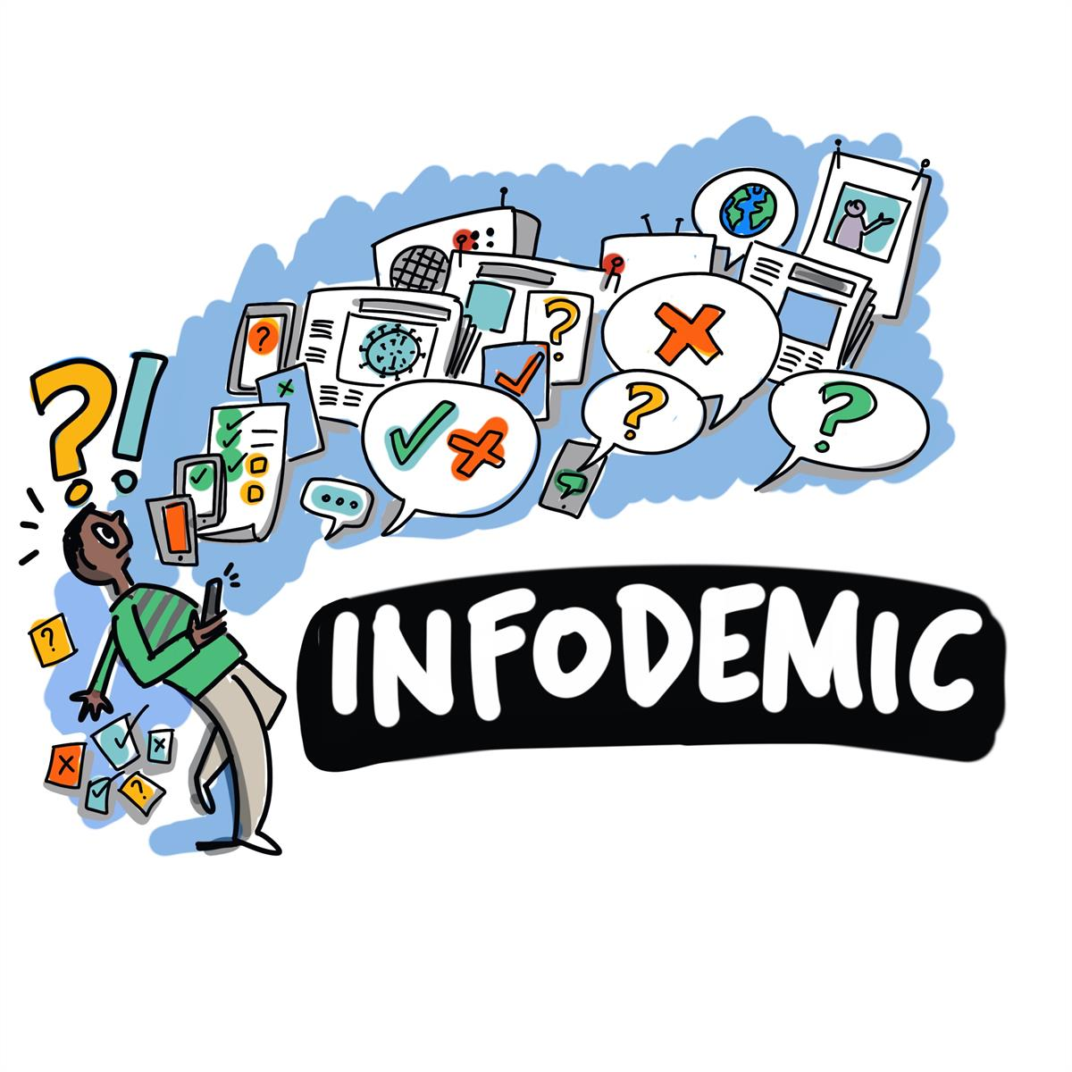
What makes us
more susceptible
to believing myths or
misinformation?
Image credit: WHO/Sam Bradd
Notes:
What makes us more susceptible to myths and misinformation?
How can we combat it?
Use PAHO and CDC website and tools
Use this https://www.paho.org/es/documentos/entender-infodemia-desinformacion-lucha-contra-covid-19

Slide 3
Image credit: WHO/Sam Bradd
Sharing Content with others...
Makes us more susceptible to misinformation and disinformation
People must monitor their impulse to share until having
fact-checked information
Notes:
We need to ask ourselves what is more important to us, automatically sharing content or sharing accurate information?
What can we do about incorrect information being shared?
How can we resolve this situation?
Use PAHO and CDC website and tools
Use this https://www.paho.org/es/documentos/entender-infodemia-desinformacion-lucha-contra-covid-19

Slide 4
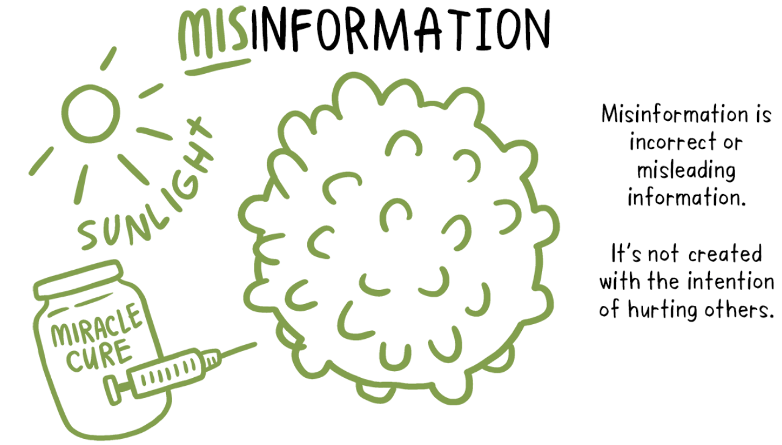
Notes:
First, we have to distinguish misinformation from disinformation. Misinformation is incorrect, misleading information, but it is not intended to do harm. A person shares it without even thinking, often unintentionally, because everyone is talking about it.
Use PAHO and CDC website and tools

Slide 5
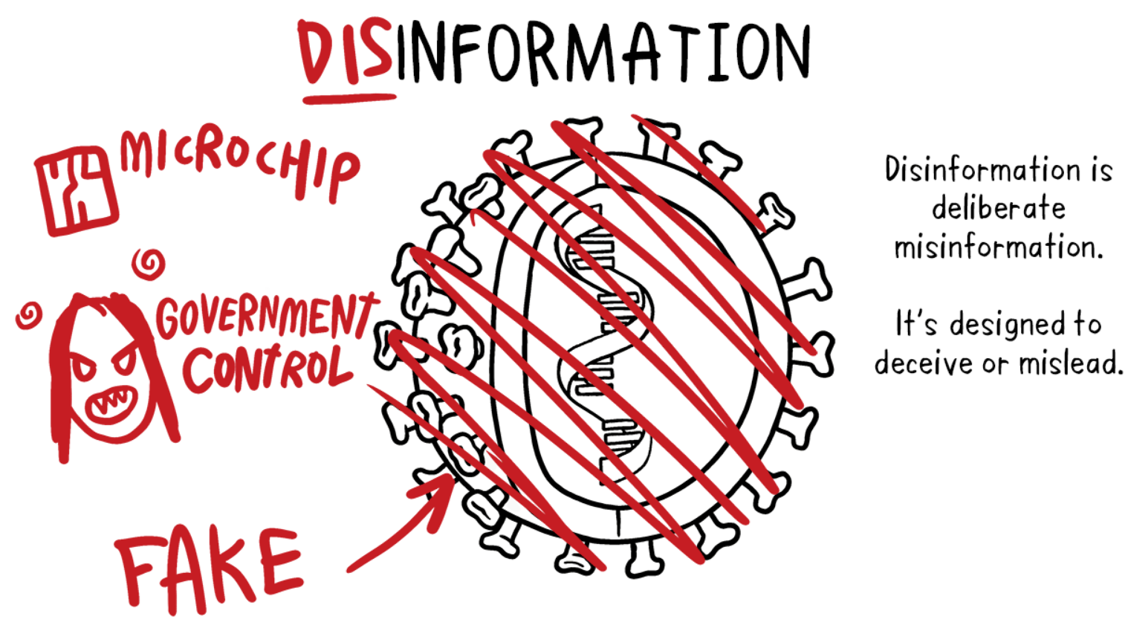
Disinformation
It is false or incorrect information with the deliberate purpose of deceiving.
Notes:
Disinformation aims to deceive, to create a doubt, a vision, an alternate reality and, unfortunately, it often succeeds in creating that doubt.
Use PAHO and CDC website and tools

Slide 6
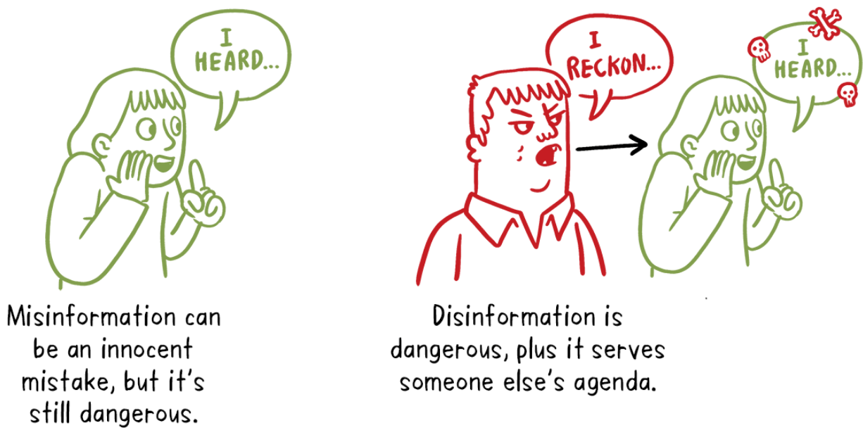
Notes:
Use PAHO and CDC website and tools

Slide 7
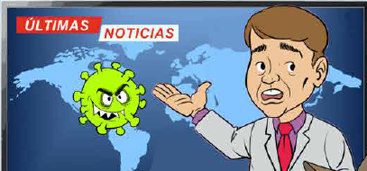
We tend to be more susceptible by:
Perception that the source is credible - If it is sent to me by my friend or family it is true
Illusory truth effect- If everyone says it, then it's true (influencer, social media) Ahem: the false claim that "COVID-19 is no worse than the flu" has been repeated many times in the media.
We learn by repetition. Level of repetition of things- The more things are repeated, the easier it is to process, remember and accept them as truth. Remember the multiplication tables
Characteristics of people:
  Age- older more susceptible
  Educational level
  Political affiliation
  Economic status
  Level of information on the topic
La información erronea como un virus
SIR Model - Susceptibility-Infection-Recovery. Van Der Linden, Sander, 2022
Notes:
We tend to believe things because the information is sent to us by our friend, our family member, someone we believe in. It doesn't matter if it was sent to us by mistake or if it's true or not, we tend to believe it; that's the first thing.
The second thing is that on many occasions we have this effect of believing that it is true, because if everyone is saying it and it is everywhere, it must be true. For example: When people say Covid-19 is not worse than the flu...
Third, we learn by repetition...by repeating and repeating, we recognize it as a reality, a truth for us.
But there are also other characteristics. We are talking about what characterizes us like:
Age: the older someone is, the more susceptible they can be.
Educational level: because it has to do with the tools people have to think.
Political affiliation: This is common now because people consider what their political party’s opinion is on a piece of information when determining whether they will assume information is true or not.
A person’s economic status and the level of information that is available to them on a topic are also very important.
Van Der Linden, Sander . Misinformation: susceptibility, spread, and interventions to immunize the public. Nature Medicine 2022. Vol. 28 DO - 10.1038/s41591-022-01713-6

Slide 8

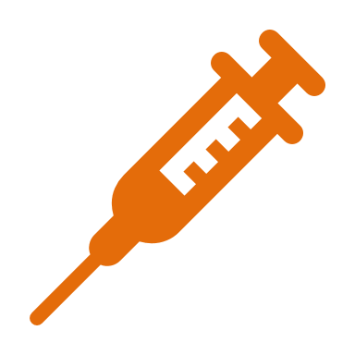
Information as a Virus
Infection:
Accepting the information
as true
Immunization/inoculation:
Prior information to generate strong antibodies to misinformation
HOW TO PROTECT YOURSELF
Correction or verification
of facts
Preparing for disinformation
Building psychological resistance
Critical Thinking
Notes:
What if information was like a virus?
I bring you this model where information is presented as if it were a virus. Whether the information is misinformation or disinformation, being infected means receiving the information as true. In this model you see that we have to vaccinate ourselves, immunize ourselves, so that when inadequate information reaches us, we can respond with everything we have learned, and our knowledge can protect us. We can protect ourselves from false information by applying this model.
The problem here is that once we get infected by believing false information, it is more difficult to be able to cure ourselves, that is, to resolve or correct the disease; we need to build what we call psychological resistance.
Stephan Lewandowsky & Sander van der Linden (2021): Countering Misinformation and Fake News Through Inoculation and Prebunking, European Review of Social Psychology, DOI: 10.1080/10463283.2021.1876983
To link to this article: https://doi.org/10.1080/10463283.2021.1876983

Slide 9
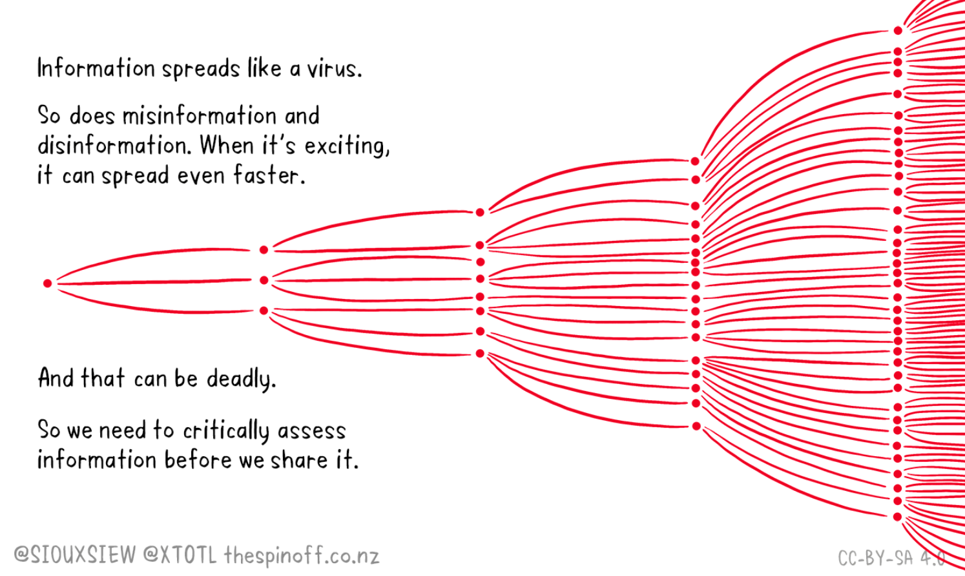
Notes:
In this example, we can see how misinformation can spread. If one person misinforms three people, and these three people misinform three other people, etc., we end up flooded with information that is not true.

Slide 10
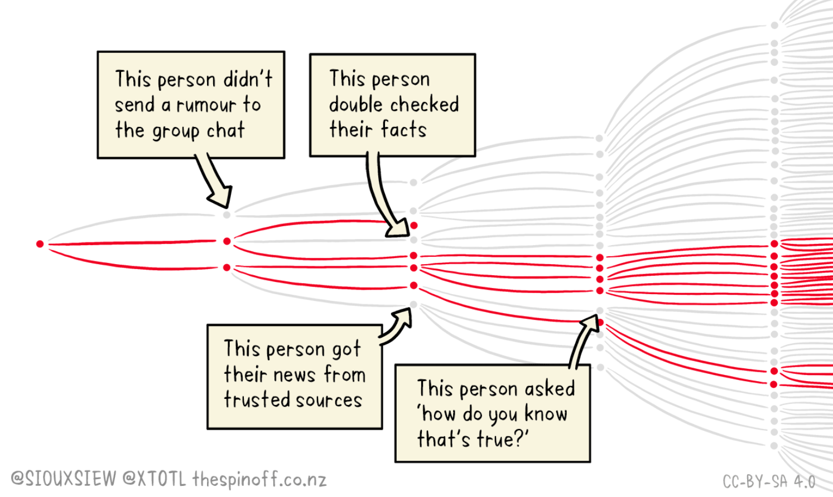
Notes:
As this model shows, what needs to be addressed is helping people to stop sharing incorrect information. If a person does not share false information, the reproduction of the information, the ‘virus’, is lower, and less people get infected. It is exactly what happens with immunizations, a person gets vaccinated and will not reproduce or mutate the virus, he/she will not become infected, and will not spread the infection to others. It is the same process.

Slide 11
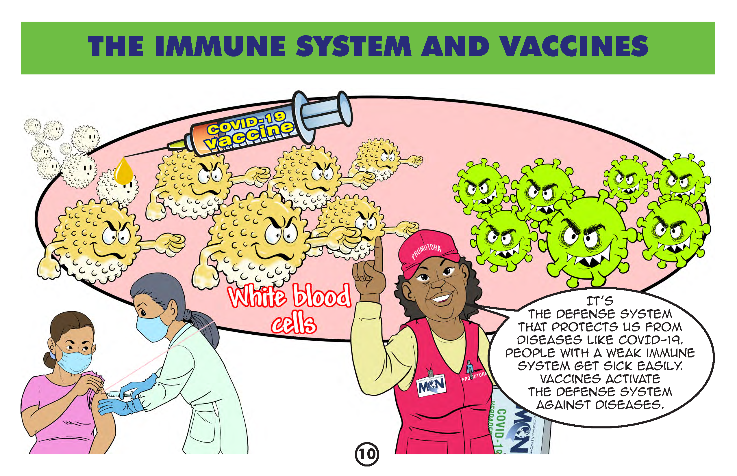
An effective
clarification message
Give facts and data
Simple and sticky using reliable sources
Alert or warn about the myth
(only once)
Exposing the technique of manipulation Explain how and why the myth is out of context (conspiracy theory)
Finish by repeating the facts and/or data
and emphasizing the correct information
or explanation
Van Der Linden, Sander, 2022
Notes:
What good does it do to understand this model?
It helps us because we can see how people pass along misinformation. This model uses simple and catchy facts and data supported by reliable sources.
Unfortunately, sometimes we share information in a way that no one understands, that's where we come in to translate to make information easier to understand.
Secondly, we need to alert or warn others about the myth. We need to tell them how virus propagation works ... to expose the manipulation technique that is used so that people have that critical thinking and say "maybe that is not true, I better check the source, I am going to use this tool to see if that is true or not.
And finally, we must end by repeating the facts, that is, repeating what is true, clearly emphasizing the correct information and the source.
Van Der Linden, Sander . Misinformation: susceptibility, spread, and interventions to immunize the public. Nature Medicine 2022. Vol. 28 DO - 10.1038/s41591-022-01713-6

Slide 12
ASK
RECOGNIZE
AFFIRM
ASK FOR PERMISSION
RESPOND
ASK – What are your concerns? What the person thinks about the topic? Learn about what makes the person hesitant. Ask open-ended questions that get to the heart of the matter.
RECOGNIZE – Validate that the person has received information. Validate when the person has correct information AND that they are the ones that make the decision.
AFFIRM – State that you have also heard about it and have sought information about it.
ASK FOR PERMISSION– Ask if they want to receive the information. May I share with you (talk with you) some of the data I have reviewed?
RESPOND – Give the information and ask if they want more resources or sources where they can find additional information.
AVOID JUDGING
DO NOT SKIP STEPS
PRACTICE!
USUALLY IN A NORMAL CONVERSATION WE DON'T ASK FOR PERMISSION
IF THE PERSON SAYS NO,
YOU STILL SUCCEEDED
YOU DID NOT WASTE YOUR TIME (EVEN IF YOU HAD GIVEN HIM/HER INFO THEY WOULD NOT HAVE ACCEPTED IT).
YOU RESPECTED THEM
PROBABLY LEFT THEM THINKING
Notes:
First, ASK: when we encounter reluctant people, ask them what they think. Let's try not to antagonize with them, ask them what is bothering them, what is happening to them, learn from what they are sharing with you; next,
RECOGNIZE what the person is thinking and feeling, let them know that you understand what they are thinking and that you have also heard about it and have information about it, and finally,
We respond to them.
As a first step in our response we AFFIRM that we have also heard the same information.
Then we ASK PERMISSION. Sometimes when we share information without asking permission, we are rejected. Asking permission is very important. If the person doesn't give you permission, don't worry, either way, you are winning because you didn't waste your time explaining, but you are telling them that you have an alternate version.
If they give their permission then you can RESPOND with the information and resources you have to share.
The important thing is to avoid judging. We must listen so we can fight this misinformation virus, know how it works, and know how we can respond. Let's practice so we don't get rejected.

Slide 13
¿Qué necesitan los trabajadores para protegerse?
Knowing about health
What do people need to make informed decisions?
What do people need to protect themselves from disinformation?
Knowledge Training
Personal protective equipment
Knowledge of rights
Community resources
Our Role
How persuasion works
Use your
decision-making
power and
freedom
Trusted resources
Trust
Notes:
This model has been shown in many occupational health presentations. We assume people have resources to make decisions, have the knowledge they need, know how to protect themselves, know their rights, and know where to go to benefit from resources in the community.
When dealing with misinformation and disinformation in communities, we may make the same assumption. However, to be immune to false information people must know about their health, know how persuasion works, and understand that they have freedom and decision-making power. This is the most valuable thing for a human being. We can empower people and give them factual and reliable resources that they can understand to help them make educated decisions.

Slide 14
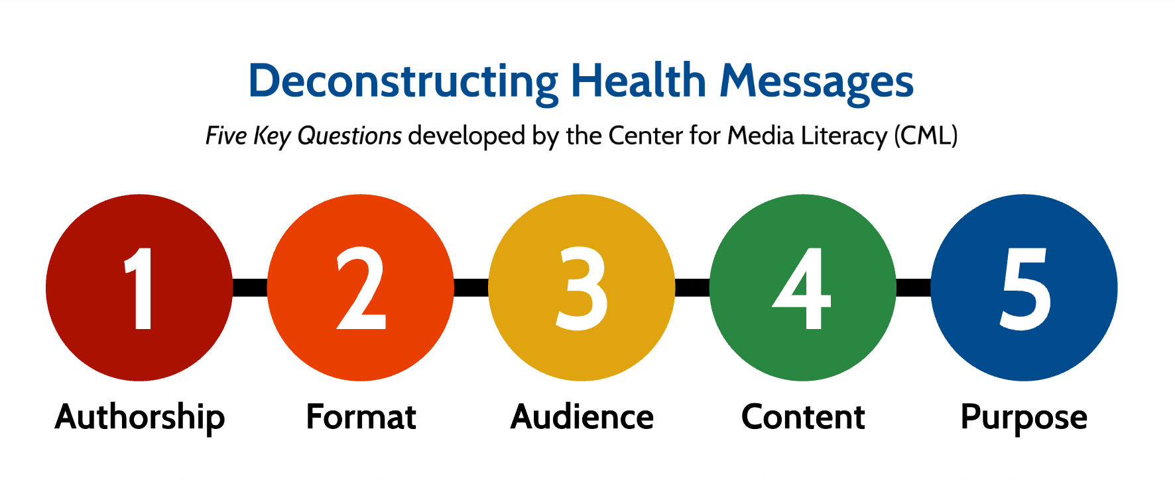

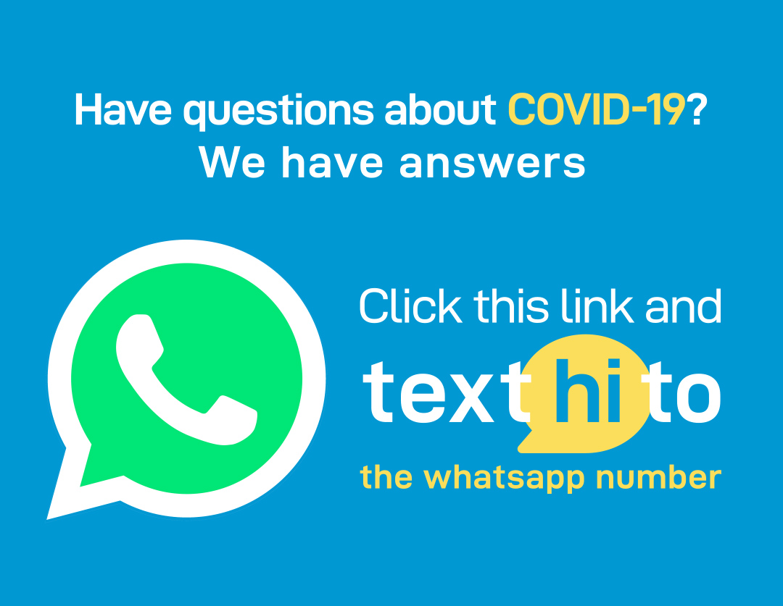
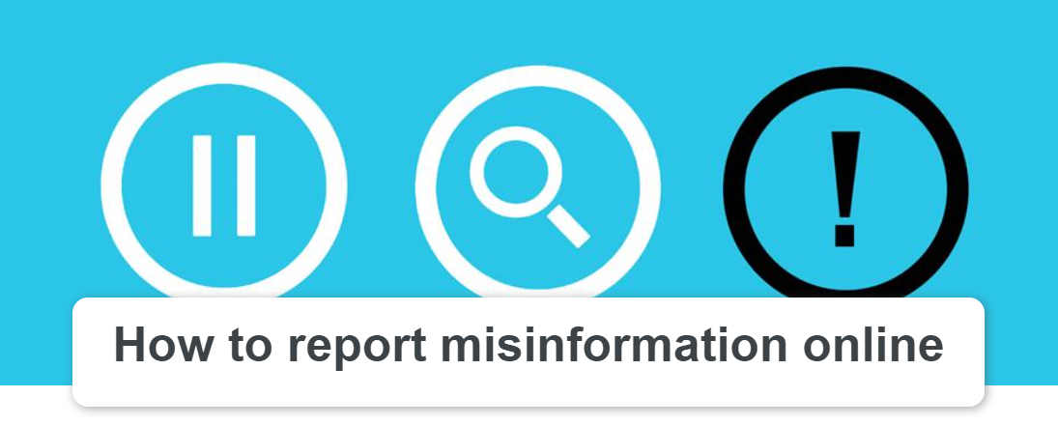



 | Deconstructing Health Messages This resource supports the analysis of health information using the Center for Media Literacy’s Five Key Questions and links to related resources. It’s available as a PDF or Prezi presentation.
 | WHO COVID-19 Mythbusters This page on the World Health Organization website is constantly updated with debunking materials to counter the latest misinformation regarding COVID-19.
 | WHO Health Alert on WhatsApp WHO has launched a special messaging service in Spanish and other languages, in collaboration with WhatsApp and Facebook, to help people protect themselves from the coronavirus.
 | How to Report Misinformation Online The WHO has compiled the steps necessary to report misinformation on the most popular online platforms in order to encourage individuals to report false or misleading content online.
 | Equal Access Language Services This service specializes in interpretation, training, translation and consultation for organizations that need to communicate in various languages.
 | Resources in Indigenous Languages CIELO has translated COVID-19 related resources into indigenous languages from across Latin America.
 | Videos from The Refugee Response Refugee Response has short videos in many languages on topics including mental health and recognizing misinformation during a pandemic.
Health Misinformation and Social Media
Resources
from the Panel Discussion

